Slide 1
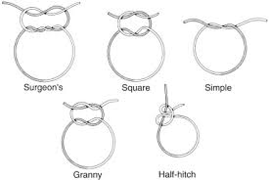
SUTURE MATERIAL AND SUTURING TECHNIQUES -II
Dr. Archana Kumari
Asstt. Professor cum Junior Scientist
Veterinary Surgery and Radiology
BVC, BASU, Patna

Slide 2
DEFINITION
Goals of suturing
Suture characteristics
Armamentarium of suturing
Suture materials
Principles of suturing
Suturing techniques
Surgical knot
Removal of suture

Slide 3
DEFINITION
What is suture?
Suture is a stich or series of stiches made to secure apposition of the edges of a surgical or traumatic wound.
What is suture materials?
Suture materials is an artificial fibers used to keep wound together until they hold themselves by natural.s

Slide 4
GOALS OF SUTURING
Wound edge apposition.
Provide adequate tension.
Maintain hemostasis.
Aid in wound healing.
Avoid wound infection.
Produce aesthetically pleasing scar by approximating skin edges.

Slide 5
Objectives
1. To facilitate healing.
2. Hemostatic.
3. To retain drainage tube and implants.
4. To reduce the size of natural opening.

Slide 6
Qualities of An Ideal Suture Material
1. It should be non-antigenic, nontoxic and non- carcinogenic.
2. It should have mono-filamentous texture.
3. It should have no capillary property.
4. It should have adequate tensile strength in-vitro and in-vivo.
5. It should have good handling property.
6. It should have good knot security.
7. It should be compatible with all kinds of antiseptic disinfectants.
8. It should be easily sterilizable.
9. It should remain intact until union occurs.
10. It should have minimum tissue reaction.
11. It should be cheap and easily available.

Slide 7
CHARATERISTICS OF SUTURE
Physical structure:
Monofilament-
This suture material is smooth & tends to slide through tissues easily.
Difficult to knot
Can be damaged by gripping it with needle holder or forceps.That can lead to fracture of the suture materials.

Slide 8
Multifilaments-
Easy to knot.
Have a greater surface area than monofilaments.
Have a capillary actions where bacteria may lodge & be responsible for persistent infections.
This material can be coated with silicone in order to make it smooth.

Slide 9
SUTURE CHARACTERISTICS
Tensile Strength:
It can be expressed as the force required to
break it when pulling the two ends apart.It
depends upon –
Constituent of suture materials.
Thickness of suture materials.
How it is handled in the tissues.

Slide 10
SUTURE CHARACTERISTICS
Absorbability:
Suture materials may be absorbable or non-absorbable.
This property must be taken into consideration when choosing suture materials for specific wound closures.
Oral mucosa & Deep sturcture need to be absorbable suture materials but vascular anastomoses need non-absorbable suture materials.
Biological Behaviour:It depends upon the constituent of raw materials.

Slide 11
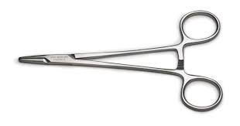
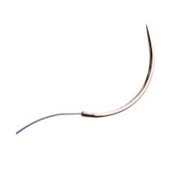
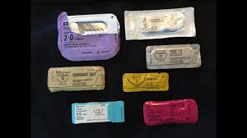
Armamentarium of suturing
Needle holder
A suture needle
Suture material

Slide 12
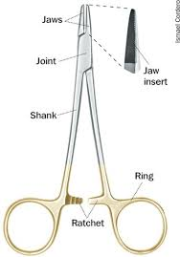
Needle holder
Parts:
Working tip/jaws
Hinge joint
Shank/body
Catchmechanism/ratchet
Grip area

Slide 13
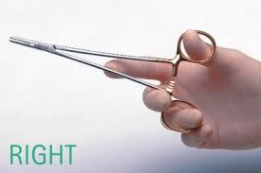
Needle holder
How to hold?
The needle holder is held with thumb & ring finger through the rings & with the index finger along the length of needle holder to provide stability & control.

