Slide 1
GMP and HACCP
GMP- Good Manufacturing Practices
HACCP- Hazard Analysis Critical Control Point
GMP are the practices required in order to conform to the guidelines recommended by agencies that control authorization and licensing for manufacture
and sale of food, milk and milk products. These guidelines provide minimum requirements
that a food product manufacturer must meet to assure that the products are of high quality
and do not pose any risk to the consumer or public.

Slide 2
This good manufacturing practices that should be followed by dairy plant owners, operators and employees to maximally assure the production of safe and sanitary products at all times.
The guideline offers suggestions for measures and precautions that should be taken regarding employee health, food handling practices, appearance, personal hygiene, plant procedures, plant and equipment design, maintenance, and sanitation.

Slide 3
HACCP
Hazard Analysis and Critical Control Point (HACCP) System -In order to enhance food safety, every stage of the food production (from purchasing, receiving, transportation, storage, preparation, handling, cooking to serving) should be carried out and monitored scrupulously.
The HACCP system is a scientific and systematic approach to identify, assess and control of hazards in the food production process.
.

Slide 4
With the HACCP system, food safety control is integrated into the design of the process rather than relied on end-product testing.
Therefore HACCP system provides a preventive and thus cost-effective approach in food safety

Slide 5
The seven principles of a HACCP System are-
1.Analyze hazards
2.Determine critical control points
3.Establish limits for critical control points
4.Establish monitoring procedures for critical control points
5.Establish corrective actions
6.Establish verification procedures
7.Establish a record system

Slide 6
Organic milk products
Organic milk refers to a number of milk products from livestock raised according to organic farming methods. In most jurisdictions, use of the term "organic" or equivalents like "bio" or "eco", on any product is regulated by food authorities. In general these regulations stipulate that livestock must be: allowed to graze, be fed an organically certified fodder or compound feed, not be treated with most drugs (includinggrowth hormone), and in general must be treated humanely.

Slide 7
Food safety standards for milk and milk products
Food Safety and Standards Authority of India (FSSAI) is an autonomous body established under the Ministry of Health & Family Welfare, Government of India.
The FSSAI has been established under the Food Safety and Standards Act, 2006 which is a consolidating statute related to food safety and regulation in India.
FSSAI is responsible for protecting and promoting public health through the regulation and supervision of food safety.

Slide 8
The FSSAI has its headquarters at New Delhi.
The authority also has 6 regional offices located
in Delhi, Guwahati, Mumbai, Kolkata, Cochin, and Chennai.
14 referral laboratories notified by FSSAI, 72 State/UT laboratories located throughout India.

Slide 9
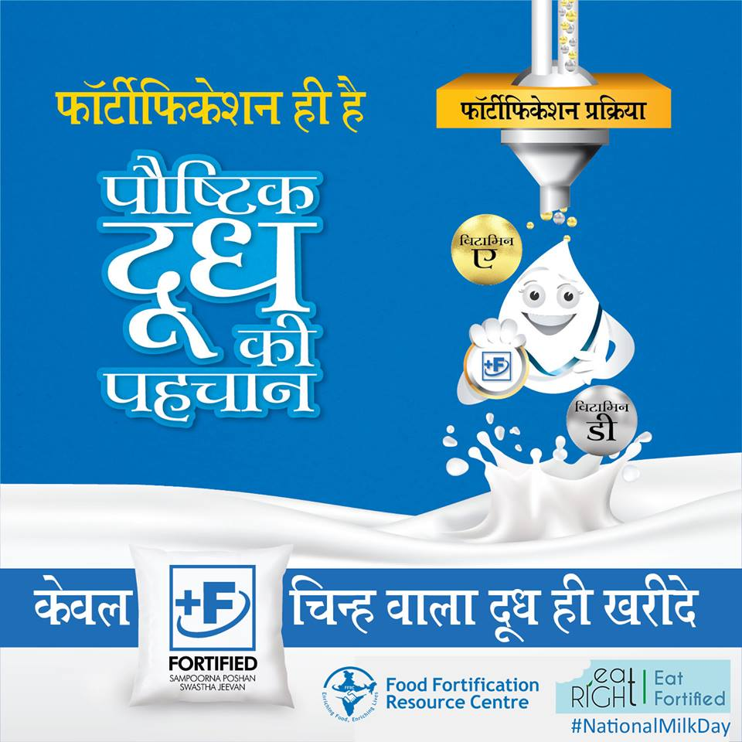
Fortified milk available at no additional cost! Buy Milk packs marked with "+F" Logo to get all the goodness of milk enriched with Vitamin A & D.

Slide 10
Cleaning and sanitation in milk plant
The degree of cleanliness:
Physical cleanliness – removal of all visible dirt from the surface
Chemical cleanliness – removal not only of all visible dirt but also of microscopic residues that can be detected by taste or smell but are not visible to the naked eye
Bacteriological cleanliness – attained by disinfection
Sterile cleanliness – destruction of all microorganisms

Slide 11
In dairy cleaning operations, the objective is nearly always to achieve both chemical and bacteriological cleanliness.
The equipment surfaces are therefore first thoroughly cleaned with chemical detergents and then disinfected.
A film of milk adheres to the walls of pipelines, pumps, tanks, etc. ('cold' surfaces). When a system is emptied, cleaning should start as soon as possible, or otherwise this film will dry out and be harder to remove.

Slide 12
CIP ( Clean In Place) has been opted in milk industry for good cleaning and sanitation.
The cleaning cycle in dairy comprises following steps-
Recovery of product residue by scrapping, drainage with water or compressed air.
Pre- rinsing with water (< 55C) to remove dirt.
Cleaning with alkaline detergent.
Rinsing with clean water.
Cleaning with acidic detergent.
Rinsing with clean water

Slide 13
Dairy effluent management

