Slide 1
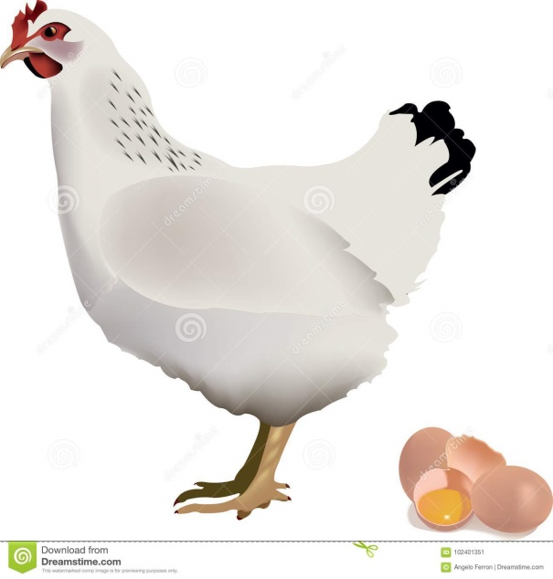
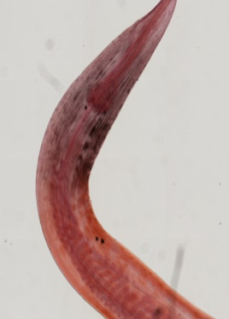
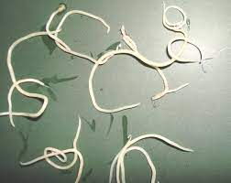
Ascaridia galli
(Poultry
Ascarid worm)
Dr. AJIT KUMAR
Department of Veterinary Parasitology
Bihar Veterinary College
Bihar Animal Sciences University
Patna-800014

Slide 2
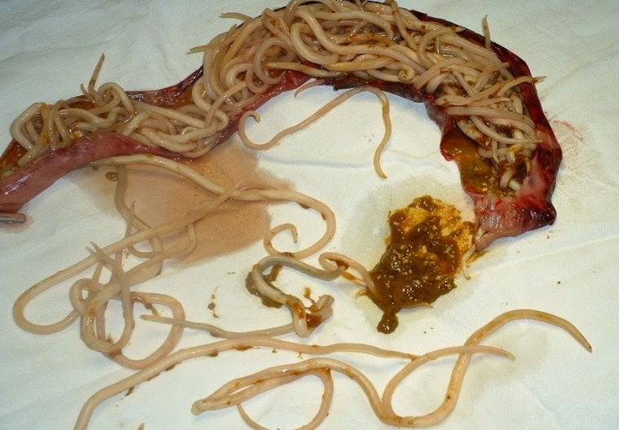
Ascaridia galli
Final Hosts : Domestic & wild birds
Location: Small Intestine
Largest nematode of poultry

Slide 3
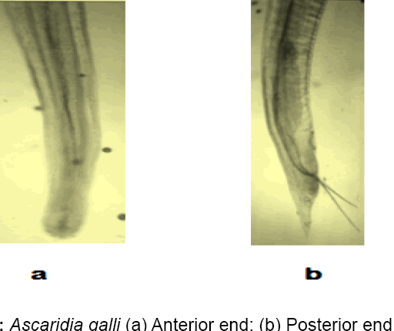
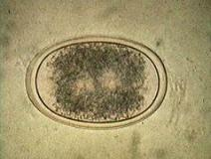
Ascaridia galli
General Characters:
Males are 50-76 mm whereas Females are 72-116 mm long
Worms are stout, densely white and oesophagus has no posterior bulb.
Male worm has 10 pairs anal papillae.
Egg is oval with smooth shells

Slide 4
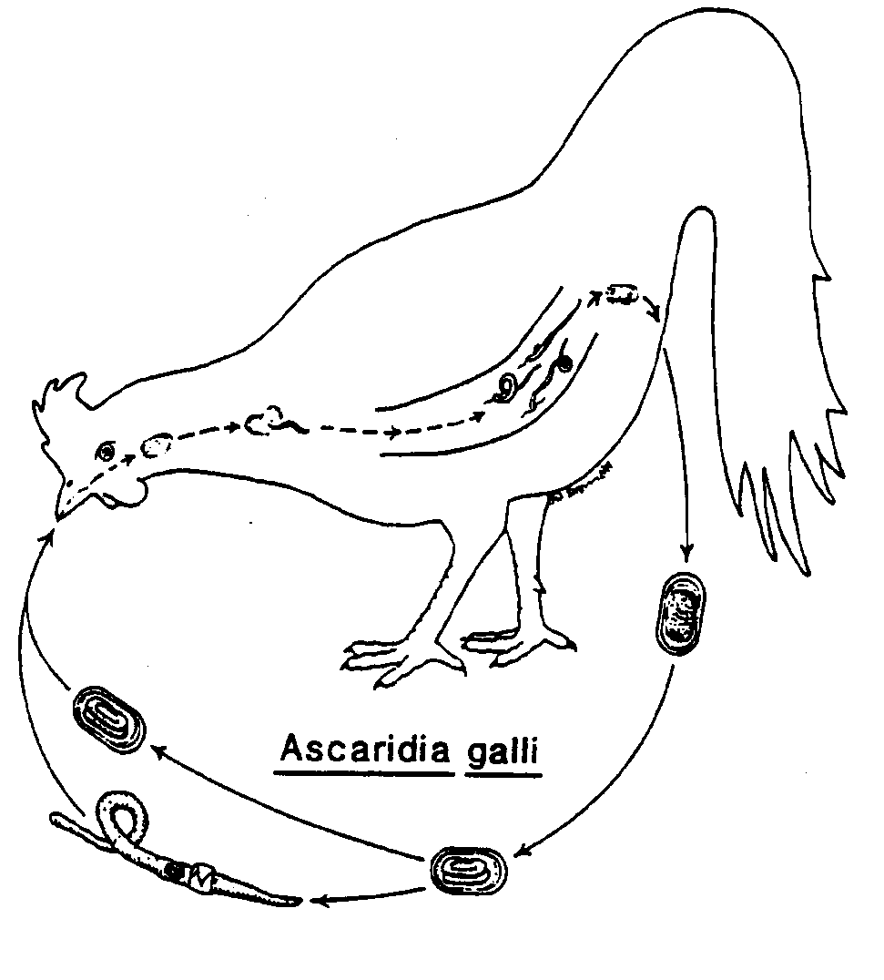
Ascaridia galli
Life-cycle:
Direct life-cycle
Infective stage: egg containing 2nd stage larvae.
Transport host: Earthworm
Transmission:
Transmission through
Ingestion of infective egg containing L₂ with food or water
Eggs are sometimes ingested by earthworms, which may act as transport host. So, ingestion of earthworm containing L₂ larva

Slide 5
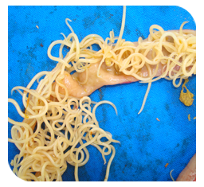
Ascaridia galli
Pathogenesis:
Young birds under twelve weeks of age are more susceptible to infection than adult birds.
Highly pathogenic in chickens of 1-3 months of age and chickens over three months of age are more resistant to infection.
Dietary deficiency such as those of Vitamin A, B and B12, various minerals and proteins, predispose to heavier infections.
Larvae cause catarrhal or haemorrhgaic enteric whereas the adult worms may cause intestinal occlusion and death.
Occlusion of Intestine

Slide 6
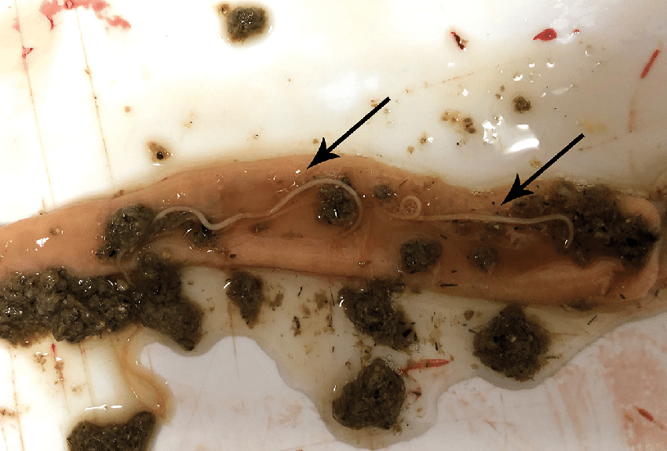
Ascaridia galli
Clinical signs:
Worms cause haemorrhagic enteritis, anaemic, emaciation and diarrhoea.

Slide 7
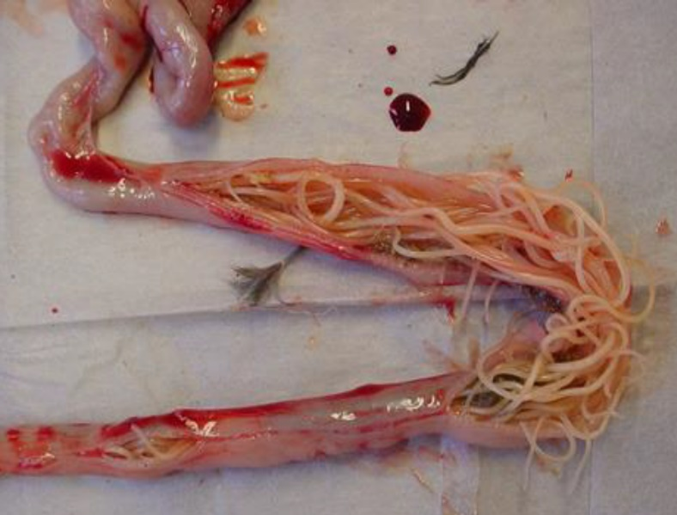
Ascaridia galli
Diagnosis :
On the basis of Clinical signs
Microscopic faecal examination
Large adult worms are found in small intestine during necropsy

Slide 8
Ascaridia galli
Treatment
Piperazine adipate, Mebendazole, Tetramisole, Phenothiazine, mixture of Phenothiazine and Piperazine are used in the treatment.

Slide 9
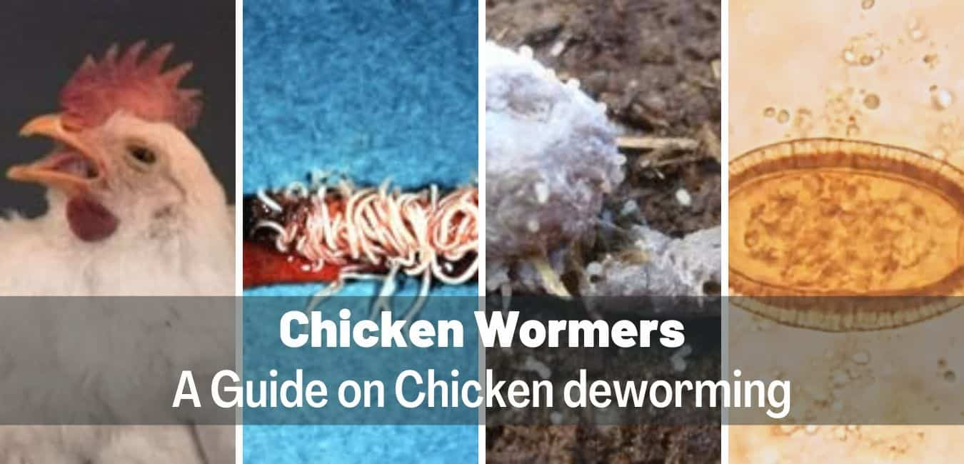
Ascaridia galli
Control:
Treatment of infected birds
Regular deworming
Regular cleaning of floor, feeding and watering utensils etc.
Segregation of adult and young birds

Slide 10
THANK YOU

