Slide 1
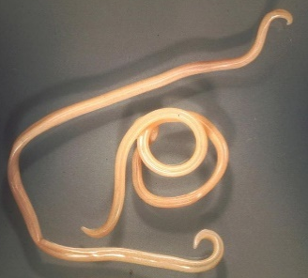
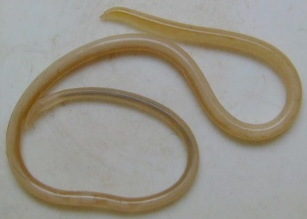
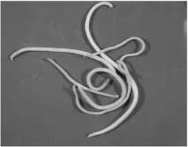
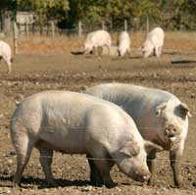
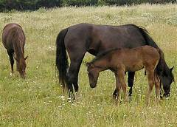
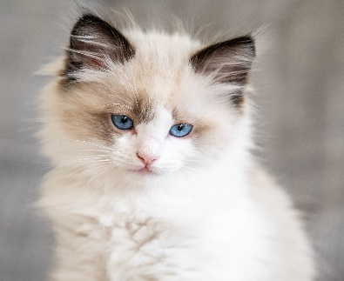
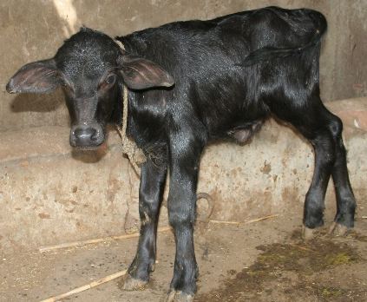
Ascaris suum
Family: Ascarididae
Dr. AJIT KUMAR
Department of Veterinary Parasitology
Bihar Veterinary College
Bihar Animal Sciences University
Patna-800014
Image source: Google image

Slide 2
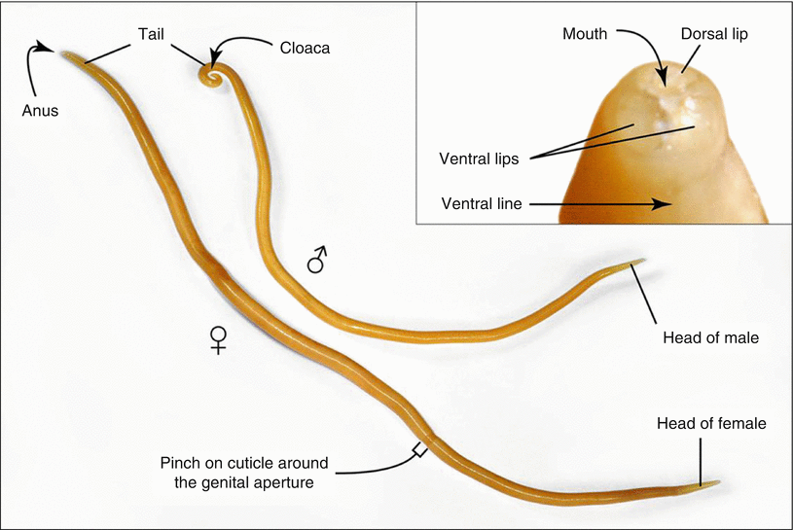
Family: Ascarididae
General Characters:
Three well developed lips
Buccal capsule or pharynx absent
Oesophagus is usually club-shaped,
Male has paired spicules
Direct life-cycle
Worms are commonly called ascarids.
Genus: Ascaris, Parascaris, Toxocara and Toxascaris spp.
Club shaped Oesophagus

Slide 3
Species of Ascarid worms
Sl. No. | Species of Ascarid | Common name
1 | Ascaris suum | Ascarid worm of pig
2 | Toxocara vitulorum | Ascarid worm of cattle, buffalo, sheep and goat
3 | Toxocara cati | Ascarid worm of cat
4 | Toxocara canis | Ascarid worm of dog
5 | Toxascaris leonina | Ascarid worm of dog and cat
6 | Parascaris equorum | Ascarid worm of horse
7 | Ascaris lumbricoides | Ascarid worm of man
.

Slide 4
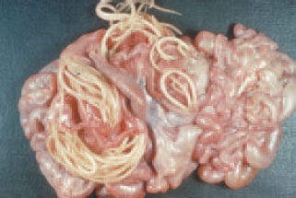
Ascaris suum
Ascaris suum
Final Host/ Host: Pig
Predilection site: Small Intestine
Largest nematode of pig

Slide 5
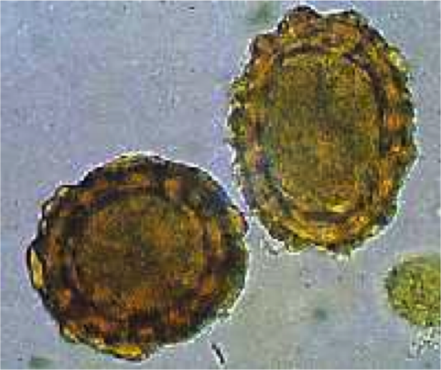
Ascaris suum
General Characters:
Male are 15-25 cm whereas Females are up to 40 cm long
Three well developed lips
Eggs are oval shaped, brownish yellow clour with thicked shell, the outer layer of which is irregularly mammillated.

Slide 6
Ascaris suum
Life-cycle:
Direct life-cycle
Infective stage: egg containing 2nd stage larvae.
Transmission: by the ingestion of egg containing 2nd stage larvae with food and water
Ingested infective eggs containing 2nd stage larvae hatch in the small intestine and L₂ reach to the liver where develop into L₃.
L₃ finally reach into the small intestine via trachea and oesophagus (Tracheal route migration).
L₃ via blood-stream enter into the lungs and thence final two parasitic moults occur in the small intestine

Slide 7
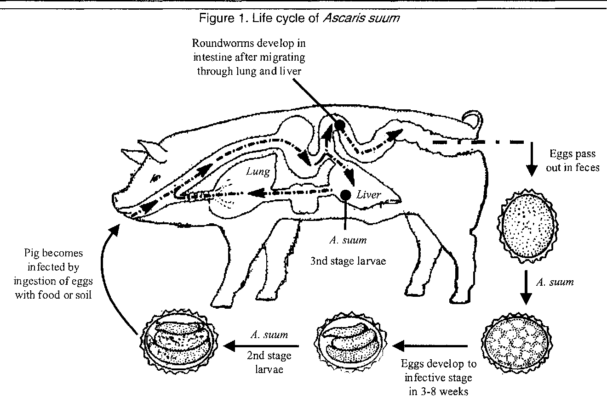
Life-cycle of Ascaris suum

Slide 8
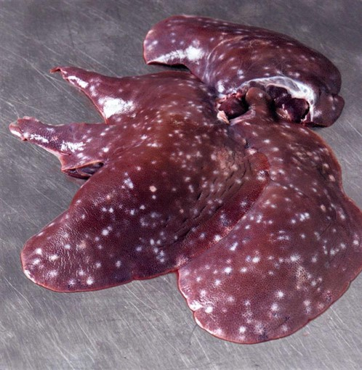
Ascaris suum
Pathogenesis:
In the liver, the migrating L₂ and L₃ can cause milk spots which appear as cloudy whitish spots of up to 1.0 cm in diameter.
L₃ larvae followed tracheal route of migration which result haemorrhagic lesions in alveoli.
milk spots

Slide 9
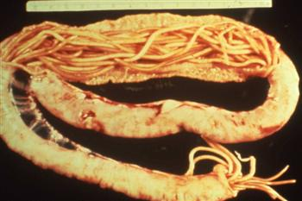
Ascaris suum
Pathogenesis:
Adult Ascaris suum: less pathogenic. Intestinal Obstruction may be found in heavy infection
Intestinal Obstruction

Slide 10
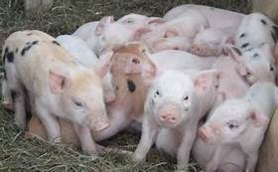
Ascaris suum
Ascaris suum
Young pigs ( below 6 months of age) are chiefly affected and show signs of
pneumonia (Ascaris pneumonitis)
Coughing
Decreased growth rate
Diarrhoea.

Slide 11
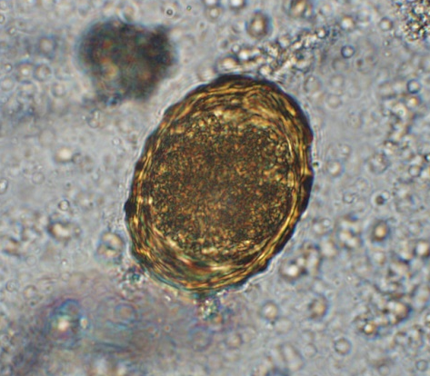
Ascaris suum
Diagnosis:
On the basis of Clinical signs.
Microscopic faecal examination
Egg is brownish yellow ovoid with thick shells, the outer layer of which is irregularly mamillated.

Slide 12
Ascaris suum
Treatment:
Levamisole, Fenbendazole, Pyrantel tartrate, Piperazine salts, ivermectin etc. are used in the treatment.
Control:
Treatment of Infected pigs
Regular deworming: every 3-6 months interval with suitable anthelmintic
House of pigs should be cleaned and faeces disposed regularly

Slide 13
THANK YOU

