Slide 1
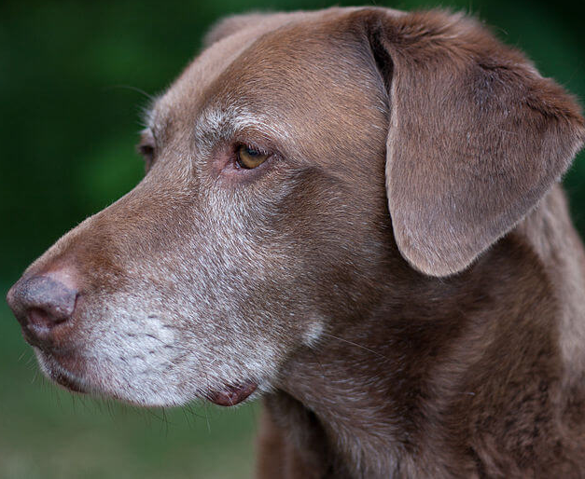
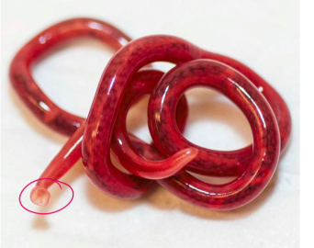
Dioctophyma renale
Dr. AJIT KUMAR
Department of Veterinary Parasitology
Bihar Veterinary College
Bihar Animal Sciences University
Patna-800014
Image source: Google image

Slide 2
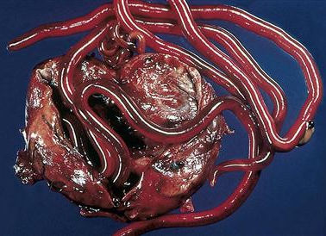
Dioctophyma renale
Family: Dioctophymidae
Other name: Eustrongylus gigas
Common name: Giant kidney worm of
dog

Slide 3
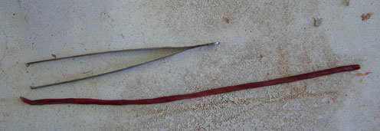
Dioctophyma renale
General Characters:
Largest nematode of domestic animals (Length of female is up to 103 cm).
Worms are blood red in colour.
Male worm (35-45 cm long) has single spicule and cup-shaped bursa without bursal rays.
Barrel shaped eggs in the single cell stage are passed in the urine, either singly or in clusters or chain and the shells are pitted except at the poles.
Egg

Slide 4
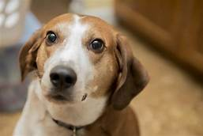
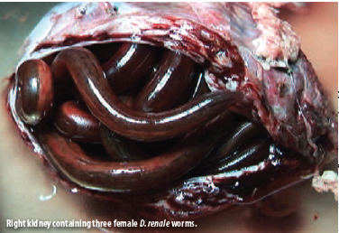
Dioctophyma renale
Final Hosts : Dog, fox and mink
Location: Kidney

Slide 5
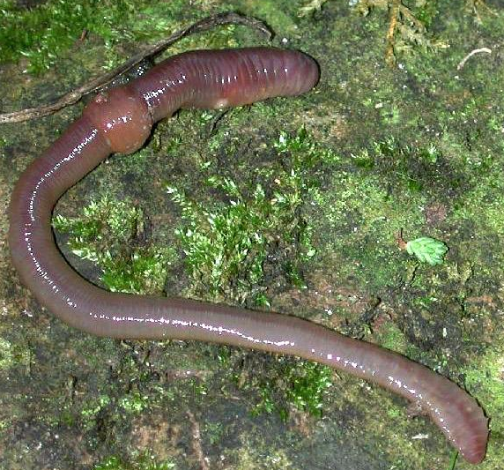
Dioctophyma renale
Life-cycle:
Indirect life-cycle
Intermediate host: Oligochaete annelid (Lumbriculus variegatus)
Infective stage : 3rd stage larva (L₃)

Slide 6
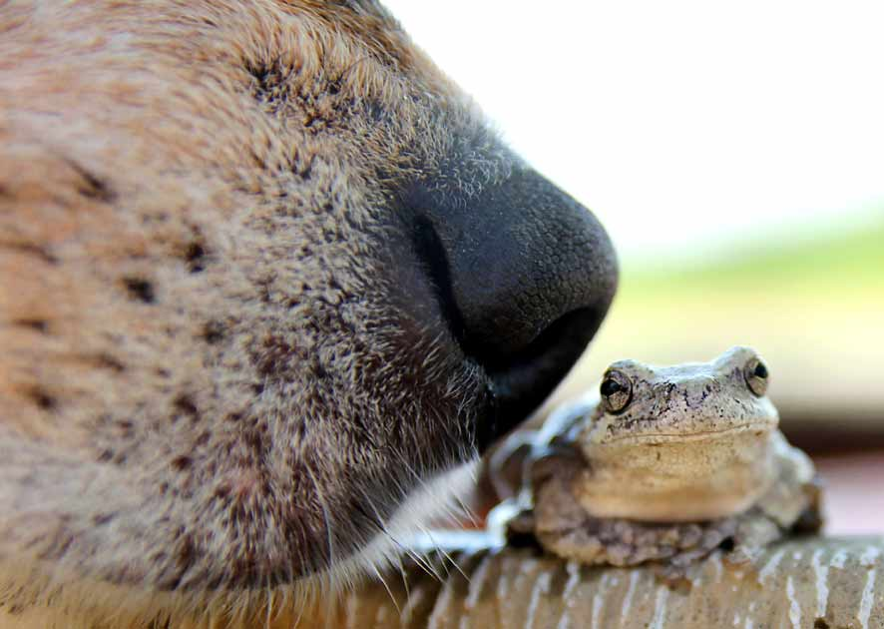
Dioctophyma renale
Transmission:
Final host gets the infection -
by swallowing the L₃ larvae infected intermediate host i.e. Oligochaete annelid (Lumbriculus variegatus) with the drinking water
OR
by the ingestion of paratenic host like fish (Idus spp.) or frog which has itself eaten the infected annelid.

Slide 7
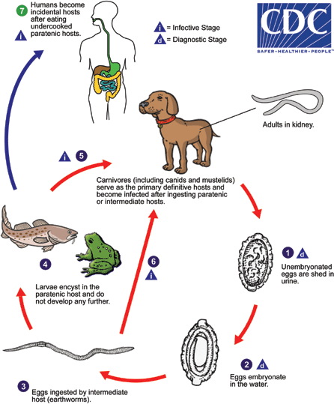
Dioctophyma renale
Life-cycle:

Slide 8
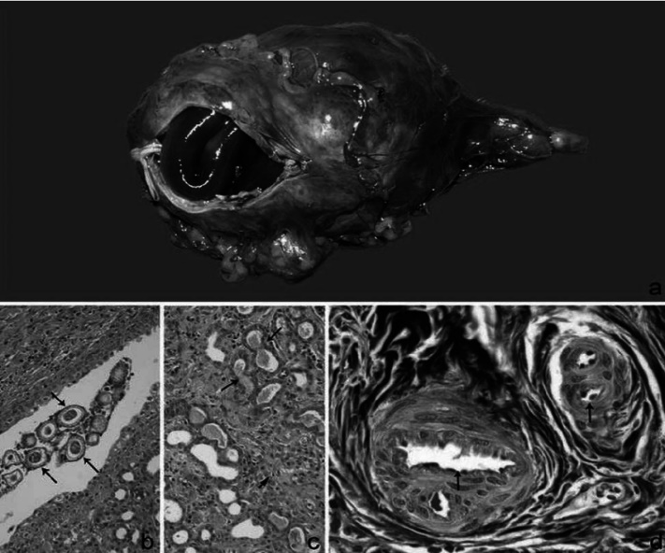
Dioctophyma renale
Pathogenesis:
Worms destroy the parenchyma of pelvis of the kidney.
Usually right kidney invaded more frequently than the left.
Formation of a sac–like structure in the capsule where worms are found.

Slide 9
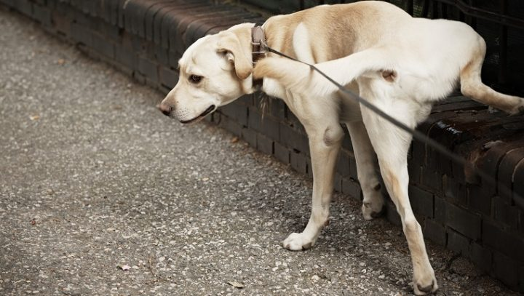
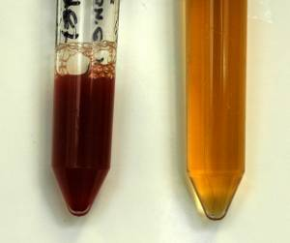
Dioctophyma renale
Clinical signs:
Kidney worms infection leads to
Dysuria with some haematuria, especially at the end of micturition.
Renal colic
Dysuria
Haematuria

Slide 10
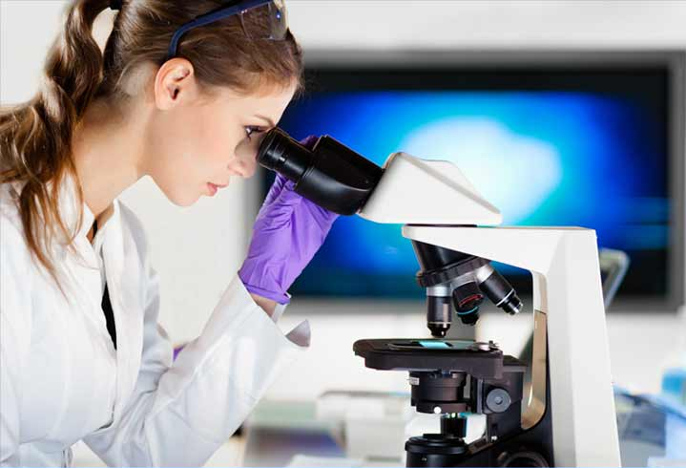
Dioctophyma renale
Diagnosis:
On the basis of symptoms.
Microscopic examination of urine reveals eggs of worm.
Eggs are barrel–shaped, brown colour and the shells are pitted except at the poles.
EGG

Slide 11
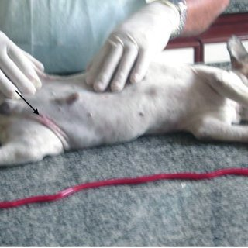
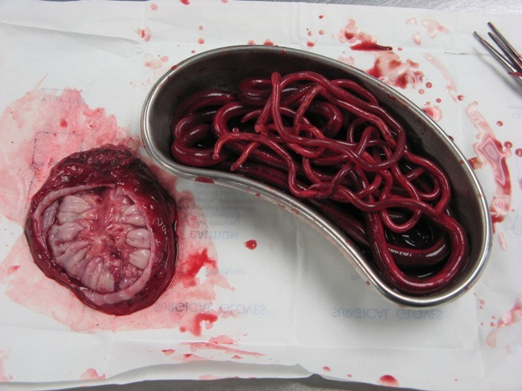
Dioctophyma renale
Treatment :
Worms may be removed surgically.

Slide 12
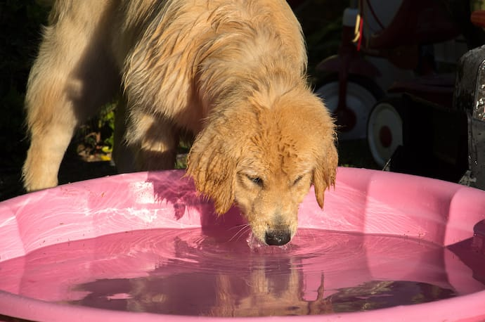
Dioctophyma renale
Control:
Providing of clepened water like shallow water.
Prevent ingestion of earthworms.
Proper cooking of frog and fish before eating by dogs.

Slide 13
THANK YOU

