Slide 1
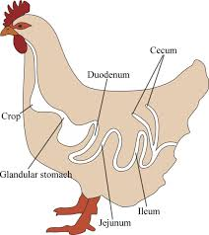
Heterakis gallinarum
(Poultry
Ascarid worm)
Dr. AJIT KUMAR
Department of Veterinary Parasitology
Bihar Veterinary College
Bihar Animal Sciences University
Patna-800014

Slide 2
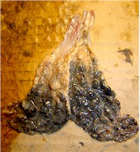
Heterakis gallinarum
Final Hosts : Domestic & wild birds
Location: Caecum
Caecal worm of poultry

Slide 3
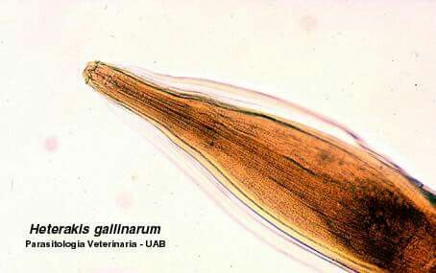
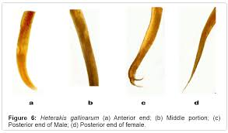
Heterakis gallinarum
General Characters:
Marked sexual dimorphism. Males are smaller and shorter, about 9 mm in length, with a unique bent tail whereas Females are stouter and longer about 13 mm in length, with a straight tail end.
Oesophagus has large posterior bulb and spicules are unequal in length
Male worm has 12 pairs anal papillae.
Egg is oval with smooth shells

Slide 4
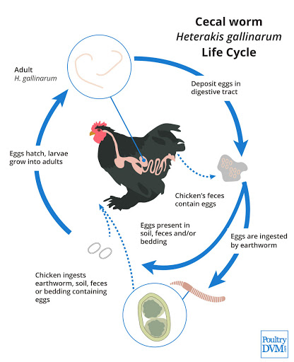
Heterakis gallinarum
Life-cycle:
Similar to Ascaridia galli.
Infective stage: egg containing 2nd stage larvae.
Transport host: Earthworm
Transmission:
Transmission through
Ingestion of infective egg containing L₂ with food or water
Eggs are sometimes ingested by earthworms, which may act as transport host. So, ingestion of earthworm containing L₂ larva

Slide 5
Heterakis gallinarum
Pathogenesis:
Worms are usullay non-pathogenic but it’s important role is transmission of Histomonas meleagridis (protozoa).
Histomonas meleagridis (protozoa) causes entero-hepatitis or black head disease in turkey.
Protozoa remain safe inside the infective eggs of the nematode against the lethal effect of the anterior part of the digestive tract of the bird on ingestion of eggs by them and reach caeca in viable state.
Worms cause nodular typhlitis.

Slide 6
Heterakis gallinarum
Clinical signs:
Nodular typhalitis, anaemic, emaciation and diarrhoea.

Slide 7
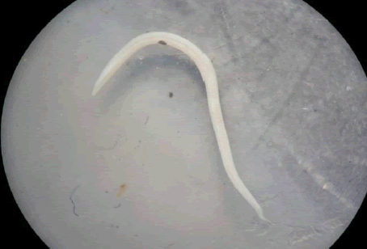
Heterakis gallinarum
Diagnosis :
On the basis of Clinical signs
Microscopic faecal examination
Small adult worms are found in the caeca during necropsy

Slide 8
Heterakis gallinarum
Treatment
Fenbendazole
Phenothiazine @ 0.5- 1 gm/ bird are effective.

Slide 9
Heterakis gallinarum
Control:
Treatment of infected birds
Regular deworming
Regular cleaning of floor , feeding and watering utensils etc.
Segregation of adult and young birds

Slide 10
THANK YOU

