Slide 1
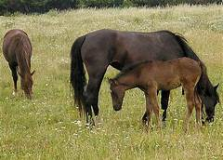
Parascaris equorum
Family: Ascarididae
Dr. AJIT KUMAR
Department of Veterinary Parasitology
Bihar Veterinary College
Bihar Animal Sciences University
Patna-800014
Image source: Google image

Slide 2
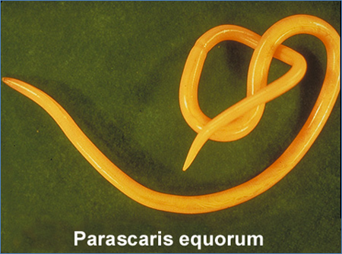
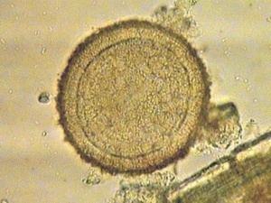
Parascaris equorum
General Characters:
Largest nematode of equine
Male are 15-28 cm whereas Females are up to 50 cm long
Worms are rigid, stout with a large head.
Three well developed lips
Male tail has small lateral alae and numerous post-cloacal papillae.
Eggs areherical or sub-spherical, brownish yellow colour with thick and pitted shell.

Slide 3
Parascaris equorum
Parascaris equorum
Final Host/ Host: Horse, ass, pony, Zebra etc.
Predilection site: Small Intestine

Slide 4
Parascaris equorum
Life-cycle:
Direct life-cycle
Infective stage: egg containing 2nd stage larvae.
Transmission: by the ingestion of egg containing 2nd stage larvae with food and water
Life –cycle similar to Ascaris suum.

Slide 5
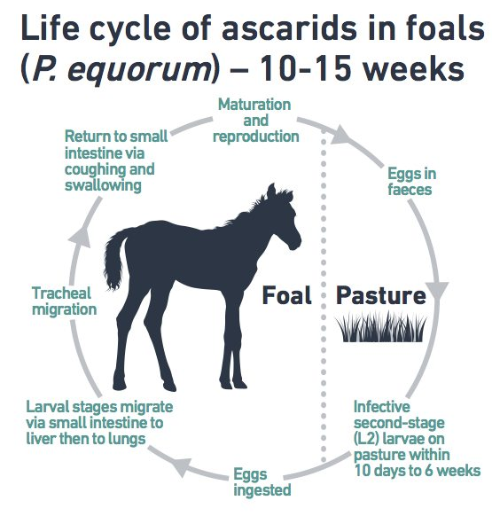
Parascaris equorum

Slide 6
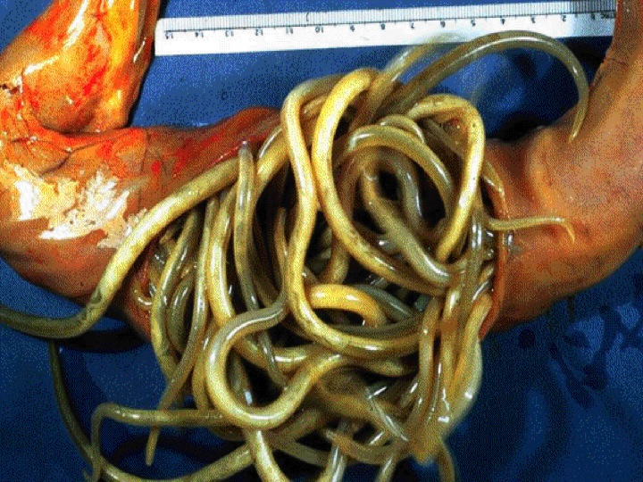
Parascaris equorum
Clinical signs:
Foals 3-4 months of age especially suffer from flatulence, foetid diarrhoea pot-belly, balling up and an obstruction

Slide 7
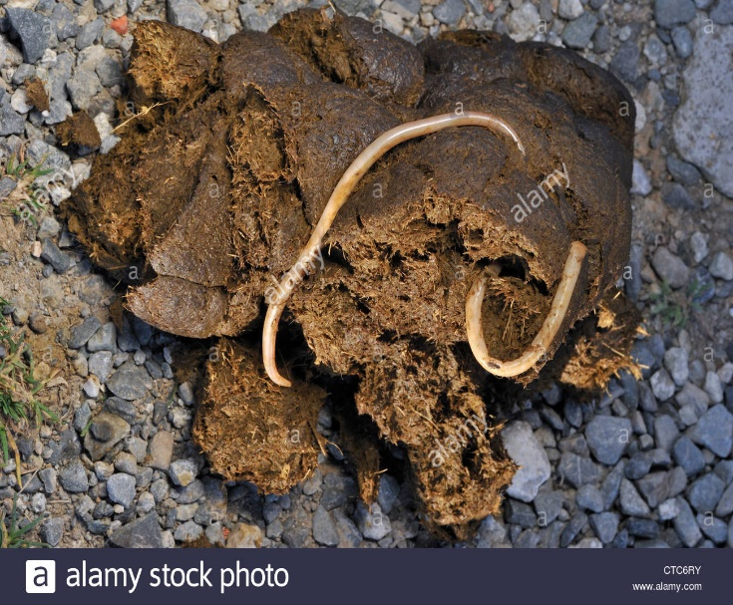
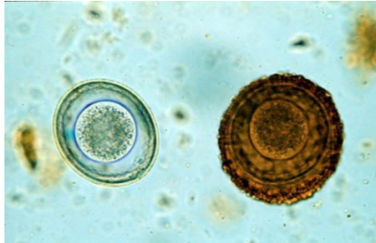
Parascaris equorum
Diagnosis:
On the basis of Clinical signs.
Gross examination of faeces:
Microscopic faecal examination
Eggs areherical or sub-spherical, brownish yellow colour with thick and pitted shell.

Slide 8
Parascaris equorum
Treatment:
Levamisole, Ivermectin, Fenbendazole, Morantel tartrate and Piperazine salts are used in the treatment.
Control:
Mares with foals graze cleanest pasture
Foaling stall hygiene
Monitor mares and treat as needed
Treat foals at 6 week intervals from 6 weeks of age until 6 months.

Slide 9
THANK YOU

