Slide 1
Family: Oxyuridae
Pin worms
Dr. AJIT KUMAR
Department of Veterinary Parasitology
Bihar Veterinary College
Bihar Animal Sciences University
Patna-800014
Date-23.04.2021
Image source: Google image

Slide 2
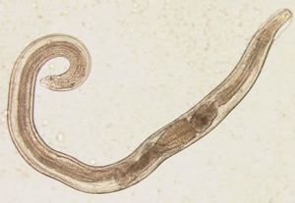
Family: Oxyuridae
General Characters:
Oesophagus has well developed posterior bulb
Female worms have long pointed tail
Male has single spicule
Vulva located anteriorly.
Direct life-cycle

Slide 3
Species
Sl. No. | Species | Host
1 | Oxyuris equi ( Pin worm of Equine) | Horse & donkey
2 | Enterobius vermicularis ( Pin worm of worm of man) | Man
3 | Skrjabinema ovis | Sheep & Goat
.

Slide 4
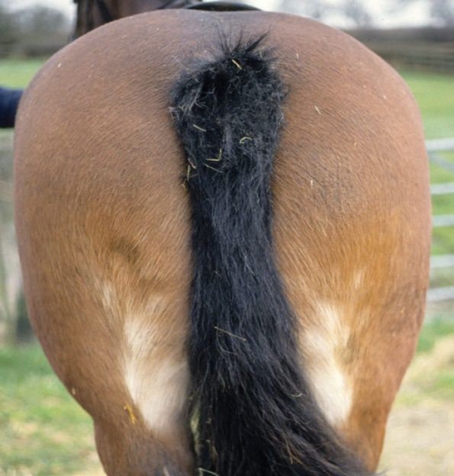
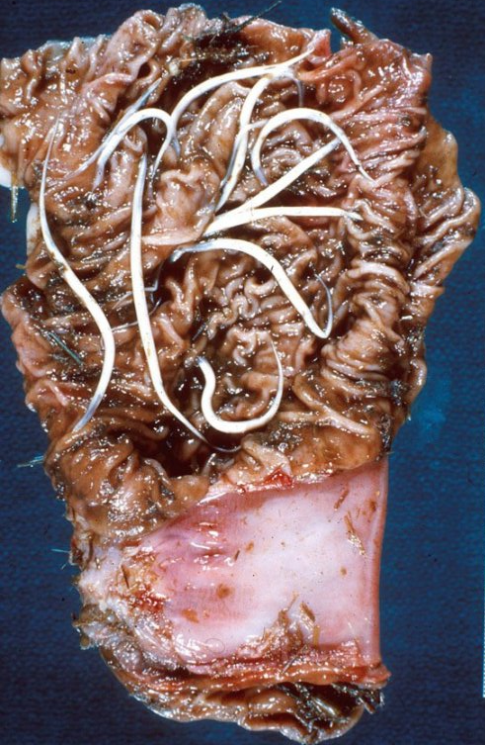
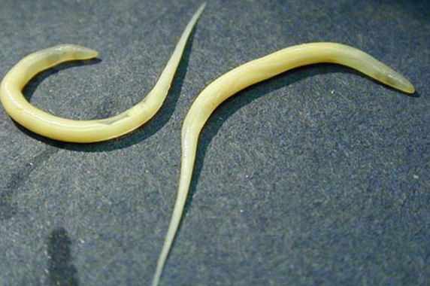
Oxyuris equi
Final Hosts : Horse & Donkey
Location: Large intestine
Pin worm or rectal worm of horse

Slide 5
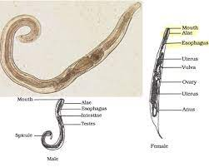
Oxyuris equi
Hour-glass shaped oesophagus
General Characters:
Hour-glass shaped oesophagus has a well developed posterior bulb.
Female is much larger than the male and have long tapering tail.
Young females are almost white in colour, slightly curved and with a pointed tail whereas mature female worms are slatey-grey or brownish in colour with a very long narrow tail (3 times of the rest body).
Male has one pin- shaped spicule.
Eggs are elongate, slightly flattened on one side with a plug at one pole.

Slide 6
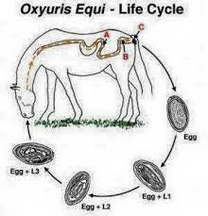
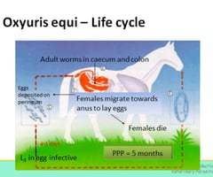
Oxyuris equi
Life-cycle:
Infective stage: egg containing 3rd stage larvae.
Transmission:
Transmission through
Infection in equines occurs by the ingestion of infective eggs containing third stage larva on fodder and bedding.

Slide 7
Oxyuris equi
Life-cycle:
After fertilization, the mature female worms crawl out through the anal opening and lay eggs in clusters on the skin in the perineal region.
3rd stage larvae (L₃) are developed inside eggs and final hosts get infection during feeding/ ingestion of egg containing L_{3.}

Slide 8
Oxyuris equi
Pathogenesis:
Anal pruritis produced by the egg laying females.
Affected animal rubs the base of its tail against any hard object, causing the hairs to break off and the tail acquires an ungroomed rat–tailed appearance.
Rat–tailed appearance

Slide 9
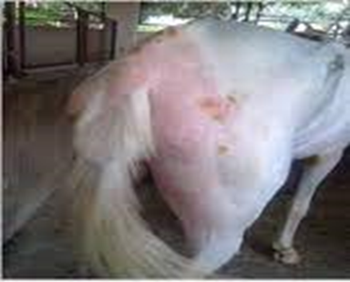
Oxyuris equi
Clinical signs:
Rubbing of tails to get rid of pruritus which result broken hairs and gives it a “rat-tailed appearance”.

Slide 10
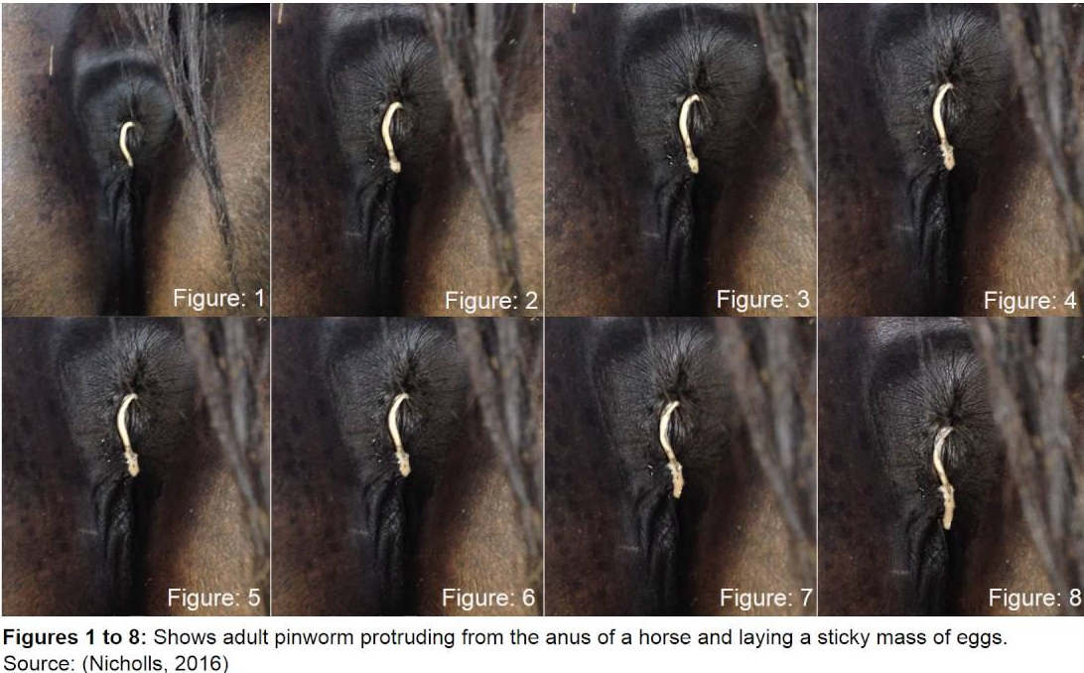
Oxyuris equi
Diagnosis :
On the basis of Clinical signs
Examination of the perineal region of infected horse revealed cream coloured masses of eggs.
Eggs are elongate, slightly flattened on one side with a plug at one pole.
Egg

Slide 11
Oxyuris equi
Treatment
Levamisole,
Fenbendazole,
Pyrantel tartrate,
ivermectin etc. are used in the treatment.

Slide 12
Oxyuris equi
Control:
Good hygiene in stables, frequent removal of beddings and prevent contamination of feed and drinking water with beddings are helpful in controlling the Oxyuris equi infection in horses.

Slide 13
THANK YOU

