Slide 1
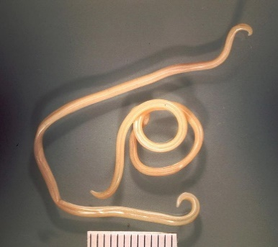
Toxocara canis
Family: Ascarididae
Dr. AJIT KUMAR
Department of Veterinary Parasitology
Bihar Veterinary College
Bihar Animal Sciences University
Patna-800014
Image source: Google image

Slide 2
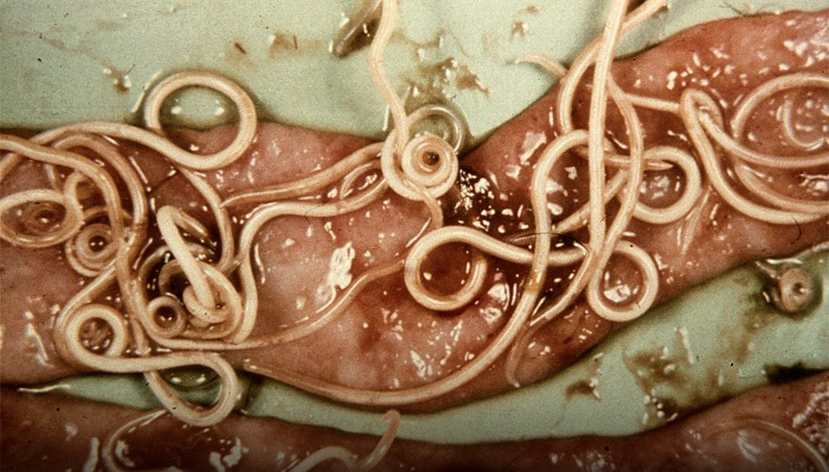
Toxocara canis
Common Name : Arrow headed worm
Final Host/ Host: Dog
Predilection site: Small Intestine
Highest prevalences have been recorded in dogs of less than six months of age.

Slide 3
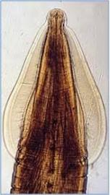
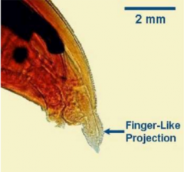
Toxocara canis
Cervical alae
General Characters:
Male are up to 10 cm whereas Females are up to 18 cm long
Presence of large cervical alae which gives arrow-like appearance. Hence, known as Arrow-headed worms.
Anterior end is bent dorsally
Tail of male worm bears a small finger like process.
Egg are subglobular in shape, dark brown in colour unsegmented embryos at the centre with thick finely pitted shells.
Egg

Slide 4
Toxocara canis
Life-cycle:
Direct life-cycle
Infective stage: egg containing 2nd stage larvae.
Transmission: There are four routes of Toxocara canis transmission: –
1. Oral or ingestion of infective egg containing L2
It follows tracheal migration of larvae similar to A. suum.
It occurs in puppies of a few weeks to less than three months of age.

Slide 5
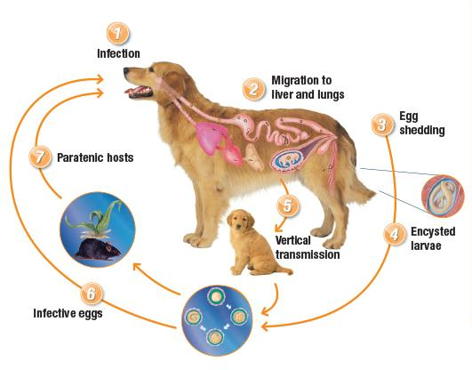
Toxocara canis
Life-cycle:
2. Transuterine infection or Transplacental or Prenatal or Congenital infections :
In dogs over three months of age, the hepatic-tracheal migration occurs less frequently and at six months it has almost ceased.
Instead, only somatic migration of L₂ larvae and these remain in L₂ stage in organs/tissues.
In the pregnant bitch, prenatal infection occurs, larvae becoming mobilized at about three weeks prior to parturition and migrating to the liver of the foetus where they moult to L₃ just before birth.
A bitch, once infected, will usually harbours sufficient larvae to infect all her subsequent litters, even if she never gain encounters the infection.
Mobilization and migration of larvae induce probably due to alteration of hormonal status during pregnancy stage.

Slide 6
Toxocara canis
Life-cycle:
Direct life-cycle
Infective stage: egg containing 2nd stage larvae.
Transmission: There are four routes of Toxocara canis transmission: –
1. Oral or ingestion of infective egg containing L2
It follows tracheal migration of larvae similar to A. suum.
It occurs in puppies of a few weeks to less than three months of age.

Slide 7
Toxocara canis
Life-cycle:
3.Transmammary Transmission
L₃ larvae are passed to suckling pups via the colostrums and develop directly to adult worms in the intestine of the puppy.
There is no migration in the pup following infection by this route.
4. Paratenic host transmission
Dogs, being predators, may eat on rodents having dormant larvae.
L₂ stage develops to adult stage in the intestine of pups/dogs without migration.

Slide 8
Toxocara canis
Pathogenesis:
Most fatalities from Toxocara canis infection occur during the pulmonary phase, and pups which have been heavily infected transplacentaly may die within a few days of birth.
Larvae are caused pneumonia, pulmonary oedema, haemorrhages, etc whereas adult worms lead to enteritis and occlusion of intestine.
Intestinal Obstruction

Slide 9
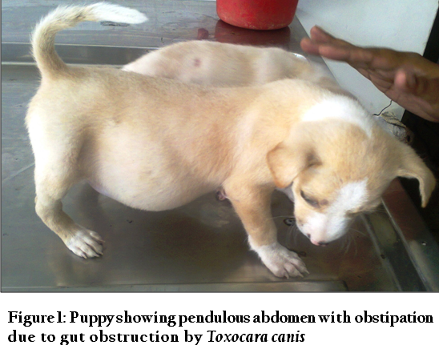
Toxocara canis
Clinical signs:
Pot-belly or tucked-up abdomen, coat is dull and harsh, nervous convulsions and diarrhoea or constipation, vomiting, coughing, poor body condition, loss of appetite etc.
Death of pups occurs due to heavy prenatal infection as well as blocking of intestine.

Slide 10
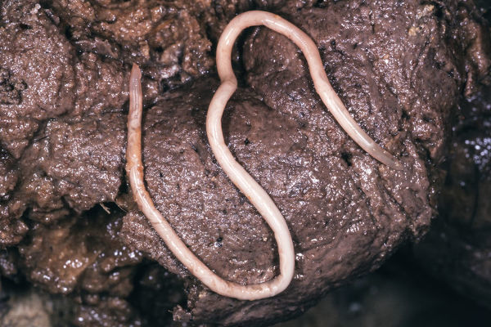
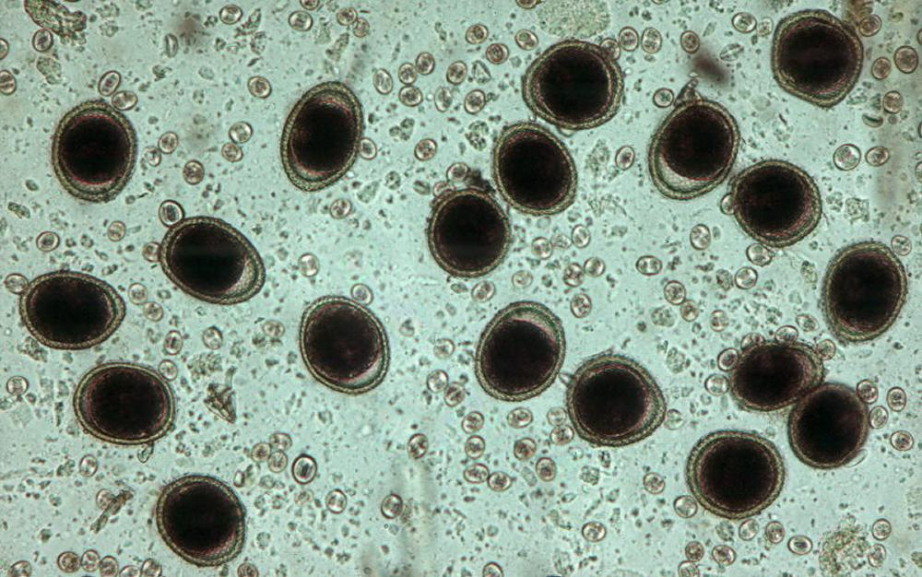
Toxocara canis
Diagnosis:
On the basis of Clinical signs.
Gross examination of faeces:
Microscopic faecal examination:
Egg are subglobular in shape, dark brown in colour unsegmented embryos at the centre with thick finely pitted shells.

Slide 11
Toxocara canis
Treatment:
Piperazine adipate, Fenbendazole, Pyrantel pamoate, Diethylcarbamazine and Levamisole are used in the treatment.
Control:
Toxocara canis infected bitches should be treated with fenbendazole which is also effective against dormant larvae in tissues to may prevent prenatal infection.
Floor of kennels should be kept clean, dry and washed either by boiling water or 3% Lysol solution.
Rodents should be eliminated from the kennel.
Deworming Schedule:
Puppies : 2 wks, 4 wks, 6wks, 8wks, 12 wks, 16 wks, 6 months and 1 year
Adult dogs: twice in a year

Slide 12
THANK YOU

