Slide 1
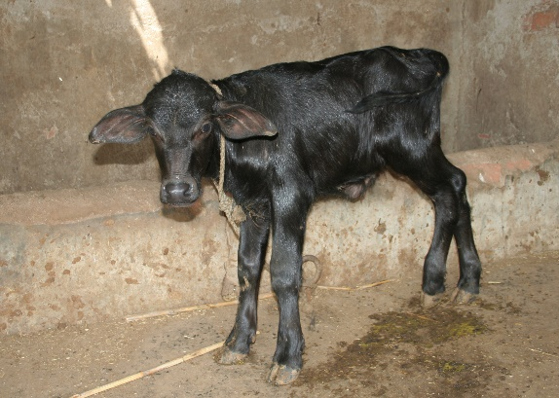
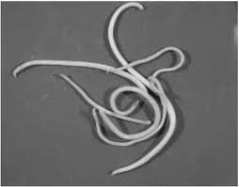
Toxocara vitulorum
Family: Ascarididae
Dr. AJIT KUMAR
Department of Veterinary Parasitology
Bihar Veterinary College
Bihar Animal Sciences University
Patna-800014
Image source: Google image

Slide 2
Toxocara viotulorum
Final Host/ Host: Cattle & buffalo
Predilection site: Small Intestine
Largest nematode of Cattle & Buffalo.

Slide 3
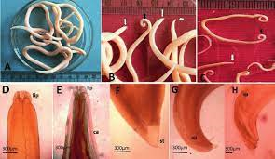
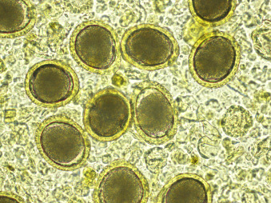
Toxocara viotulorum
General Characters:
Male are 25 cm whereas Females are about 30 cm long
Body of worm is soft and cuticle is translucent. So, the internal organs can be seen
Extremities are not so narrow.
Eggs are subglobular shaped, colourless with thick finely pitted shell.

Slide 4
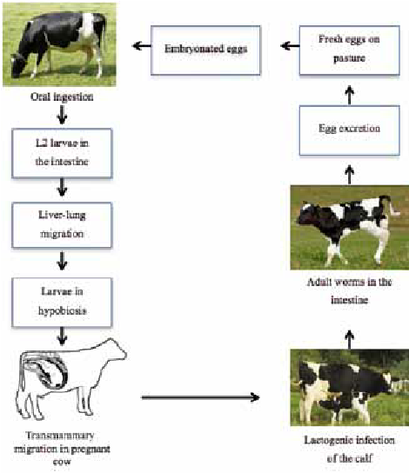
Toxocara virulorum
Life-cycle:
Direct life-cycle
Infective stage: egg containing 2nd stage larvae.
Transmission : Toxocara vitulorum transmission occurs following route: –
Oral or ingestion of infective egg containing L₂
2.Transmammary / transcolostral transmission

Slide 5
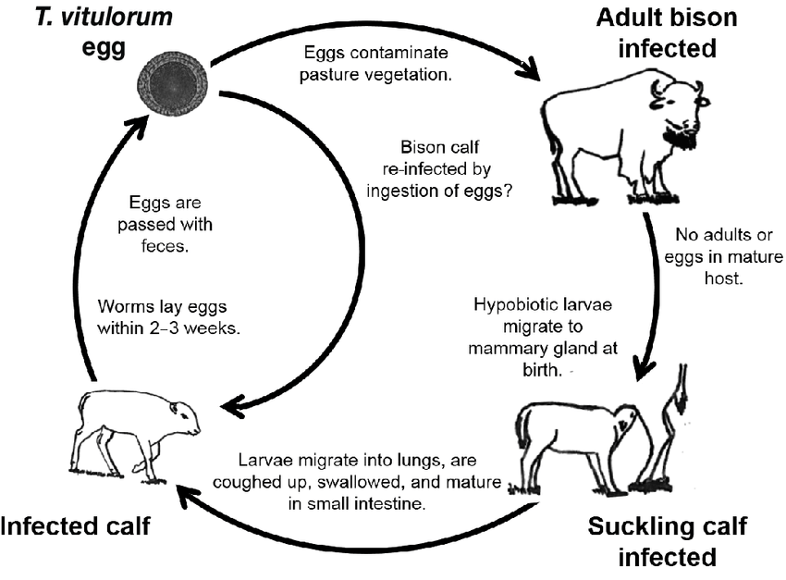
Toxocara virulorum
Life-cycle:
Transmammary infections constitute the major sources of T. vitulorum infection for calves.
Ingestion of infective eggs containing L₂ larvae by calves or adult does not lead to patent infection.
Instead hatched out L₂ stage reaches various organs /tissues and remain dormant. Larvae start mobilizing and migrating to mammary glands during late pregnancy period. Just after parturition, the migrating larvae are shed in milk and lead to transmammary transmission up to 3-4 weeks.
Calves, soon after birth, feed on colostrums and the larvae grow to adult worms in their intestine in approximately four weeks.

Slide 6
Toxocara viotulorum
Pathogenesis:
Worms are highly pathogenic in calves ( especially buffalo calves) below 6 months of age.
Partial or complete obstruction of the lumen of gut.
Digestive disturbances
Anaemia
Patent period is short and natural expulsion of adult worms starts as early as 38 days after birth and by 4-6 months no adult worms remain.
Intestinal Obstruction

Slide 7
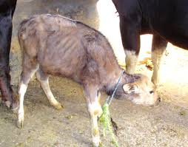
Toxocara vitulorum
Clinical signs:
Worms produces steatorrhoea, colic, mud-coloured foul smelling faeces, intestinal obstruction in case of large number of worms, pot-belly, poor boat coat, emacition and death.

Slide 8
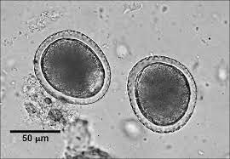
Toxocara vitulorum
Diagnosis :
On the basis of Clinical signs
Gross examination of faeces
Microscopic faecal examination
Each female worm produces about 8 × 10⁶ eggs/day.

Slide 9
Toxocara vitulorum
Treatment
Pyrantel pamoate ( 250 mg/kg body wt. orally), Piperazine, Fenbendazole, Levamisole etc. are used in the treatment.

Slide 10
Toxocara vitulorum
Control : Toxocara vitulorum infection can be controlled by regular deworming with suitable anthelmintic. In case of calves deworming will be started at the age of 10-15 days and then after every months up to 6 months of age.
Regular disposal of faeces, separate rearing of adult and young animals etc..

Slide 11
THANK YOU

