Slide 1
Renal Function Tests

Slide 2
Kidney Functions
Excretory
Formation and excretion of urine
Glomerular filtration
Tubular reabsorption
Tubular secretion
Excreting toxic substances in synergy with liver
Homeostatic
Regulation of blood volume
Regulation of blood pH
Regulation of serum electrolytes; Na, K, Cl and Ca
Reabsorption of essential nutrients

Slide 3
Endocrine
Erythropoietin
Renin Angiotensin system
Vitamin D activation
Degradation of hormones like insulin and aldosterone
Metabolic
Along with liver site for gluconeogenesis

Slide 4
Renal function tests; Why needed?
To assess functional capacity of kidneys
To diagnose renal impairment
To assess the severity and progression of renal impairment
To assess the effectiveness of treatment
Monitor the safe and effective use of drugs which are excreted in the urine

Slide 5
When should we assess renal function?
Older age
Family history of Chronic Kidney disease (CKD)
Decreased renal mass
Diabetes Mellitus (DM)
Hypertension (HTN)
Autoimmune disease
Systemic infections
Urinary tract infections (UTI)
Nephrolithiasis
Obstruction to the lower urinary tract
Drug toxicity

Slide 6
Causes of renal disease
Pre-renal
Any condition that results in reduced blood flow to kidneys
Severe blood loss
Hemolysis
Renal
Damage to renal tissue, glomerular basement membrane or tubules
Glomerulonephritis
Diabetic or hypertensive nephropathy
Tubular damage due to toxic substances
Post Renal
Obstruction to urine outflow
Ureteric or urethral stone
Prostatic cancer

Slide 7
Renal function test
Renal function tests are divided into the following
Urine analysis
Blood examination
Glomerular Function Test
Tubular Function Test

Slide 8
Renal function test
The following parameters are commonly included in assessing renal function (the normal values/reference range is mentioned)
Serum Urea ( 15-45 mg/dl)
Serum Creatinine (0.6 – 1.2 mg/dl)
Serum Uric acid (males 3.5-7.2 mg/dl, females 2.6-6 mg/dl)
Total protein (6.4-8.1 g/dl)
Serum albumin (3.2-4.6 g/dl)
Serum electrolytes
Na (136-146 mEq/L)
K (3.5-5.1 mEq/L)
Cl (101-109 mEq/L)
Phosphate (2.8-4 mg/dl)
Calcium (8.8-10.2 mg/dl)

Slide 9
Complete hemogram
Hemoglobin
total RBC
RBC indices
MCH (Mean corpuscular hemoglobin)
MCV (Mean corpuscular volume
PCV (Packed cell volume)
MCHC (Mean corpuscular Hemoglobin concentration)
ESR

Slide 10
Urine Analysis
includes physical or macroscopic examination, chemical examination and microscopic examination of the sediment

Slide 11
Colour
Blue Green | Pink-Orange- Red | Red-brown-black
Methylene Blue | Haemoglobin | Haemoglobin
Pseudomonas | Myoglobin | Myoglobin
Riboflavin | Phenolpthalein Porphyrins | Red blood cells Homogentisic Acid
 | Rifampicin | L -DOPA
 |  | Melanin Methyldopa
▪ Colour of urine depending upon it’s constituents.

Slide 12
Specific Gravity
Measured by urinometer or refractometer.
It is measurement of urine density which reflects the ability of the kidney to concentrate or dilute the urine relative to the plasma from which it is filtered.
Normal :- 1.001- 1.040
S.G | Osmolality (mosm/kg)
1.001 | 100
1.010 | 300
1.020 | 800
1.025 | 1000
1.030 | 1200
1.040 | 1400

Slide 13
Specific Gravity
Increase in Specific Gravity seen in
Low water intake
Diabetes mellitus
Albuminuruia
Acute nephritis.
Decrease in Specific Gravity is seen in
Absence of ADH
Renal Tubular damage.
Isosthenuria-Persistent production of fixed low Specific gravity urine isoosmolar with plasma despite variation in water intake

Slide 14
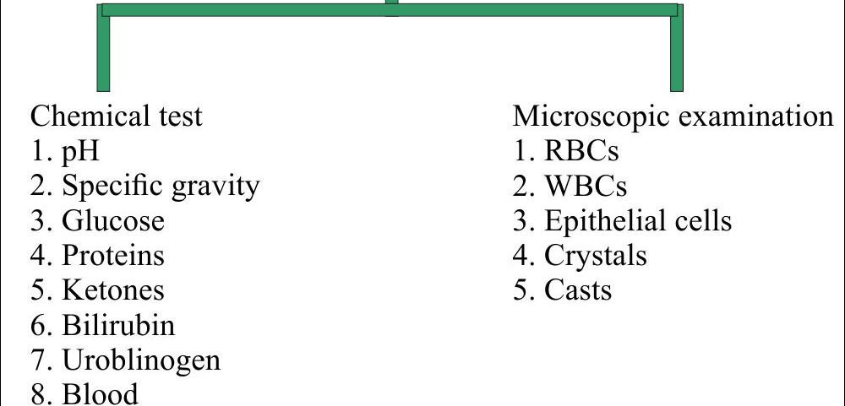
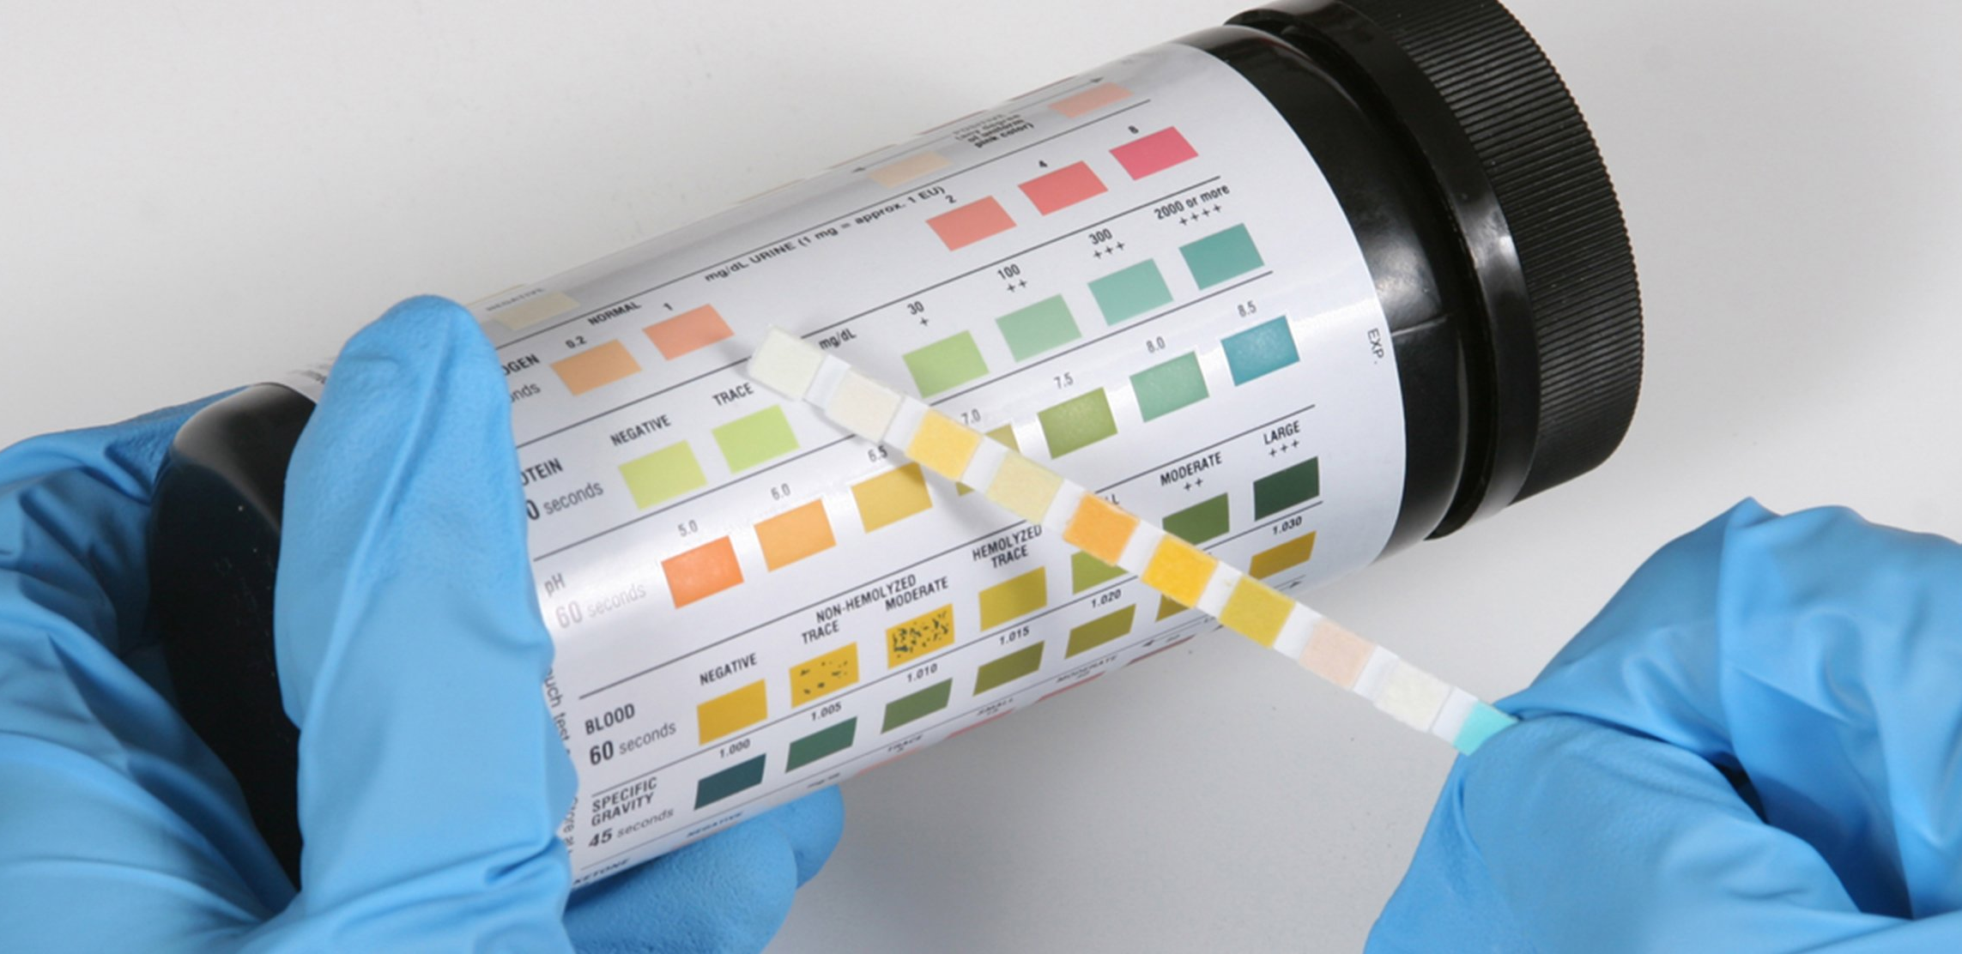
Urine Analysis

Slide 15
Blood examination
to measure substance in blood that are normally excreted by kidney.
their level in blood increases in kidney dysfunction.
markers of renal function creatinine, urea, uric acid and electrolytes are done for routine analysis

Slide 16
Serum creatinine
Creatinine is filtered but not reabsorbed in kidney
Not increased above normal until GFR<50 ml/min
The methods most widely used for serum creatinine are based on the Jaffe reaction. This reaction occurs between creatinine and the picrate ion formed in alkaline medium (sodium picrate); a red-orange solution develops which is read colorimetrically at 520 nm

Slide 17
Blood urea
major nitrogenous end product of protein and amino acid catabolism
filtered freely by the glomeruli
Many renal diseases with various glomerular, tubular, interstitial or vascular damage can cause an increase in plasma urea concentration
High protein diet causes significant increases in plasma urea concentrations and urinary excretion
Enzymatic Berthelot Method is used for blood urea estimation

Slide 18
Plasma Cystatin C
one of the latest small molecular weight proteins to be considered and used as KFT
also seems to be subject to the tubular mechanisms for handling low molecular mass proteins, the rate of hepatic protein synthesis, and thyroid dysfunction

Slide 19
Serum Uric Acid
uric acid is the major product of the catabolism of the purine nucleosides, adenosine and guanosine
Overproduction of uric acid may result from increased synthesis of purine precursors
may increase in chronic kidney disease but not sufficient to cause gout
raised uric acid is a bad prognostic indicator for chronic renal disease

Slide 20
Total protein and albumin
Both serum total protein and albumin is decreased in chronic kidney disease (CKD) due to increased proteinuria
Even though proteinuria may also be seen in acute kidney disease but it usually does not alter the total protein and albumin

Slide 21
Serum electrolytes
Sodium is decreased (hyponatremia) and potassium is increased (hyperkalemia) in chronic kidney disease (CKD) as kidney reabsorb sodium in exchange of potassium
Chloride and phosphate is increased in CKD
Calcium is decreased as vitamin D is deficient

Slide 22
CBC
decreased in advanced stages of kidney disease due to deficiency of erythropoietin

Slide 23
Clearance test
Clearance of substance is defined as the volume of plasma that is cleared of that substance in unit time
Inulin clearance accurately measures GFR as it is neither secreted or absorbed by the renal tubules; ⁵¹Cr-EDTA
However it is not routinely done in patients.
In clinical setting estimated GFR (eGFR) is more commonly used; it is calculated from serum creatinine value

Slide 24
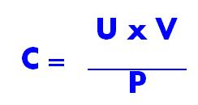
Clearance
U = Concentration of the substance in urine.
V = Volume of urine in ml excreted per minute.
P = Concentration of the substance in plasma

Slide 25
Creatinine Clearance Test
Creatinine is an excretory product derived from creatine phosphate.
The excretion of creatinine is rather constant & is not influenced by body metabolism or dietary factors.
Creatinine is filtered by the glomeruli & only marginally secreted by the tubules

Slide 26
GFR Significance
State | Grade | GFR ml/mt/1.73m²
Minima damage with normal GFR | 1 | >90
Mild damage with slightly low GFR | 2 | 60-89
Moderately low GFR | 3 | 30-59
Severely low GFR | 4 | 15-29
Kidney failure | 5 | <15

Slide 27
Cockroft Gault Formula
Creatinine Clearance =(140-age)* weight in kg / S.creat.*72
(multiplied by 0.85 for females)
MDRD Nomogram
GFR(ml/min)=170*S.creat.^{-0.999} *age^{-0.176} * BUN^{-0.170} *albumin^{0.318}
(multiplied by 0.742 if female)

Slide 28
Urea Clearance Test
Urea is the end product of protein metabolism.
After filtered by the glomeruli, it is partially reabsorbed by the renal tubules.
Urea clearance is less than the GFR & it is influenced by the protein content of the diet.
Urea clearance is not as sensitive as creatinine clearance

Slide 29
Tests for tubular function
Urine Concentration Test
The ability of the kidney to concentrate urine
This test requires a water deprivation for 14 hrs in healthy individuals.
A specific gravity of > 1.02 indicates normal concentrating power.
Specific gravity of 1.008 to 1.010 is isotonic with plasma and indicates no work done by kidneys.
The test should not be performed on a dehydrated patient

Slide 30
TFT
Vasopressin Test
Urine Dilution (Water Load) Test
After overnight water deprivation patient is asked to take 1200ml of water in half hour, urine specific gravity is measured in samples collected over next 4 hours. At least one sample should show sp gr of 1.003 or below
The test should not be done if there is oedema or renal failure; water intoxication may result

Slide 31
TFT
Para Aminohippuric Acid Clearance
PAH is unique in that it is completely excreted in one passage through kidney as it is both filtered and secreted
Maximum secretory capacity of tubules for PAH is nearly constant at about 80mg/min.
A decrease in the Tm_{PAH} indicates tubular damage

Slide 32
TFT
Acidification test
In this the ability to acidify urine is tested after administering 0.1g/kg ammonium chloride gelatin coated samples

Slide 33
TFT
Micropuncturing
Micropuncturing various part of tubule and analysis of fluid for volume and composition.
Microcryoscopic study
Studying slices of renal tissue at different depths.
Microelectrode study
Measuring membrane potential of the tubular cells

Slide 34
Enzymes in urine
useful in detection of acute renal damage specifically, proximal tubular damage
Cytosolic lactate dehydrogenase (LDH)
proximal tubular brush border enzymes
alanine aminopeptidase (AAP)
leucine arylamidase
gamma glutamyl transferase
alpha-glutathione S-transferase
distal tubular enzyme
rat tau-glutathione S-transferase
lysosomal enzyme
N-acetyl-beta-glucosaminidase (NAG)

