Slide 1
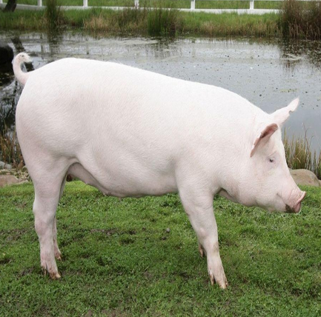
Stephanurus dentatus
Dr. AJIT KUMAR
Department of Veterinary Parasitology
Bihar Veterinary College
Bihar Animal Sciences University
Patna-800014
Image source: Google image

Slide 2
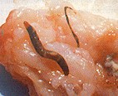
Stephanurus dentatus
Family : Stephanuridae
Common name: Kidney worm of
Pig

Slide 3
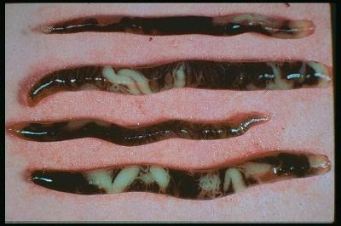
Stephanurus dentatus
General Characters:
Stout worms with mottled appearance.
Male is 20-31mm whereas female is 20-45 mm long.
Buccal capsule is cup-shaped with cusp shaped teeth
Body has transparent cuticle through which the internal organs may be seen.
Both external and internal leaf crowns are present
Ellipsoidal shape thin shelled egg
Egg

Slide 4
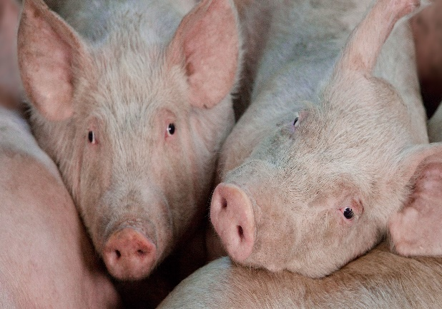
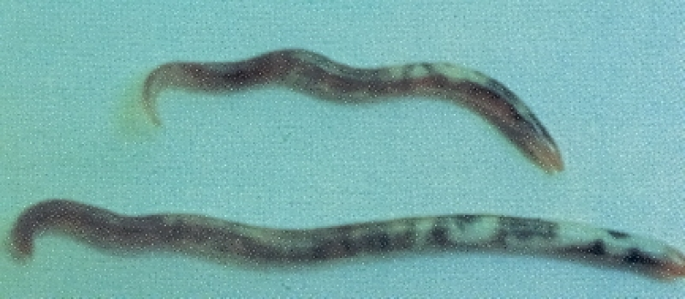
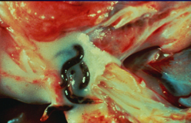
Stephanurus dentatus
Final Hosts :Pig
Location: Perirenal fat, pelvis of kidney and ureter

Slide 5
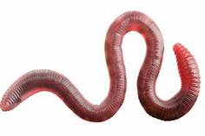
Stephanurus dentatus
Life-cycle:
Direct life-cycle
Infective stage : 3rd stage larva (L₃)
Transport host: Earthworm
Earthworm

Slide 6
Stephanurus dentatus
Transmission:
Final host (pig) gets the infection -
by ingestion of free L₃ with food and water
by the ingestion of infected earthworm (transport host)
Percutaneous ( through skin penetration)
Prenatal mode of infection

Slide 7
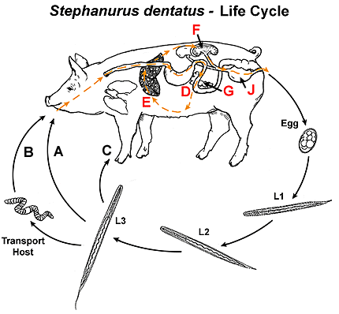
Stephanurus dentatus
Life-cycle:

Slide 8
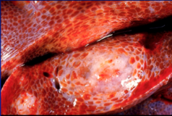
Stephanurus dentatus
Pathogenesis:
Pathogenesis mainly caused by larval stage
Subcutaneous nodules formation
Severe cirrhosis
Enlargement of superficial lymph glands
Ascitis
Lungs, spinal cord, muscles are also affected due to erratic migration of L₃ from liver
Adult worms form cysts in the perirenal tissues and kidney
Ureter may be thickened and occluded
S.dentatus in perirenal fat
S. dentatus caused lesions in liver

Slide 9
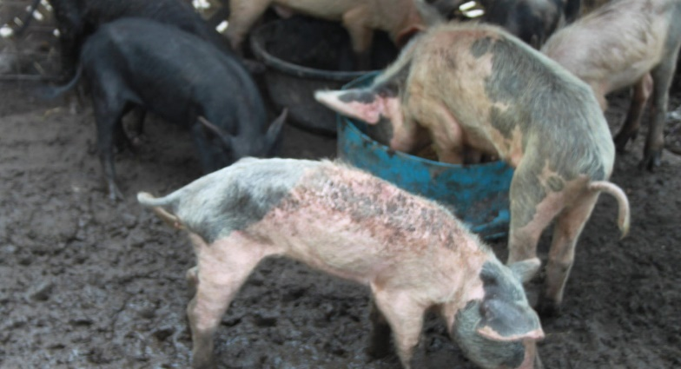
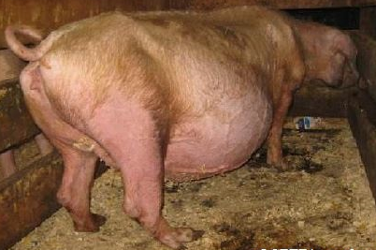
Stephanurus dentatus
Clinical signs:
Stephanurus dentatus infection leads to
Sever weight loss
Accumulation of fluid in peritoneal cavity ( Ascitis)
Death of infected pig in acute condition
Emaciated pig
Ascitis

Slide 10
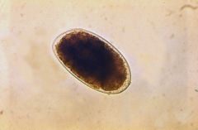
Stephanurus dentatus
Diagnosis:
On the basis of symptoms.
Microscopic examination of urine reveals eggs of worm.
Eggs are ellipsoidal in shape with thin shelled egg
EGG

Slide 11
Stephanurus dentatus
Treatment :
Ivermectin @ 0.3 mg/kg body weight
Levamisole
Fenbendazole
Thiabendazole

Slide 12
Stephanurus dentatus
Control:
Deworming of pigs
Proper disposal of urine
Prevent ingestion of earthworms.
Since patency of Stephanurus dentatus does not usually occur until animals are two years old . A policy of ‘gilt only’ breeding in which gilts are bred only once and then sold before kidney worms develop to maturity.

Slide 13
THANK YOU

