Slide 1
Antifungal Agents (Part-I) (Lecture-1 : Dated 12.05.2021)
Dr. Nirbhay Kumar
Asstt. Professor & Head
Deptt. of Veterinary Pharmacology & Toxicology
Bihar Veterinary College, Bihar Animal Sciences University, Patna

Slide 2
Antifungal drugs
Fungicidal drugs: Destroy parasitic fungi.
Fungistatic drugs: Prevent growth and multiplication of fungi.

Slide 3
Characteristics of Fungi
Eukaryotic cells.
Nutrition: Saprophytic or parasitic.
Fungi exist either in -
- A unicellular yeast form (Candida, Cryptococcus) or
As a multicellular, filamentous, mould colony (Aspergillus, Microsporum, Trichophyton, Mucor, Rhizopus).
Several types of fungi can assume either form depending upon environmental conditions (Blastomyces, Histoplasma, Coccidiodes, Sporothrix).
Fungal Cell Wall: Composed primarily of polysaccharide.
Fungal cell membrane: Lipid bilayer whose principal lipid is ergosterol and contains enzymes necessary for normal function.

Slide 4
Diseases caused by fungi
[I]. Superficial Infections:
Dermatomycoses: Infections of the skin, hair and nails (onychomycosis). Most commonly caused by Trichophyton, Microsporum or Epidermophyton, giving rise to various types of 'ringworm' or tinea.
Superficial candidiasis: Yeast-like organism may infect the mucous membranes of the mouth or vagina (thrush), or the skin.
[II]. Subcutaneous/ Regional Lesions: Myecetomas, Chromomycosis, Zygomycosis, Phycomycosis, Sporotrichosis and Rhinosporodiosis.
[III].Systemic Fungal Infections: Blastomycosis, Histoplasmosis, Coccidiomycosis, Cryptococcosis, Aspergillosis.

Slide 5
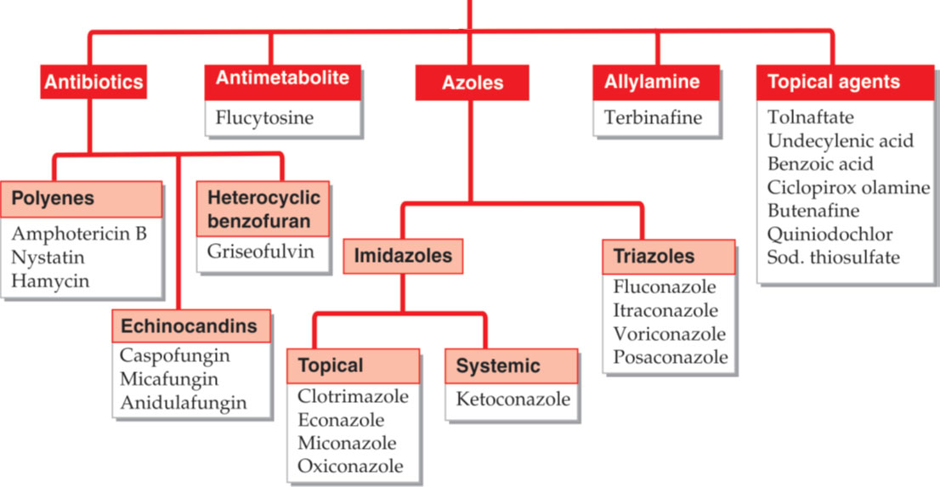
Classification of Antifungal Agents

Slide 6
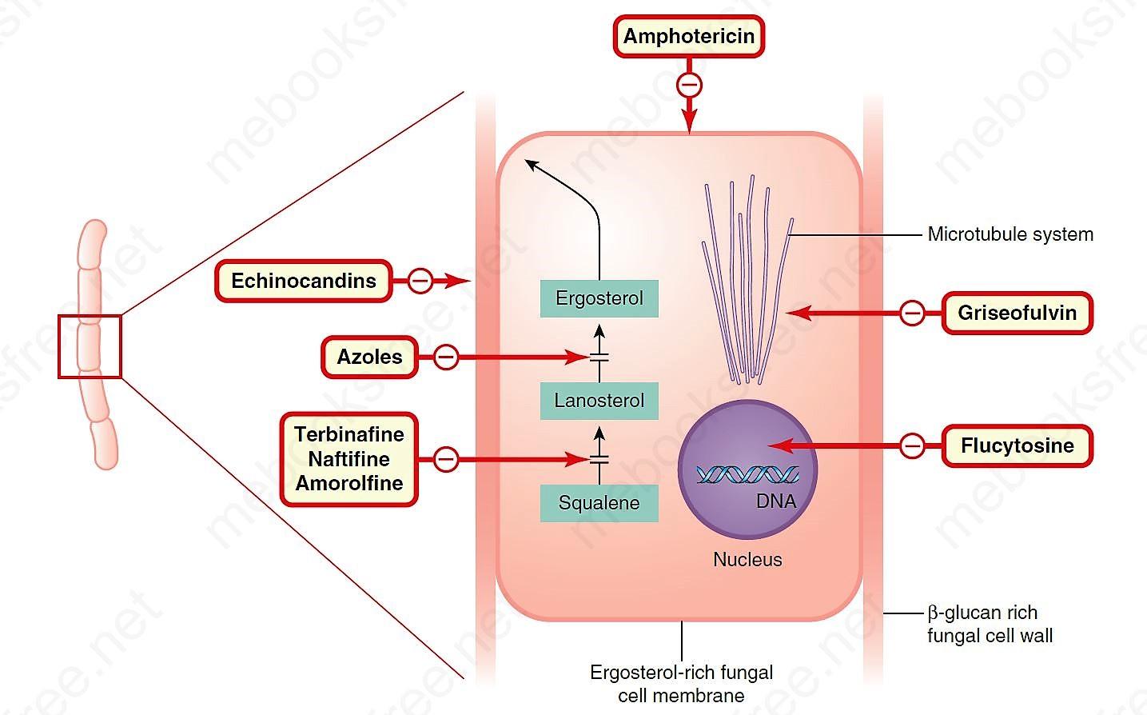
Sites of action of antifungal drugs
Source: Rang & Dale’s Pharmacology, 9th Edn.

Slide 8
To be continued in next class

Slide 9
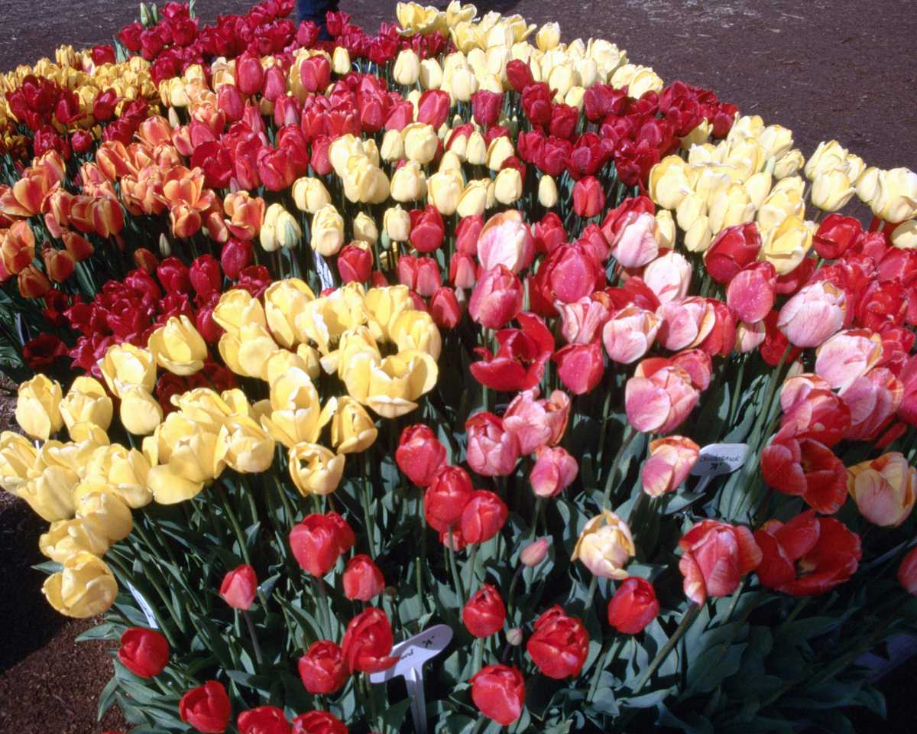
Thank You

