Slide 1
Antifungal Agents (Part-II) (Lecture-2 : Dated 19.05.2021)
Dr. Nirbhay Kumar
Asstt. Professor & Head
Deptt. of Veterinary Pharmacology & Toxicology
Bihar Veterinary College, Bihar Animal Sciences University, Patna

Slide 2
Antifungal Antibiotics

Slide 3
Griseofulvin
Produced by Penicillium griseofulvum.
Mechanism of action: Fungistatic.
- Interferes with mitosis.
- Disrupts the mitotic spindle.
- Results in multinucleated and stunted fungal hyphae known as ‘Curling phenomenon’.
- Daughter nuclei fail to move apart.
- Disorients the microtubules.

Slide 4
Griseofulvin contd…
Antifungal spectrum:
Dermatophytosis: Microsporum spp.,
Trichophyton spp. & Epidermophyton spp.
but not against Candida and other fungi causing deep mycosis.
Uses:
- Used systemically. Ineffective topically.
Since Griseofulvin is a fungistatic drug, cure depends on the shedding of the infected layers : thus dosing must continue for long enough to allow this to occur.
Small animals : 3 to 4 weeks.
Man : Body skin- 3 weeks; palm & sole- 4 to 6 weeks; finger nails- 4 to 6 months, toe nails- 8 to 12 months.
Griseofulvin should be reserved for cases with nail, hair, or large body surface involvement.

Slide 5
Amphotericin B
A polyene antibiotic
Obtained from Streptomyces nodosus.
Mechanism of action: Fungicidal.
- All polyenes share a common mechanism of action.
- Binds to ergosterol in the fungal plasma membrane.
- Increased permeability results, leakage of cell electrolytes, resulting in cell death (Fungicidal action).
- The selective toxicity of amphotericin B is based on its decreased binding to the major cell membrane sterol of mammalian cells (cholesterol) as compared to that of fungal cells (ergosterol).

Slide 6
Amphotericin B contd…
Antifungal spectrum:
Active against a wide range of yeasts and fungi:
Candida albicans Coccidiodes immitis
Histoplasma capsulatum Torulopsis spp.
Cryptococcus neoformans Rhodotorula spp.
Blastomyces dermatitidis Aspergillus spp.
Sporothrix spp.
- Ineffective against Dermatophytes (ringworm).
- Amphotericin B is also active against species of Leishmania.

Slide 7
Amphotericin B contd…
Toxicity:
- Acute reaction: Chills, fever, aches, and pain all over, nausea, vomition and dyspnoea.
- Long term toxicity: Nephrotoxicity is most important. Azotaemia, reduced glomerular filtration rate, acidosis, hypokalaemia and inability to concentrate urine.
- Slow progressive anaemia is also seen due to bone marrow suppression.

Slide 8
Amphotericin B contd…
Uses:
Amphotericin B is most effective drug for various types of systemic mycosis and is the gold standard of antifungal therapy.
However, because of higher toxicity of amphotericin B, azole antifungal agents are now preferred in conditions where their efficacy approaches that of amphotericin B.
Leishmaniasis – It is a reserve drug for resistant cases of Kala azar and mucocutaneous leishmaniasis.
Drug Interactions: Flucytosine has supra-additive action with amphotericin B in case of fungi sensitive to both. [Amphotericin B increases the penetration of 5-FC into the fungal cells.]

Slide 9
Nystatin
Obtained from Streptomyces noursei.
Mechanism of action : Similar to amphotericin B.
It is mainly used to treat Candidiasis.
It is more toxic than amphotericin B but preferred topically over amphotericin B.
Administration – Topical. No absorption orally.
Not effective against dermatophytes.

Slide 10
Echinocandins
Mechanism of action: Inhibit the synthesis of 1,3-β-glucan, a glucose polymer that is necessary for maintaining the structure of fungal cell walls. In the absence of this polymer, fungal cells lose integrity and lysis quickly follows.
Caspofungin (Obtained from Glarea lozoyensis) : Effective in treatment of candidiasis and forms of invasive aspergillosis that are refractory to amphotericin. It is given intravenously, once daily.
Micafungin (Obtained from Coleophoma empedri).
Anidulafungin (Semisynthetic, Obtained from Aspergillus nidulans).

Slide 11
Synthetic Antifungal Agents

Slide 12
FLUCYTOSINE (5-Fluorocytosine or 5-FC)
Synthetic antifungal agent.
Mechanism of action: Fungistatic
- A pyrimidine antimetabolite.
- Ineffective as such (Prodrug).
- Taken up by the fungal cells ⇨ converted to the active form, 5-fluorouracil by the fungal cytosine deaminase enzyme.
- 5-FU is either incorporated in RNA disrupting protein synthesis or is converted to a related compound which inhibits DNA synthesis.
- Mammalian cells are deficient in cytosine deaminase enzyme.

Slide 13
5-FC contd…
Antifungal spectrum:
- It is a narrow spectrum fungistatic active against Cryptococcus neoformans and certain species and strains of Candida.
Uses:
- Not employed as the sole therapy. Rapid development of resistance limits its utility in deep mycosis.
- Flucytosine is used as adjunct therapy with Amphotericin B in systemic infections caused by Candida or Cryptococcus neoformans.
Synergy between two medications.

Slide 14
AZOLE ANTIFUNGAL AGENTS
Fungistatic agents.
Broad spectrum of activity.
IMIDAZOLES:
Clotrimazole Econazole Fenticonazole
Ketoconazole Miconazole Tioconazole
Sulconazole Isavuconazole Posaconazole
TRIAZOLES:
Itraconazole Voriconazole Fluconazole

Slide 15
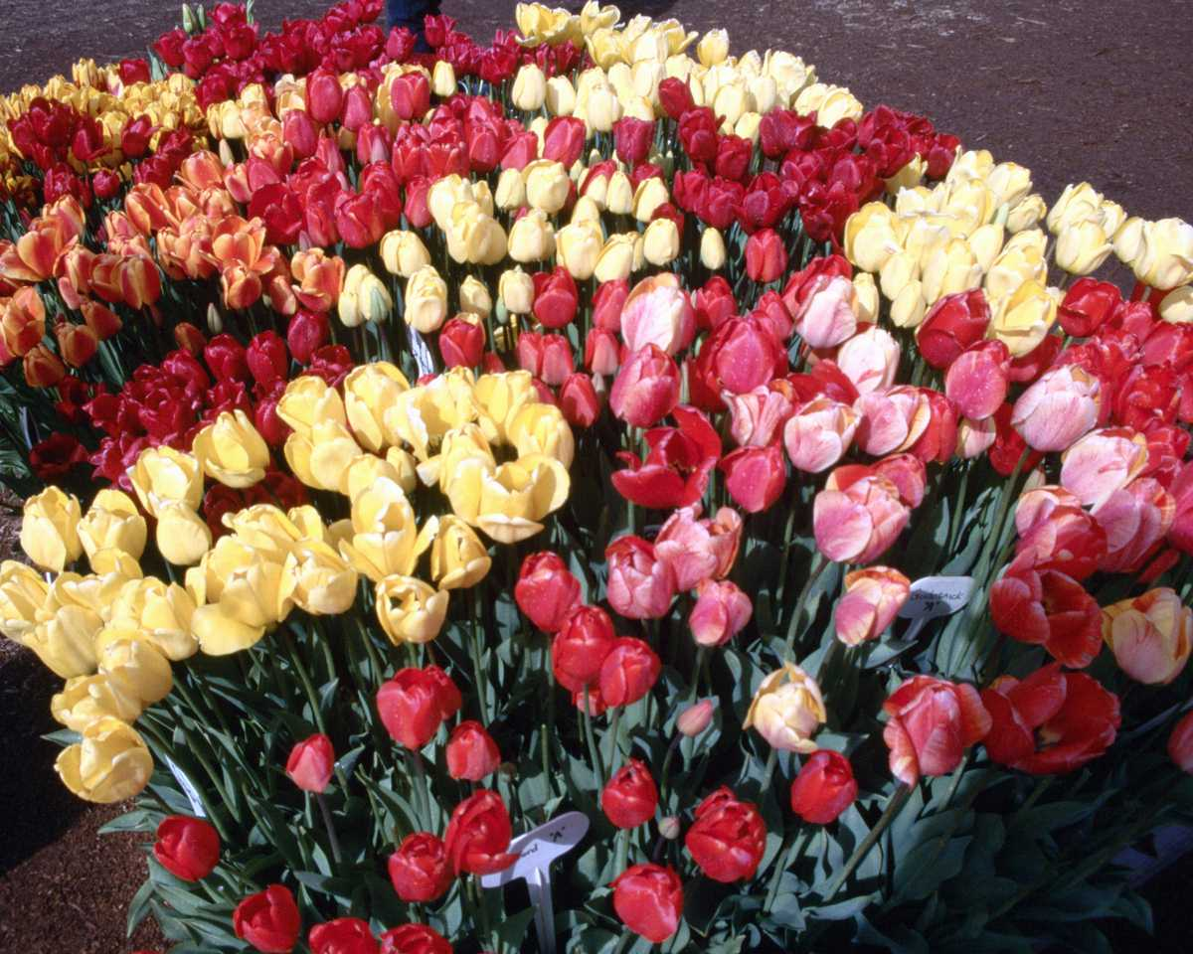
Thank You

