Slide 1
VACCINATION IN RUMINANTS
Dr. Anil Kumar
Asst. Professor
Dept. of VCC, BVC(BASU), PATNA

Slide 2
Vaccination is practice of administration of killed, mild or attenuated microbes in order to stimulate immune system against wild form of infection thereby preventing infection
Types of vaccines:
Based on importance of disease, vaccines are divided into three categories (Tizard, 2013):
Essential or core vaccine: Vaccines which protect against common, dangerous disease with significant morbidity and mortality.
Optional or non-core vaccines: Disease for which risk is low
Special vaccine: Vaccines that may have no application in routine vaccination but may be used under very special cases.

Slide 3
BASED ON VIRULENCE

Slide 4
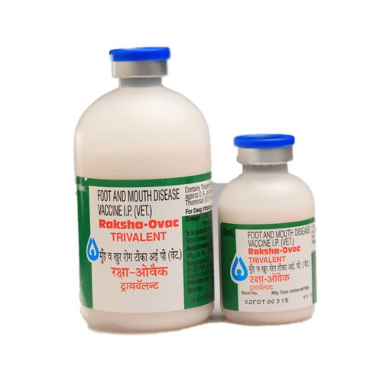
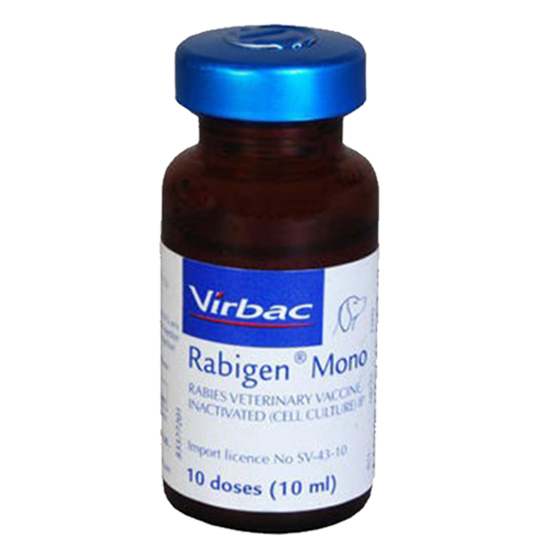
Points to be noted during vaccination
Good health at the time of vaccination
The cold chain of the vaccines
The manufacturers’ instruction
A minimum vaccination coverage of 80% of population is required for proper control of the disease.
De-worm the animals 2-3 weeks before vaccination for better immune response.
Vaccinate animals at least a month prior to the likely occurrence of the disease.
In advanced pregnancy may be avoided even though in most cases nothing untoward may happen.

Slide 5
Side effects of vaccination :
Transient swelling at the site of injection and a reaction that may change coat colour in the area
Coughing after nasal administration
Transient pyrexia (fever)
Respiratory distress, salivation, vomiting, diarrhoea, urticaria
Reduced fertility, foetal deformities and abortion
Excretion of vaccine virus, which may affect other animals in the herd that are susceptible, e.g. spread of vaccine virus in pigs from fatteners to breeder
Source: Rev. sci. tech. Off. int. Epiz., 26 (1)

Slide 6
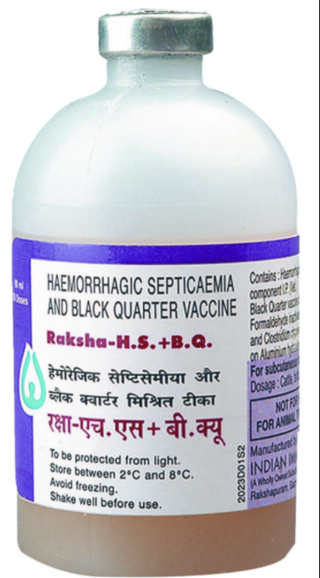
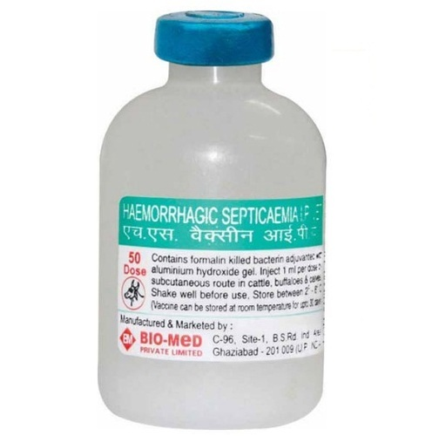
Most common reasons for vaccination failure
Lack of maintenance of cold chain
Poor immune response (weak and improperly fed animal)
Lack of herd immunity due to only a few animals being vaccinated.
Poor quality of vaccine (Rapidly thawing and cooling)
Low efficiency or ineffective vaccine – May occur in case of strain variation (eg. FMD).

Slide 7
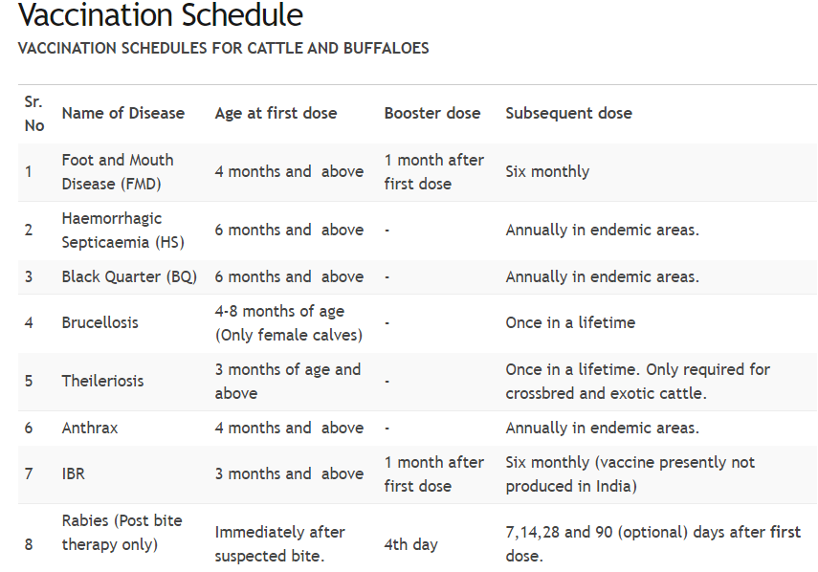

Slide 9
