Slide 1
PATR-II
VITAMIN D DEFICIENCY DISEASES
Unit-3
Dr. Anil Kumar
Assistant Professor, VCC, BVC, BASU,PATNA

Slide 2
RICKETS
Rickets is a disease of young growing animals caused by impaired mineralization of physeal and epiphyseal cartilage during endochondral ossification and of newly formed osteoid
Rickets is a metabolic bone disorder caused either due to deficiency of :
Vitamin D
Calcium or phosphorus in diet or
Due to malabsorption of these elements from intestine AND ultimately leading to softening and weakening of the bones
The most common causes of rickets and osteomalacia in animals are dietary deficiencies of vitamin D or phosphorus.
Note: Osteoid- is the unmineralized, organic portion of the bone matrix that forms prior to the maturation of bone tissue.

Slide 3
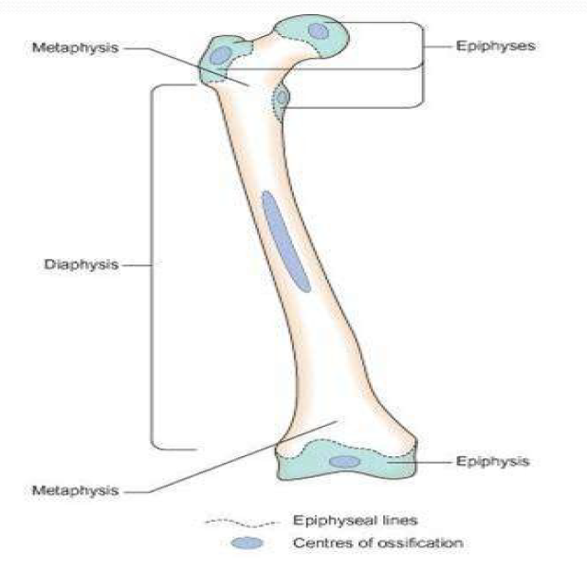
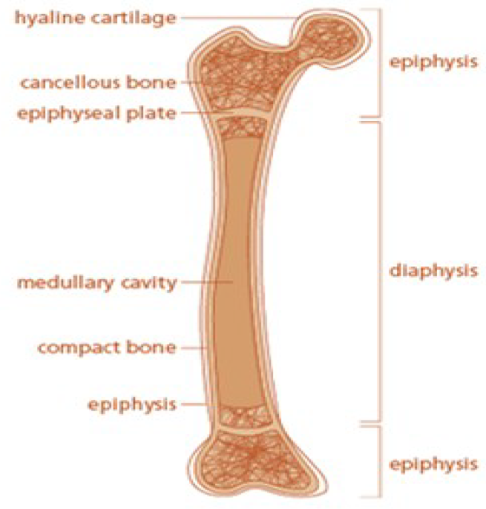

Slide 4
Genetic defects (sheep, pigs and domestic cats including Human)
The overall homeostasis of calcium and phosphorus are regulated by: PTH, the vitamin D endocrine system and FGF23 (phosphatonin fibroblast growth factor 23).
In Calves phosphorus and Vitamin D deficiencys the most common form of rickets in cattle raised indoors for prolonged periods
Horses are less dependent on vitamin D for intestinal absorption of calcium, which may contribute to rickets/osteomalacia being relatively rare in equids, although fibrous osteodystrophy is comparatively common
Vitamins D2 and D3 are biologically inactive and must undergo two hydroxylation reactions to be activated:
The Vit. D3 25-hydroxylation occur in –Liver by cytochrome P450, then after transportation to Kidney
second 1alpha-hydroxylation takes place in PCT in kidney 1,25-dihydroxyvitamin D3, the active form of vitamin D

Slide 5
PTH also has a 2 major role:
Stimulation of bone breakdown by osteoclasts
Potent inducer of renal synthesis of 1,25(OH)2D3, an active form of Vit. D and helps in stimulates active intestinal absorption of calcium
In the cat and dog, the dermal concentrations of 7-dehydrocholesterol (7-DHC) are too low to produce vitamin D through UVB exposure and they are more dependent on their carnivorous diet, which contains good sources of:
vitamin D (blood, fat)
phosphorus (meat) and
calcium (bones).

Slide 6
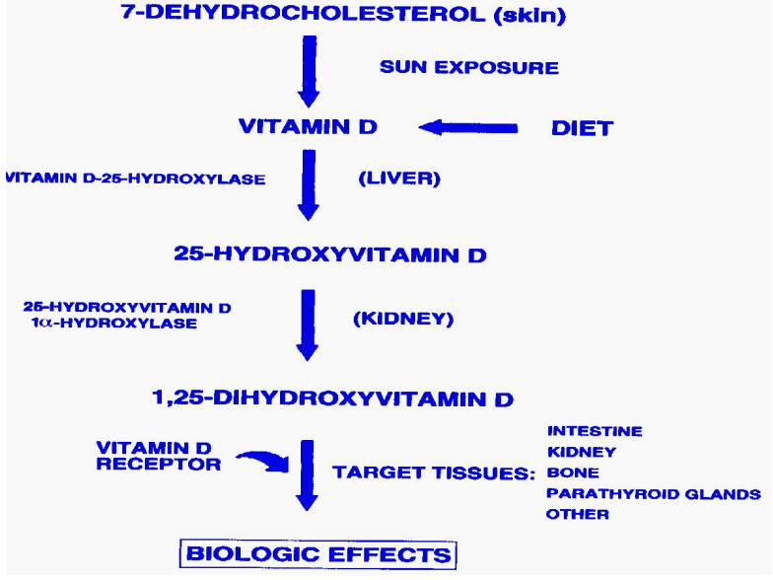

Slide 7
PATHO-PHYSIOLOGY OF RICKETS
Deficiency of Vit. D/ Deficiency of Calcium in Diet
Decreased absorption of Calcium from Gut
Hypocalcaemia/Hypocalciuria
Stimulation of PTH
Mobilization of Ca from bone, Decrease phosphorous re-sorption from Kidney leading to Phosphateuria and Hypophosphatemia
Negative in Calcium and Phosphorous Balance
Disturbance in Bone metabolism and Mineralization leading to weak and thin bones
RICKETS

Slide 8
Clinical rickets is characterized by the following:
• Stiffness in the gait
• Enlargement of the limb joints, especially in the forelegs
• Enlargement of the costochondral junctions
• Long bones showing abnormal curvature, usually forward and outward at the carpus, in sheep and cattle
• Lameness and a tendency to lie down for long period

Slide 9
The lesions of rickets are found in multiple bones especially ofmetaphyseal and epiphyseal regions of the long bones and the costochondral junctions.
In animals with rickets, the growth plate is irregularly thickened, the cortex is thinned and the bones are poorly mineralized
Histologically two major features characterize rickets: expansion of the hypertrophic chondrocytes in the growth plate and accumulation of unmineralized bone matrix (osteoid)

Slide 10
POULTRY:
Rickets in modern birds usually occurs between 2 and 4 weeks of age.
Occurs due to disturbances in calcium, vitamin D or phosphorus metabolism secondary to dietary deficiencies
Poultry are also susceptible to tibial dyschondroplasia, and clinically characterized by lameness and leg deformities.
Clinically, there is :
Poor growth,
Weakness,
Lameness
Inability to stand and
Prominent valgus or varus deformations of the femur and/or tibiotarsus.

Slide 11
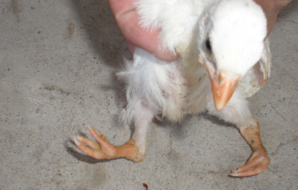

Slide 12
Cattle :
Mostly associated with phosphorus deficiency (‘stiff sickness’).
Cattle are considered more susceptible than sheep to phosphorus deficiency
Clinical signs included:
Osteophagia
Stiff or lame gait
Swollen joints and
Spontaneous fractures

Slide 13
Horse:---
Rickets is rare in horses.
Horses have higher serum calcium concentrations.
The normal levels of plasma vitamin D metabolites in the horse are lower than those inducing rickets in other species.
Pig:---
When dietary vitamin D is inadequate.
Barn designs that restrict exposure to sunlight have also been a factor in outbreaks.
Affected piglets may have muscle tremors, are lame and reluctant to move, preferring a dog sitting or in a hunched back posture, and can die suddenly from hypocalcemia; they have soft bones, enlarged costochondral junctions and growth plates, and both acute and chronic fractures can be present.

Slide 14
Dogs and Cats:--
Failure of both vascular invasion and mineralization in the area of provisional calcification of the physis.
Bone pain, stiff gait, swelling in the area of the metaphyses, difficulty in rising, bowed limbs, and pathologic fractures.
On radiographic examination, the width of the physes is increased, the non-mineralized physeal area is distorted, and the bone may show decreased radiopacity.
Lameness is the initial functional disturbance in growing dogs and may vary from a slight limp to inability to walk.
The bones are painful on palpation, and folding fractures of long bones and vertebrae are common

Slide 15
History
Diet deficient in Ca, P, and Vitamin D, winter season, type of grass/feed etc. may helpful for the diagnosis of rickets.
Clinical signs like stiffness of gait and enlargement of the distal physis of long bones mainly observed on metacarpus and metatarsal as a circumscribed painful swollen joints and bendings of bones are also helpful.
Biochemical estimation like Ca, P and alkaline phosphatase.
Radiographic examination:
Lack of density compared to normal
Widening of epiphyseal plate and epiphyseal line (Pathognomonic)
The epiphyseal ends of long bones have a woolly, moath eaten appearance, and have a concave or flat appearance instead of normal contour.
Diagnosis:--

Slide 16
Animals should provide rich calcium and Phosphorous diet like Fishmeal, meat meal and bone meal.
Adequate feeding of Ca, P and Vit. D preprations like dicalcium phosphate, shark-liver oil, calcium lactate(orally/IV), cod-liver oil or cotton seed (rich in P) is necessary.
Lamb: Vit. A and Vit. D and calcium borogluconate solution containing magnesium and phosphorous parenterally and supplementation of diet with bone meal and protein.
Vit. D therapy for rickets should be given 10-20 times of its daily requirement(700 IU for dogs; 1500IU for sheep, cattle, pig and horse dail).
In pups:
Providing organic meat such as liver, Kidney or heart.
Massage of long bones with oil containing Vit. A and D and putting them in sun light.
A good diet containing 1-1.2% calcium and 0.8-1% phosphorous, exercise and fresh air should be provided
Dogs of rachitic diathesis should not be used for breeding.
Treatment:

Slide 17
Vitamin D poisonings in animals can result from:
ingestion of plants
excess dietary supplementation
ingestion of rodenticides containing cholecalciferal(vitamin D3)
In vitamin D toxicity, intestinal calcium absorption is increased, as is mobilization of calcium from the bone, while excretion from the kidney is reduced
The result is hypercalcemia and hyperphosphatemia, which, if chronic, results in soft tissue mineralization AND Death from renal failure

Slide 18
Osteomalacia
Osteomalacia is a disease of mature animals affecting bones in which endochondral ossification has been completed and is characterized by lesion is osteoporosis and the formation of excessive uncalcified matrix (osteoid).
Lameness and pathologic fractures are the common clinical findings
ETIOLOGY:
Same as for Rickets except that the predisposing cause is not the increased requirement of growth but the drain of lactation, pregnancy, or both.
Its main occurrence is in cattle in areas seriously deficient in phosphorus.
In feedlot animals (indoors), excessive phosphorus intake without complementary calcium and vitamin D may lead condition

Slide 19
Pathogenesis:
Increased resorption of bone mineral to supply the needs of pregnancy, lactation, and endogenous metabolism leads to osteoporosis and weakness and deformity of the bones
Large amounts of uncalcified osteoid deposited around the diaphyses
There is role of fibroblast growth factor 23
CLINICAL FINDINGS
Ruminants:
Licking and chewing of inanimate objects begins at early stage
painful condition of the bones and joints with a stiff gait; lameness and often shifting from leg to leg
Crackling sounds while walking; and an arched back.
Hocks may be rotated inward

Slide 20
Disinclined to move, lie down for long periods, and are unwilling to get up
The colloquial names “pegle,” “creeps,” “stiffs,” “cripples,” and “bog lame for such syndrome.
Pigs:
Recumbent and unable to rise from lateral recumbency or from the dog-sitting position
The shaft of one femur or the neck of the femur is commonly fractured
Diagnosis:
Increased serum alkaline phosphatase and decreased serum phosphorus levels.
Radiographic examination of long bones shows decreased density of bone shadow.

Slide 21
OSTEODYSTROPHIA FIBROSA
It occurs in horses, goats, and pigs due to laid down of soft, cellular, fibrous tissue instead of the specialized uncalcified osteoid tissue of osteomalacia
Secondary nutritional hyperparathyroidism---in Equines
Renal hyperparathyroidism-----in Dogs
ETIOLOGY:
A secondary calcium deficiency resulting from excessive phosphorus feeding—in Horse and pigs
Tropical grasses contain oxalate, which interferes with mineral utilization by horses by forming calcium oxalate, which renders the calcium unavailable for intestinal absorption
The disease can be readily produced in horses on diets with a ratio of calcium : phosphorus of 1 : 2.9 or greater, irrespective of the total calcium intake

Slide 22
TREATMENT AND CONTROL:
A balanced ration with regard to calcium and phosphorus (calcium : phosphorus should be in the vicinity of 1 : 1 and not wider than 1 : 1.4) is preventive in horses
The affected animals can only be treated by correcting the existing imbalance.
Cereal hay may be supplemented with alfalfa or clover hay, or finely ground limestone (30 g daily) should be fed.
Dicalcium phosphate and bone meal are not as efficient because of their additional content of phosphorus.

