Slide 1
Biochemistry of Shock

Slide 2
Shock
Shock may be defined as a condition in which circulation fails to meet the nutritional needs of the cells and at the same time
A final common pathway for many potentially lethal clinical events (hemorrhage,trauma, burns, large MI, massive pulmonary embolism microbial sepsis) fails to remove the metabolic waste products
Shock is a physiologic event with many different causes; but if untreated it has a single clinical outcome

Slide 4
Types of Shock
Primary (INITIAL SHOCK)
Secondary (TRUE SHOCK)
Anaphylactic (Type I immunologic reaction)
True shock- circulatory imbalance between oxygen supply and oxygen requirements at cellular level; hence name CIRCULATORY SHOCK

Slide 5
Primary or Initial shock
transient and usually benign vasovagal attack resulting from sudden reduction of venous return to the heart caused by neurogenic vasodilatation and consequent peripheral pooling of the blood
It can occur immediately following
Trauma
Severe pain
Emotional overreaction due to
Fear
Sorrow and surprise
Sight of blood

Slide 6
Secondary (or) True shock
occurs due to haemodynomic derangements with hypoperfusion of the cells, this type of shock is the ‘true shock’.

Slide 7
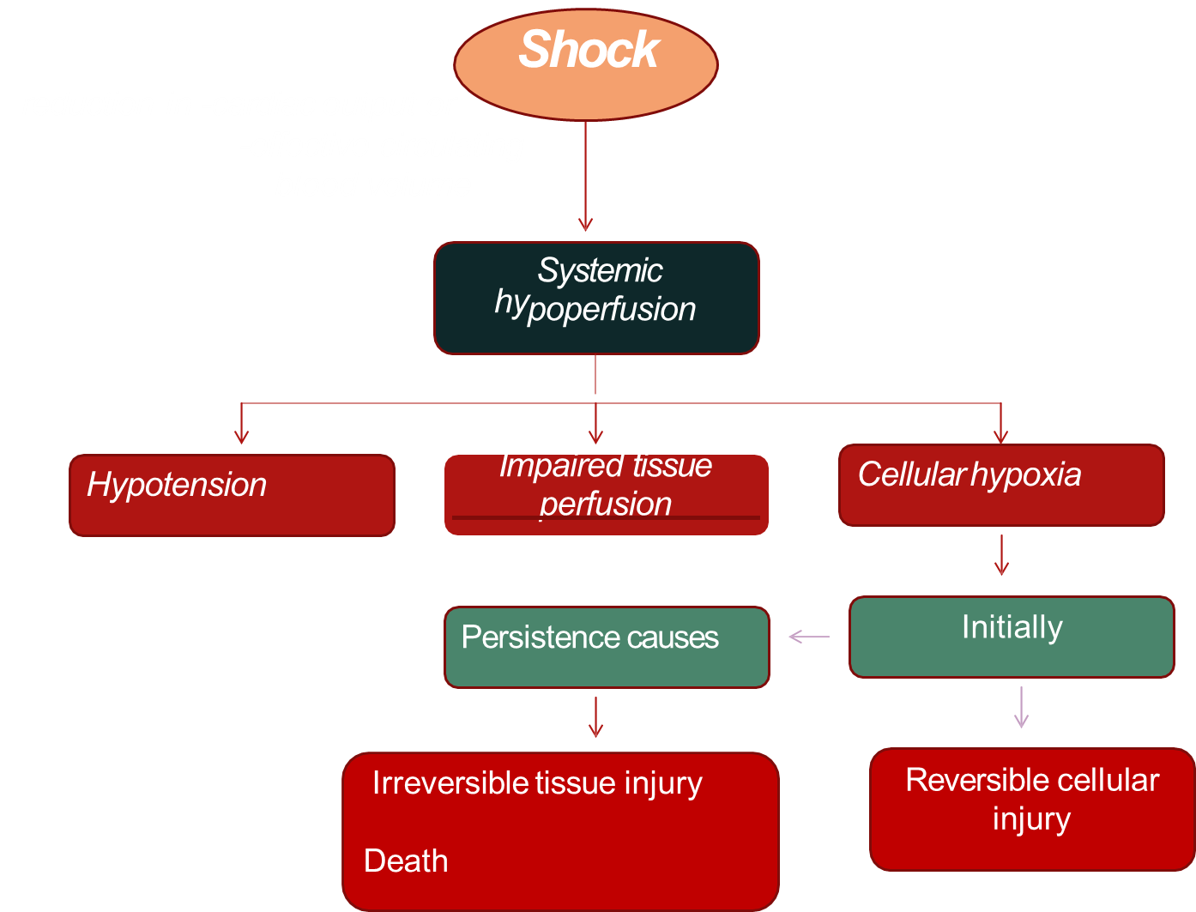

Slide 8
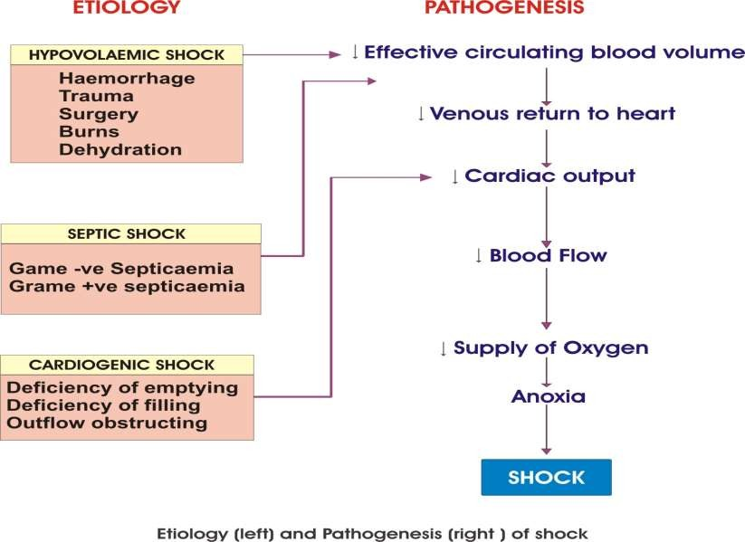

Slide 9
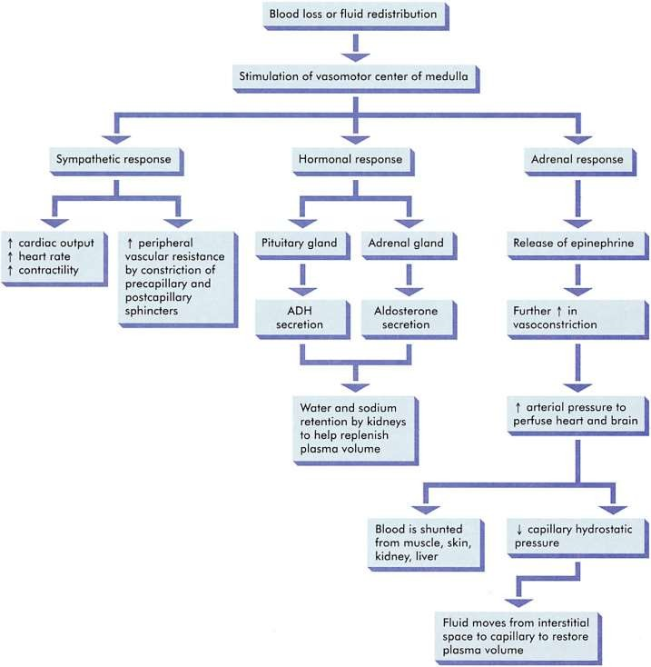
NON-PROGRESSIVE (INITIAL, COMPENSATED REVERSIBLE ) SHOCK

Slide 10
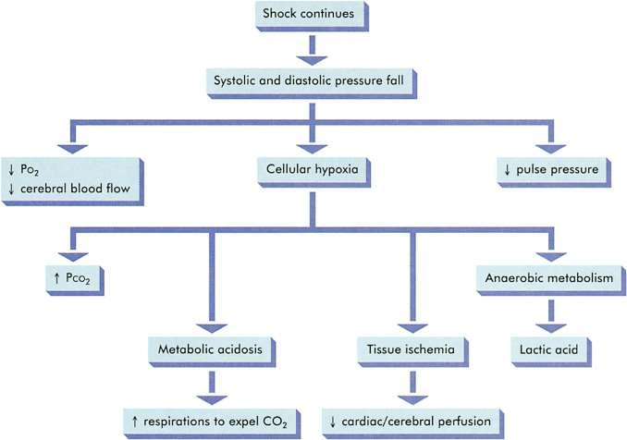
PROGRESSIVE DECOMPENSATED

Slide 11
EFFECT OF SHOCK
CARDIOVASCULAR
decrease of preload and afterload
Baroreceptor response
Release of catechol amines
Tachycardia and vasoconstriction.
RESPIRATORY
Metabolic acidosis
Inc. respiratory rate and excretion of carbon dioxide
Results in compensatory resp. alkalosis

Slide 12
RENAL and ENDOCRINE
decreased urine output
stimulation of renin angiotensin and aldosterone axis release of vasopressin from hypothalamus
resulting vasoconstriction and increase Na+ and water reabsorption

Slide 13
CELLULAR
Cells switch from aerobic to anaerobic metabolism → Decreased ATP production → lactic acidosis → Glucose exhausts and aerobic respiration ceases → Na+/ K+ pump impaired → Lysosomes release autodigestive enzymes → mitochondria damage → cell death

Slide 14
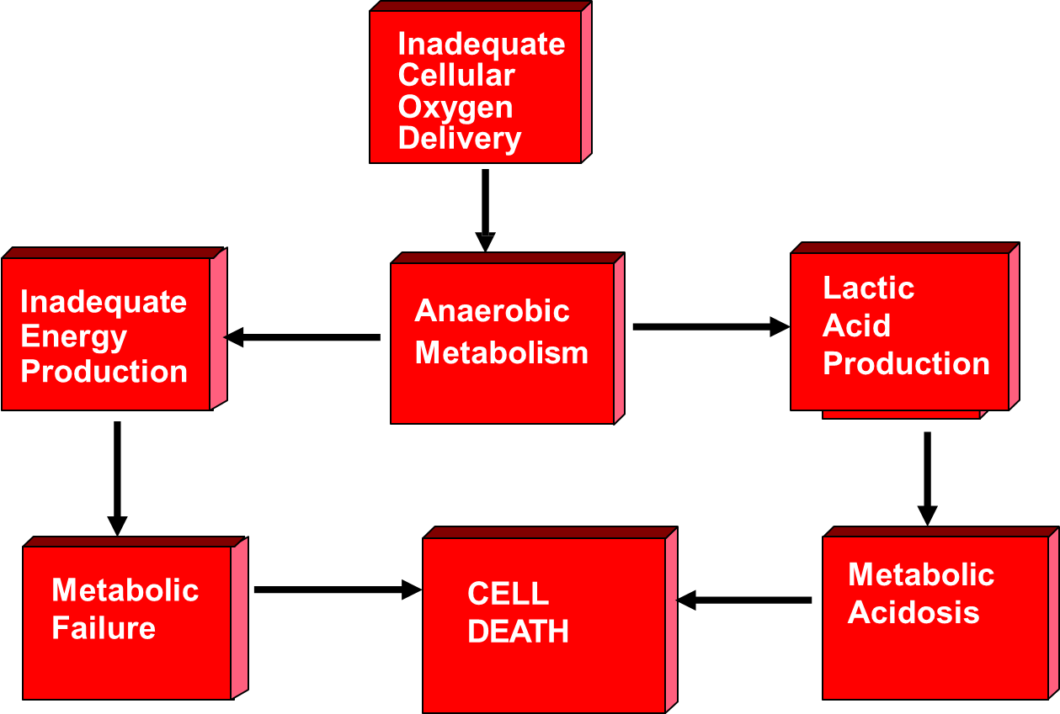
ULTIMATE EFFECTS OF ANAEROBIC METABOLISM

Slide 15
METABOLIC CHANGES IN SHOCK
CARBOHYDRATE METABOLISM
Compensated shock : Hyperglycemia due to increased hepatic glycogenolysis.
Decompensated shock : Hypoglycemia due to hepatic glycogen depletion & increased consumption of glucose by tissue.
Anaerobic glycolysis occurs as assessed by high blood levels of lactate & pyruvate

Slide 16
PROTEIN METABOLISM
Increased intracellular protein catabolism
Conversion of amino acids to urea.
Increased blood non-nitrogen protein.
FAT METABOLISM
Increased endogenous fat metabolism.
Rise of fatty acid level in blood.
WATER & ELECTROLYTE DISTURBANCES
Failure of sodium pump → potassium leaves the cell (hyponatremia)→ causes cellular swelling
Shock due to loss of plasma only (in burns) → hemoconcentration

Slide 17
METABOLIC ACIDOSIS
Hypoxia of kidney, renal function is impaired blood levels of acids like lactate, pyruvate, phosphate & sulfate rise causing metabolic acidosis.
MORPHOLOGIC COMPLICATIONS
Morphologic changes in shock are due to Hypoxia. resulting in degeneration & necrosis in various organ.
Organs affected are : Brain, Heart, Lungs, Kidneys, Adrenals and GIT

