Slide 1
Unit-II Digestive System
Digestive system-III
Course No. – VPB 1st Professional year
Credit Hrs. – 4+1=5
Date: 02.06.2021
Dr. Pramod Kumar
Asstt. Professor
Dept. of Veterinary Physiology
BVC, Patna

Slide 2
Pancreatic secretions:
Regulation- Pancreas secretion is divided into three phases
Cephalic phase:- Thought, sight, smell or taste of food produces the cephalic phase of pancreatic secretion. Enzyme secreted by the acinar cells are stimulated by enteric neurons releases from ACh (vagal stimulation) HCO3⁻ secreted by ductal cells stimulated by vagus nerves releases a non-cholinergic & non-adrenergic transmitter
Gastric phase:- This phase is enhanced during the distension & food breakdown products. Distension leads to secretion of HCO₃⁻ & enzymes through ACh (Antrum & corpus). When food breakdown occurs G-cells of the antrum releases gastrin, produces a low volume & high enzyme pancreatic secretion
Intestinal phase:- Major stimulants for pancreatic secretion are the hormones CCk & secretin. They are released from endocrine cells in the duodenum & jejunum. Both CCk & secretin along with potentiate the secretion of HCO₃⁻ & produce in significant amount

Slide 3
Composition- Pancreatic secretion consists of electrolytes & enzymes
Electrolytes: Na⁺ & K⁺ , HCO₃⁻ & H⁺ from the dissociated of H₂CO₃. It also contains small amounts of Ca₂⁺, Mg₂⁺, Zn₂⁺, HPO₄²⁻ (mono-hydrogen phosphate) & SO₄²⁻ (sulfate)
Enzymes: It consists of α-amylase which hydrolyzes glycogen, starch to disaccharides except cellulose in carbohydrate. Water soluble esters can be hydrolyzed through pancreatic lipases. Trypsinogen & chymo-trypsinogen is converted to trypsin by enterokinase.
Functions-
The endocrine cells secrete insulin, glucagon, somatostatin & pancreatic polypeptide.
The exocrine cells into acini produces 4 types of digestive enzyme peptidases, lipases, amylases & nucleases, which are responsible for the digestion of proteins, fats, carbohydrates & nucleic acids respectively.

Slide 4
The ductal cells consist of high concentration of HCO₃⁻ which neutralizes gastric acid & regulates the pH of upper intestine
Failure to neutralize the chyme & undergoes to intestine can cause duodenal ulcers.
Digestion in the ruminant stomach:
Ruminant stomach have microbial fermentation of the ingesta by hydrolysis & anaerobic oxidation
Microbes generate ATP for further hydrolysis & fermentation to absorb the end products i.e., VFA but in case of non ruminants, it is glucose
Ruminant stomach is highly vascularized & blood flow ↑^{es} when the absorption of end products are being going on
The innervations are by vagal & splanchnic nerves provides sensory & motor pathways

Slide 5
Mechanism of absorption of carbohydrates, protein & fat:
Ruminal microbes consists of yeast, fungi & mixed but independent population of bacteria
CH₂O in diet mainly consists of starch, sucrose, lactose & fiber
In the lumen, pancreatic α-amylase combines disaccharides & tri-glysaccharides & α-limit dextrins
Intra-luminal products of CH₂O digestion with the dietary disaccharides can`t be absorbed by the mucosa
It further breakdown into mono-saccharides being transported into the epithelial cells by Na-dependent co-transport & facilitated diffusion process & enters into the blood stream
Protein hydrolysis begins in stomach but digestion occurs in proximal small intestine

Slide 6
Amino acids, di-peptides & tri-peptides are the remaining products after pancreatic digestion
Peptides are further hydrolsed by brush border hydrolases (junction between intestinal lumen & cytoplasm)
10% of peptides escape hydrolysis & diffuse to baso-lateral membrane having neuro-active properties contains non nutritional value
Amino acids are absorbed by Na-dependent co-transport & diffuse across the baso-lateral membrane into the portal vein
Dietary fat consists of water insoluble triglycerides, emulsified in the stomach
In duodenum, pancreatic lipase acts at oil-water interface of the emulsion particles releasing β-monoglycerides & 2 free fatty acids (amphipaths)
Bile salts act as detergent & bring the water insoluble into micelle & get dissolved into micelle core in jejunum

Slide 7
Amphipaths- part polar-water insoluble & non polar-lipid soluble
Micelle (-vely charged aggregates)- to form micelles, need of bile acids & 2mM
Micelles diffuse from the emulsion particle to the brush border where fat releases for diffusion across the lipid membrane into cell
Fat soluble vitamins can only be absorbed when incorporated into micelle
Chylomicrons facilitate the transport of water insoluble triglycerides & without protein coat, fat is unable to leave the cell

Slide 8
Cellular fermentative digestion-
Due to low metabolic rate of cellulolytic bacteria, slow fermentation occurs
The pH optimum is 6.2 to 6.8 of cellulolytic bacteria (methanogenic bacteria)
It requires CO₂ & 2H (reducing equivalents) supplies to produce methane & amino acids supply to get their protein requirements
These mixed microbes leads to produce VFA, CO₂ & CH₄
Fermentative digestion of Starch:
Starch & simple sugar degradation is performed by various primary amylolytic bacteria
These bacteria`s have faster fermentative rates & low pH optimum 5.5 to 6.6
These bacteria`s require NH₃ & amino acid for synthesis of protein

Slide 9
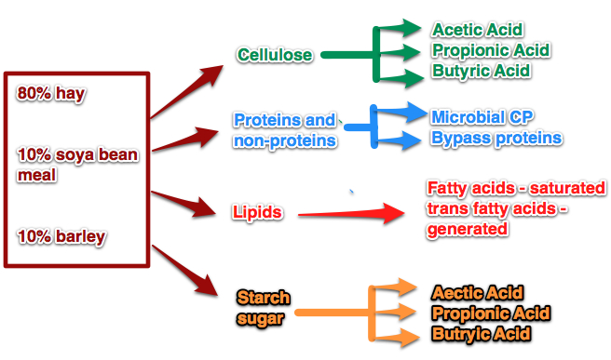

Slide 10
Fermentative digestion of Protein:
Proteolytic bacteria degrades 15 to 35% of dietary protein in the rumen
Bacterial proteolysis produce peptides which are absorbed & further hydrolyze within the cell of bacteria
End products are amino acids taken up by some other microbes & rest are used to produce ammonia & certain metabolic acids
These end products are further fermented to VFA`s required as nutrition for cellulolytic bacteria
After conversion of dietary & NPN compounds & de-amination, results in production of ammonia
Ammonia is an important substrate for microbial protein synthesis to provide the energy needed for the synthetic reaction
During fermentation of dietary protein, recycling of dead microbes protein is continues

Slide 11
Fermentative digestion of Lipids:
Ruminal microbes hydrolyze dietary lipids, using the unsaturated fatty acids as hydrogen acceptors which converts mostly into stearic acid
From VFA`s ruminal microbes synthesize microbial lipids
Protozoa absorb few of poly-unsaturated fatty acids (PUFA) in their own structure to protect them from hydrogenation
During intestinal digestion, the protozoa`s which comes from the rumen, release their content of PUFA as the main source for ruminants
Absorption of food stuffs:
VFA`s- It is absorbed by passive diffusion through the granulosum cells of the fore-stomach epithelium
Lactic acid- It is also absorbed by fore-stomach epithelium

