Slide 1
Unit-II Digestive System
Digestive system-IV
Course No. – VPB 1st Professional year
Credit Hrs. – 4+1=5
Date: 03.06.2021
Dr. Pramod Kumar
Asstt. Professor
Dept. of Veterinary Physiology
BVC, Patna

Slide 2
Digestion in Birds:
Regulation of food intake-
It is a complex process & involves both peripheral & central control regulation
Peripheral regulation involves the GI tract and liver
Crop and gizzard monitored the ingestion of food by distention sensitive receptors
Meal termination is associated by distention of gizzard less by crop
For the termination of feeding in the crop and intestine various receptors act like glucose, osmotic and intestinal amino acid when stimulated by glucose, hypertonic saline or amino acids
By the hepatic portal blood system, liver absorbs the nutrient from the intestinal tract
The information regarding absorption is communicated by brain via signals through the vagus nerve
For ingestion of food CCk, bombesin, gastrin and neurotensin peptides are responsible, produced by the avian intestinal tract

Slide 4
Central regulation of food intake includes the systems:
Sl No. | Nerves | systems
1 | Trigeminal | Mandibulation
2 | Gustatory | Taste
3 | Olfactory | Smell
4 | Visual | See or sight
5 | A.N.S. | Parasympathetic division

Slide 5
Cholecystokinin and melatonin acts as reduction factor for food intake while ↑^{ed} temperature, ↑^{ed} energy diet level & ↑ protein diet levels also act as external factors.
Gastro-intestinal tract motility:
Food is swallowed by the stimulation of the tongue & muscles reflex causes entering into the esophagus by peristalsis
For gastro-duodenal contraction, a sequence of 3 rhythmic/minute occurs which contracts the ventriculus & passes the peristaltic waves through the duodenum,
Contraction of gizzard muscles occur causes contraction of pylorus & isthmus
The esophagus, crop, pro-venticulus & gizzard are innervated by vagal nerves
Colonic motility occurs continous & are anti-peristalsis causes
(a) movement of urine from the cloaca into colon & ceca for absorption of H₂O
(b) filling of the ceca

Slide 6
This anti-peristalsis contraction ceases just before defecation
The rate of food passage is influenced by the consistency, fat content, hardness, water content of the food & amount absorb
Likewise, the age & the metabolic rate is associated with them are also the factors which influenced the food passage rate
The slower rate of food passage is directly related with the ↑^{ed} microbial fermentation of fibrous feed stuffs in the ceca & thus utilizes its extreme in the adult birds.
Secretion & Digestion:
Only mucus is secreted in the buccal cavity and crop which tends to moistens & lubrication of the food
Hence, starch digestion occurs in the crop. Amylase is secreted in very few amounts for carbohydrate digestion
In pro-venticulus, simple mucosal gland secrete mucus & compound sub-mucosal glands secrete mucus as well as HCl & pepsinogen

Slide 7
Compound glands = chief + parietal cell of the mammalian stomach
The protein digestion initiates in ventriculus in acidic medium
Pro-venticulus secrete pepsin which hydrolyses protein molecules
Gizzard breakdown the food material into small pieces & mixes with digestive fluids
The pH ranges between 0.5 to 2.5
Almost 1 ml of gastric juice/Kg b.wt./hour is secreted by poultry
Chemical digestion starts in the large intestine
Exocrine cells of the pancreas in the intestinal lumen & membrane digestion of saccharides occurs via the action of digestive enzyme
The large protein molecules hydrolyze into oligo-peptides & di-peptide fragments by the secretion of pancreatic trypsin, chymotrypsin in the intestinal lumen

Slide 8
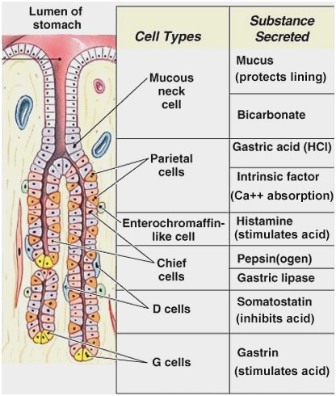

Slide 9
The free amino acids being released by the pancreas & aminopeptidase in the brush border membrane of enterocytes transported to microvillus membranes & perform membrane hydrolysis of oligopeptide & dipeptide fragments
Pancreatic α-amylase in the intestinal lumen cleaves maltose units leaving α-dextrins limit in amylopectin
Maltose, maltotriose & α-limit dextrins are water soluble & diffuse through an aqueous dispersion of mucin absorbed by the glycocalyx covering the microvilli of enterocytes
Maltose & sucrase-isomaltose in the apical membranes hydrolyse into glucose & absorbed by enterocytes
The mucin layer protects the enterocyte from the degradation by pancreatic proteases
Intestinal pH ranges from 5.6 to 7.2
Bile salts emulsify the fat particles for their further digestion and reabsorbed in the lower ileum & re-circulated to the liver to be used again as in mammals

Slide 10
The proximal ceca has the ability to transport mono-saccharides & amino acids against a concentration gradient
Microbial digestion of cellulose also occurs in the ceca
Reflex of urine into ceca exposes the cecal microflora to urea & uric acid for degradation
Cecal microflora uses the recycled nitrogen
Microbial synthesis of vitamins-B occur in the ceca but are not absorbed by the bird
So, feces of chickens are the source of vitamin B₁₂ & other vitamin-B`s
Regulation of G.I. tract motility and secretion:
The presence of food, its smell & taste gives the secretion of saliva into the buccal cavity, esophagus & crop
The motility rises due to the presence of food goes descended & is controlled by reflex
Gastric activities including gastric motility & secretion are regulates via cephalic and gastric phase

Slide 11
Vagus stimulation cause the pro-venticular secretion & motility of the pro-venticulus & gizzard
Neural & humoral mechanism act to ↓ gastric secretions & motility
Serotonin acts as a humoral mediator in avian gastric regulation
There is less inhibition of gastric secretion after duodenal distention & this is blocked by the serotonin
The intestinal secretion & motility is ↑^{ed} by vagal stimulation & latter part is ↑^{ed} by the distention of the duodenum
Avian secretion stimulates ↑^{ed} pancreatic secretion (aqueous component) but not ↑^{ed} enzyme secretion
The secretion of pancreatic enzymes initiates on the release of CCk
On feed, the poultry have ↑^{ed} bile secretion due to CCk
Absorption: Almost the absorption of the dietary fatty acids, carbohydrates & amino acids occurs in the duodenum & proximal part of jejunum.

