Slide 1
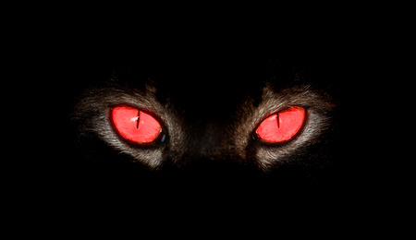
Unit-I physiology of EYE (Vision)
Eye - III
Course No. – VPB 1st Professional year
Credit Hrs. – 4+1=5
Date: 16.06.2021
Dr. Pramod Kumar
Asstt. Professor
Dept. of Veterinary Physiology
BVC, Patna

Slide 2
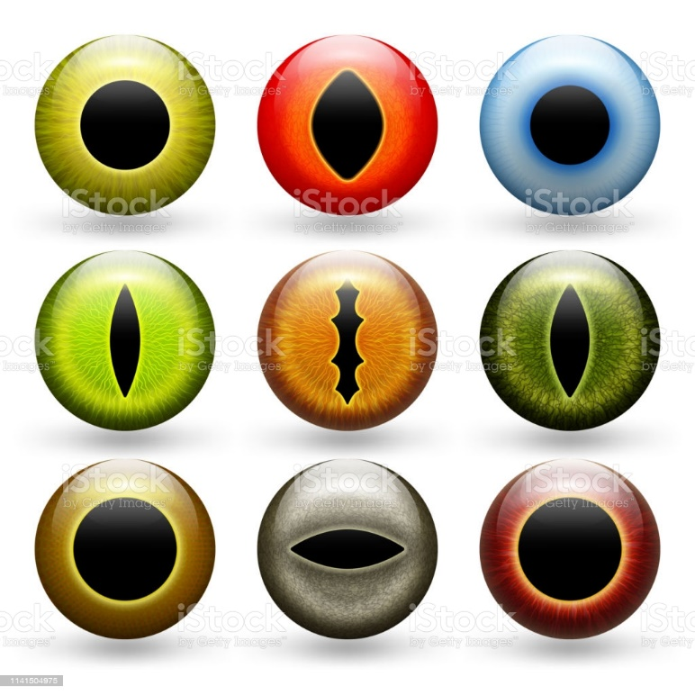
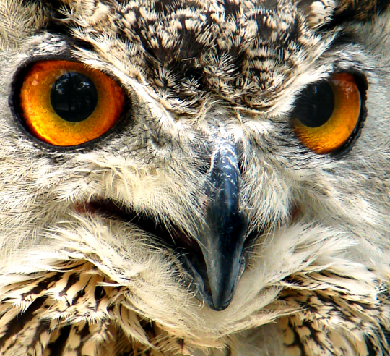
Eye receives light stimulus and transforms it into a nerve impulse which runs along the optic nerve reaching the visual cortex and gives rise to visual sensation.
Eyeball is a spherical structure

Slide 3
Eye has 3 layers:-
Sclera - Outer coat protects anteriorly and is transparent – cornea while, posteriorly it is white, opaque, avascular - sclera and amidst it forms sclerocorneal junction
Choroid - Middle coat vascular anteriorly (iris) - circular diaphragm with pupil
In middle - ciliary body (intraocular muscle)
inner aspect contain ciliary processes which secrete aqueous humour
posteriorly - choroid
Retina - Inner coat (sensory) contains nerves and are transparent

Slide 4
Retina
Optic disc - where optic nerve comes out of the eyeball, blind spot, no vision at this point
Macula - the most sensitive spot, cones concentrated. Fovea is the centre of the macula.
Ophthalmoscopy - Examination of the eye using an illuminated source.
Inside of the retina, optic disc containing blind spot, macula & fovea and retinal blood vessels can be seen.

Slide 5
Lens
crystalline structure
biconvex lens, posterior surface more convex
suspended from the ciliary body by fine delicate fibres called zonule or suspensory ligament of the lens
covered by a capsule

Slide 6
lens and zonule divide eyeball into posterior compartment containing a transparent jelly-like structure called vitreous humour
lens and zonule divide eyeball into anterior compartment contains aqueous humour subdivided by iris into anterior and posterior chamber and are communicated by pupil

Slide 7
Aqueous humour
clear fluid
volume is about 250 ul
water 98.9%
other: protein, non-protein N, glucose, Na, K, Cl, ascorbic acid, pyruvate, lactate, dissolve O2
lower conc of protein, urea and glucose than plasma
osmotic pressure higher than plasma
secreted by ciliary processes, ultrafiltrate of plasma
pass through posterior chamber
absorbed back into canal of Schlemm in sclera

Slide 8
Intra ocular pressure
this is about 10-20 mmHg
maintained by aqueous humour
measured using a tonometer
elevated intraocular pressure occurs in glaucoma
glaucoma may cause blindness

Slide 9
Optics
In the eye, pupil act as the aperture and its size can vary
lens can change its curvature
as light passes through the lens system several interfaces are traversed
their refractive indices are different.

Slide 10
Parasympathetic activity
contracts ciliary muscles
relaxes suspensory ligaments in the zonule
lens become more convex
power of the lens increases
subject can focus near objects
with age this ability decreases
power of accommodation decreases
Presbyopia: is the lack of accommodation, occurs with age, requires + glass to increase power

Slide 11
Errors of Refraction
Myopia
short sightedness
near objects can be focussed
far objects focuses in front of retina
this could be due to
lens having more refractive power
eyeball being longer than normal
correction is done by concave lenses
these lenses will move the image back to retina

Slide 12
Hypermeteropia
Far sightedness
objects are focused behind the retina
this could be due to
lens having less refractive power
eyeball being shorter than normal
correction is done by convex lenses
these lenses will bring the image on to retina

Slide 13
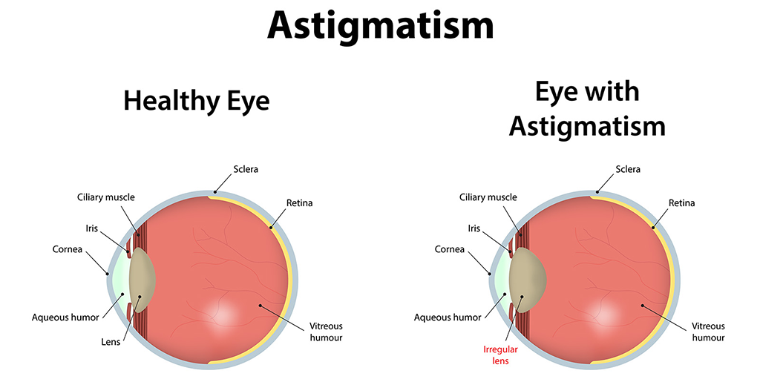
Astigmatism
spherical aberration of the cornea or/and lens resulting in an image with mutiple focal points which is not clear
correction is done by spherical or cylindrical lenses
these lenses will correct the disparity in corneal curvature

Slide 14
Photochemistry of vision
Photochemicals:
rods contain rhodopsin
rhodospin - outer segment contain rhodopsin or visual purple consists of protein scotopsin and carotenoid pigment retinal (11-cis retinal)
Decomposition of rhodopsin –
by light 11-cis retinal combines with scotopsin to form rhodospin
when light is absorbed by rhodopsin
decomposition of rhodopsin starts
extremely unstable barthorhodopsin-lumirhodopsin - metarhodopsin I - metarhodopsin II
(metarhodopsin II also called activated rhodopsin starts neural activity)
in few seconds it is converted to sotopsin and all trans retinal

Slide 15
Action potentials
excitation of rods causes
hyperpolarisation rather than depolarisation
increased negativity of the membrane due to decreased permeability to Na
inner segment pumps Na out
outer segment is very leaky to Na

Slide 16
normally membrane is -40mV (inside)
when excited outer segment prevents Na influx
inner segment continually pumps Na out increased negativity inside hyperpolarisation
inside becomes -80mV

Slide 17
Neurotransmitter
visual receptor cells – glutamate
Photochemicals in cones are similar to rhodopsin (scotopsin + retinal)
cones contain photopsin + retinal
3 different types of photochemicals are present in cones
have peak sensitivity at 505 nm

Slide 18
Light Adaptation
retinal sensitivity depends on the amount of chemical pigment
if an object is in bright light for some time, large amount of photochemical is reduced to retinal and opsin
retinal converted to vitamin A and reduces the sensitivity of the retina
this is known as light adaptation
now if the object goes into a dark room he cannot see any object
reason: severe reduction in retinal sensitivity

Slide 19
Dark Adaptation
if the person remains in dark for some time then the retinal sensitivity increases
this increases exponentially
this consists of two parts
initial quick phase: due to adaptation of cones
later slow phase: due to adaptation of rods

