Slide 1
Family: Paragonimidae
Dr. AJIT KUMAR
Department of Veterinary Veterinary Parasitology
Bihar Veterinary College
Bihar Animal Sciences University
Patna-800014
Image source: Google image

Slide 2
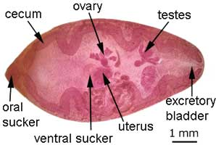
Family: Paragonimidae
Body of the parasite is oval to fusiform.
Whole body is highly bifid spiny.
Oral sucker is subterminal
oesophagus is short but caeca is long.
Ventral sucker too small present on anterior part of the body.

Slide 3
Family: Paragonimidae
Testes lobed, symmetrical in position and present in the posterior part of the body.
Genital pore just behind ventral sucker.
ovary lobed located between ventral sucker and testes. Uterus is coiled.
Excretory vesicle extends up to oesophagus.

Slide 4
Family : paragonimidae
Species | Final host | Intermediate host | 2nd intermediate host | Location
Paragonimus westermanii ( Oriental lung fluke) | Pig, dog, cat, Cattle, goat, fox and man. | Melania, Hua, Ampullaria, Assiminea sp. (snails) | Cray fishes & crabs ( Eriocheir, Patomon spp.) | Mainly in lungs
P. kellicoti | Wild animals, cat, dog & Pig | -do- | -do- | -do-

Slide 5
Paragonimus westermanii
Common name: Oriental lung fluke
Final host- Pig, dog, cat, cattle, goat, fox and man.
1st Intermediate host:- Melania, Hua, Ampullaria, Assiminea sp. (snails)
2nd Intermediate host: Cray fishes & crabs
( Eriocheir, Patomon spp.)
Infective stage:-Metacercaria infected carbs
Mode of infection: by ingestion
Location: -lungs

Slide 6
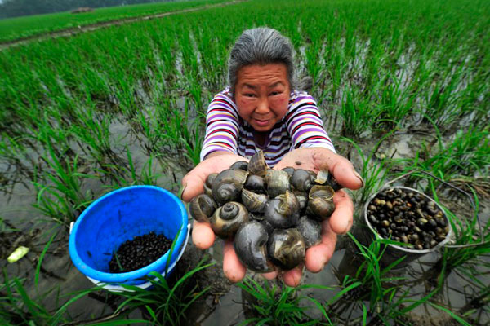
Ampullaria snails

Slide 7
Family: Paragonimidae
Cercariae are emerge out from the infected snail and then penetrate into the crabs and cray fishes in which they encyst to become metacercaria.
Final hosts get the infection by the ingestion of metacercaria infected raw or undercooked crabs or cray fishes.
The cercaria has very short tail or stumpy called microcercous cercaria.

Slide 8
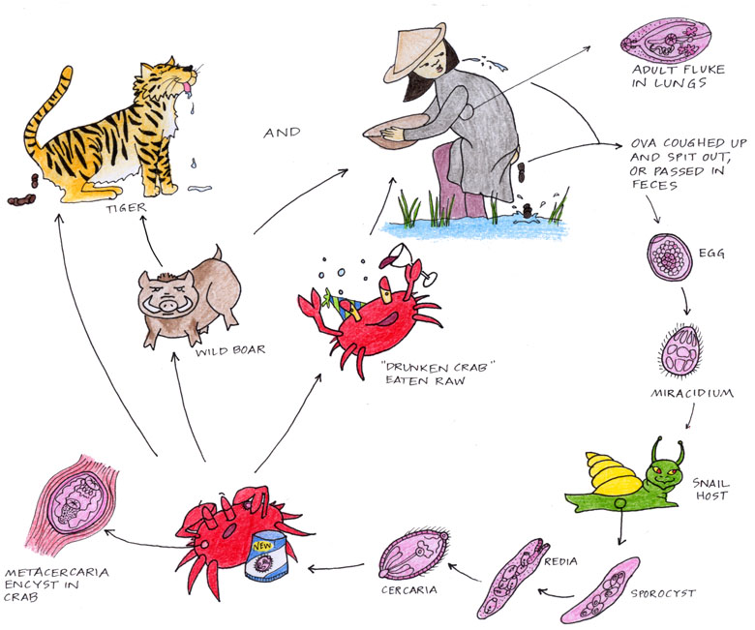
Life-cycle of Paragonimus

Slide 9
Pathogenesis of P. westermanii
Eggs are deposited in the cystic pocket from where they are voided through the opening of the cyst to the outside either with sputum or faeces.
Each Cyst in lungs usually contains two parasites surrounded by a purulent fluid mixed with blood and eggs.
Migrating immature flukes cause eosinophilic peritonitis, bronchiolitis and chronic granulomatous pneumonia.

Slide 10
Symptoms of P. westermanii
Rusty colour sputum which is similar to those of bronchial cough with thick sputum containing a little blood and the eggs of the parasites,
sneezing
Haemoptysis following paroxysmal coughing.
In man causes cerebral paragonimiasis characteristically producing a Jacksonian type of epilepsy

Slide 11
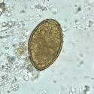
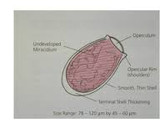
Diagnosis of P. westermanii
On the basis of
Characteristic Clinical signs (Rusty colour sputum )
Microscopic examination of sputum/ faecal sample which reveals the presence of characteristic eggs of Paragonimus westermanii.
Eggs are yellowish-brown in colour, operculated and the shell is thickened at the pole opposite this.
.

Slide 12
Treatment of P. westermanii
Albendazole @ 5-100 mg/kg/day
Niclofon @ 1mg/kg b. wt daily for 3 consecutive days
Bithionol@ 100mg/kg b. wt daily for 7 days
Control:
Uncooked or raw crabs should not be eaten
Destruction of snails
Improving sanitary measures

Slide 13
Family: Prosthogonimidae
Spiny cuticle
Tapering anteriorly and rounded posteriorly
Broad posteriorly
much lobulated ovary and vitellaria like bunches of grapes lie in the lateral field.
Genital pore situated next to the oral sucker
Oval testes lie horizontal at the middle of the body
Redia stage absent.

Slide 14
Family : : Prosthogonimidae
Species | Final host | Intermediate host | 2nd intermediate host | Location
Prosthogonimus ovatus | Domestic fowl & Geese. | Bithynia leachi & Gyraulus spp | Nymphal (naiads) stage of dragon fly ( Sympatrum decoloratum) | Bursa of Fabricius & Oviduct
P. pellucidus | -do- | -do- | -do- | -do-

Slide 15
Paragonimus westermanii
Common name: Oviducal fluke or Oviduct fluke
Final host- Domestic fowl & Geese.
1st Intermediate host:- Bithynia leachi & Gyraulus spp (snails)
2nd Intermediate host: Nymphal (naiads) stage of dragon fly
( Sympatrum decoloratum)
Infective stage:-Metacercaria infected naiad or the adult fly.
Mode of infection: by ingestion
Location: - Bursa of Fabricius , Oviduct

Slide 16
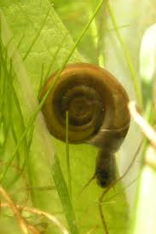
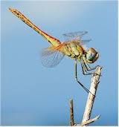
LIFE-CYCLE OF P. OVATUS
Egg Miracidium
Sporocyst
Daughter
sporocyst
Cercaria
cercaria emerge fromsnail & enter dragon fly
Form metacercaria inside dargon fly
INSIDE
THE
SNAIL

Slide 17
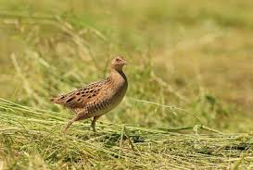
Pathogenesis of P. ovatus
Acute inflammation of the oviduct,
production of abnormal eggs
and
discharges of albumen from the cloaca and peritonitis

Slide 18
Symptoms of P. ovatus infection
Symptoms include
laying of the eggs with soft shells or without any shell,
milky discharge from the cloaca containing calcareous material which soils the feathers in perineal region.
Marked tendency to sit on the nest.
Abdomen is pendulous and the legs are held widely apart in walking
The disease is usually seen in spring or early summer.

Slide 19
Diagnosis of P. ovatus
Microscopic examination of cloacal discharges for presence of eggs.
Eggs are perculated, dark-brown bear a small spine at the pole opposite to the operculum.

