Slide 1
Family: Schistosomatidae
Dr. AJIT KUMAR
Department of Veterinary Veterinary Parasitology
Bihar Veterinary College
Bihar Animal Sciences University
Patna-800014
Image source: Google image

Slide 2
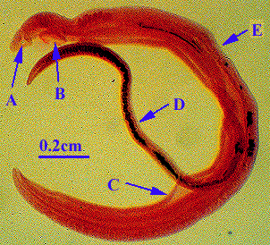
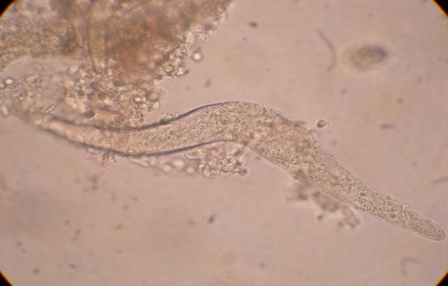
Family: Schistosomidae
General characters:
Common Name- Blood flukes because they found in the blood vessels of their definitive hosts.
Unisexual
Pharynx absent
Oesophagus short
Suckers present
Common intestinal caecum simple

Slide 3
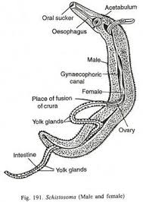
Family: Schistosomidae
General characters:
Gynaecophoric canal well developed.
Testes anterior to caecal union.
Genital pore posterior to ventral sucker.
Body of female is cylindrical

Slide 4
Family: Schistosomidae
Genus: Schistosoma
Two suckers are well defined and present close together.
Cuticle is covered with spines and tubercles but the suckers have only spines.
Oesophagus bifurcates into two intestinal caeca anterior to ventral sucker and caeca may or may not reunite in the posterior half of the body.
Gynaecophoric canal is well developed and extends through most of the body.
3-6 testes present in a longitudinal row just posterior to ventral sucker.

Slide 5
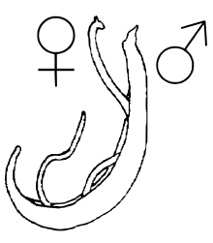
Family: Schistosomidae
Genus: Schistosoma
Flukes are elongate, unisexual and dimorphic trematodes.
Female is slender and usually longer than male and the female of some species is usually carried especially during copulation, by the male in a ventral gutter like groove called gynaecophoric canal formed by the incurved lateral edges of the body.

Slide 6
Family : Schistosomidae
Species | Final host | Intermediate host | Location
Schistosoma bovis | Cattle, Sheep, & goat | Indoplanorbis exustus | Portal & mesenteric veins
S. indicum | Ruminantes, equines & camel | -do- | -do-
S. spindale | Ruminants & dogs | -do- | Mesenteric veins
S. incognitum | Pig & dog | Lymnaea luteola | -do-
S. japonicum | Man, ruminates, equines, pig, dog & cat | Oncomelania sp. | Portal & mesenteric veins

Slide 7
Family : Schistosomidae
Species | Final host | Intermediate host | Location
S. nasalis | Cattle, buffalo, goat, sheep & horse | Indoplanorbis exustus | Veins of nasal mucosa
S. mansoni | Man, gerbils, rodents, cattle, dog and wild mammals | Biamphalaria glabrata | Mesentric veins
S. haematobium | Man, monkey and baboons | Bulinus spp. | Posterior mesenteric arteries
S. incognitum | Pig & dog | Lymnaea luteola | -do-
S. japonicum | Man, ruminates, equines, pig, dog & cat | Oncomelania spp. | Portal & mesenteric veins

Slide 8
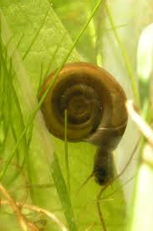
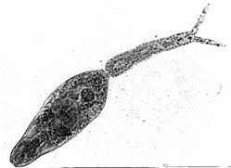
LIFE-CYCLE OF Schistosoma
Egg Miracidium
Sporocyst
Daughter
sporocyst
Cercaria
bifurcated cercaria emerge
from the aquatic snail and penetrate skin of final hosts
INSIDE
THE
SNAIL

Slide 9
Genus: Schistosoma
Redia and metacercaria stages are absent in the life-cycle.
Cercariae are without a pharynx and having a bifurcated tail called furcocercus cercariae develop from sporocysts.
Cercariae (infective stage) enter the final host through skin penetration or and do not encyst.
Cercaria penetrates through the skin and enters into the blood circulation and gets transformed into Schistosomula (Young fluke).

Slide 10
Pathogenesis of Schistosoma
Amongst all helminthes parasites, the group of blood flukes is an exception where the eggs produced by the females are mainly responsible for the pathogenesis
Eggs inflicting harm to the host both mechanically and immunologically
Harms caused by adult, cercaria and egg are phlebitis in the mesenteric veins, cercarial dermatitis and granulomatous growths in the host, respectively.

Slide 11
Pathogenesis of Schistosoma
Different types of disease occur in accordance with the location, species and course of immunopathognomic features.
Intestinal schistosomosis: Cause intestinal haemorrahge, small pseudoabscesses develop around the eggs in the intestinal wall with heavy infiltration of eosinophils and lymphocytes and nodule like structure in the intestine may be seen surrounding a number of eggs.

Slide 12
Pathogenesis of Schistosoma
Hepatic schistosomosis:
It is an immunological disease resulting from the host’s cell mediated immune response to schistosome eggs in the liver.
Soluble antigens of the eggs evoke inflammatory reaction and formation of granuloma.
Granulomatous lesions and periportal inflammation occur, followed by a progressive portal fibrosis in liver (Clay-pipe stem fibrosis).

Slide 13
Pathogenesis of Schistosoma
Hepato-intestinal schistosomosis caused by S. indicum,
S. spindale,
S. incognitum,
S. mansoni,
S. bovis.
In this case eggs are excreted out through the faeces of infected hosts.

Slide 14
Pathogenesis of Schistosoma
Urinary schistosomosis:
caused by S. haematobium of man.
Developing flukes reach to posterior arteries and lay eggs in the walls of urinary bladder, ureter and urethra.
Excretion of eggs in the urine
Eggs secretion is accompanied by mild inflammatory reaction, granuloma, ureteritis, appendicitis and unusual ectopic lesions in other body parts are frequently associated with severe S. haematobium infection in man.

Slide 15
Pathogenesis of Schistosoma
Nasal Schistosomosis: Caused by S. nasale.
Schistosoma nasale
Final host- Cattle, buffalo, goat, sheep & horse
Intermediate host:-Indoplanorbis exustus ( snail)
Location: -Veins of nasal mucosa
Infective stage:-Cercaria
Mode of infection: Skin penetration

Slide 16
Pathogenesis of Schistosoma
Nasal Schistosomosis: Caused by S. nasale.
Schistosoma nasale
Final host- Cattle, buffalo, goat, sheep & horse
Intermediate host:-Indoplanorbis exustus ( snail)
Location: -Veins of nasal mucosa
Infective stage:-Cercaria
Mode of infection: Skin penetration

Slide 17
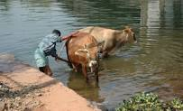
LIFE-CYCLE OF S. nasale
Egg Miracidium
Sporocyst
Daughter
sporocyst
Cercaria
cercaria emerge
from the aquatic snail and penetrate skin of final hosts
INSIDE
THE
SNAIL

Slide 18
Pathogenesis of Schistosoma
The disease condition caused by Schistosoma nasalis is known as Nasal granuloma (N.G.), Snoring Dieases or Nekhara.
Main pathogenic effects are associated with the eggs of S. nasalis which cause abscess formation in the nasal mucosa leads to fibrous granulomatous cauliflower like growth which may occlude the nasal passage.

Slide 19
Pathogenesis of S. nasale
Clinical signs and pathology of infection with S. nasalis are less severe in buffalo than in cattle.
Buffalo show only pin head sized eruptions and congestion of nasal mucosa suggesting that buffalo are a more suitable definitive host or normal host than are cattle

Slide 20
Symptoms of S. nasale
The clinical sign consists of
rhinitis,
coryza,
dysponea,
mucopurulent discharge
Cauliflower like growth in nasal mucosa and
snoring (Snoring disease).

Slide 21
Diagnosis of Schistosoma
Microscopic examination of faeces and nasal scrapings or nasal discharge reveals the eggs of schistosoma parasite
Miracidium inhibition test (MIT), Ceracrial Hoolen reaction ( CHR), Ring precipitation test, Cercum-oval precipitation test
Immunodiagnostic tests ( Counter immunoelectrophoresis, Bentonite Flocculation test, Intradermal test and Dot- ELISA ) are used in the diagnosis of schistosomosis.

Slide 22
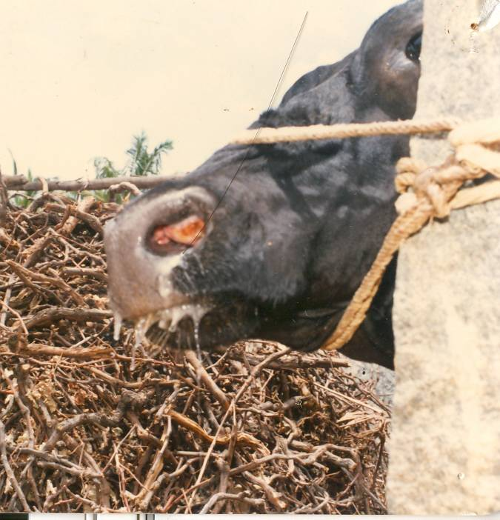
Diagnosis of Nasal schistosomosis
On the basis of
typical Clinical signs (Cauliflower like growth in nasal mucosa & mucopurulent discharge )

Slide 23
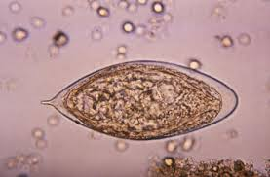
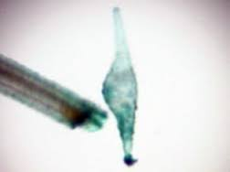
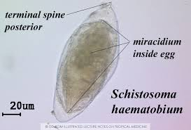
Diagnosis of Nasal schistosomosis
S. Eggs Bovis
S. Bovis egg in faeces
S. Nasale egg in nasal discharge
S. spindale egg in faeces
S. Haematobium
egg in urine

Slide 24
Diagnosis of Nasal schistosomosis
On the basis of
Microscopic examination of nasal discharge which reveals the presence of characteristic eggs of S. nasale.
Eggs are yellowish-brown in colour, operculated and the shell is thickened at the pole opposite this.
1 ml nasal scarping or mucus boiled with 9 ml of 10 % KOH (alkali) solution and examine the sediment for the presence of Boomerange shaped or Nepolean hat shaped or Plaquin shaped eggs.

Slide 25
Pathogenesis of Schistosoma
Several drugs like
Lithium antimony thiomaleate @ 15-20 ml i/m thrice at wekly interval
Oxyclozanide @ 10mg/kg orally thrice at weekly interval
Sodium antimony tartarate (Tarter emetic) 2 mg on alternate day x 6 i/v
Closantel, Praziquntal @ 20mg/kg oral single dose etc.
.

Slide 26
Treatment of S. nasale
During treatment of schistosomosis with antimony, niridazole and metrifonate drugs leading hepatic shift of the schistosomes which result temporary cessation of egg excretion and clinical signs.
When treatment is withdrawn, drug effects have subsided the symptoms may relapse.

Slide 27
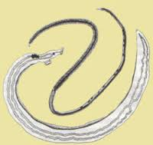
Genus: Ornithobilharzia
Intestinal caeca tend to anastomose in front of the median posterior intestinal caecum.
Testes is numerous and the uterus is short containing only one egg at a time.
Eggs are oval with a posterior spine and found in the faeces of host

Slide 28
Genus: Ornithobilharzia
Species | Final host | Intermediate host | Location
Ornithobilharzia dattai | Zebu | Lymnaea luteola | Mesentric veins
O. turkestanicum | Sheep, gaot, camel, horse, cattle & cat | Lymnaea euphratica | Mesentric veins
Bivitellobilharzia nairi | Elephant | Not known | Portal vein
Gigantobilharzia sp. | birds | Gyraulus, Physa sp.of snail | Blood vessels

Slide 29
Cercarial dermatitis
Cercarial dermatitis is caused by the active penetration of furcocercus cercariae of non- human schistosomes including the Schistosoma species of birds like genera Austrobilharzia,
Bilharziella,
Gigantobilharzia,
Heterobilharzia,
Ornithobilharzia,
Schistosomatium,
Trichobilharzia,
Schistosma spindale,
S. bovis and S. douthitti, into the skin of man.

Slide 30
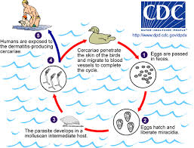
Cercarial dermatitis
In the beginning,
there is mild erythema and oedema at the site of cercarial penetration,
repeated exposure causes a severe pruritis and
a papular or pustular eruption followed by a severe dermatitis.

Slide 31
Cercarial dermatitis
It is also commonly known as
Dhobi itch or
swimmers itch or
clam diggers itch or
rice paddy itch or
hunter itch,
fisherman’s itch etc.
It is an occupational hazard which occurs in the human being who frequently comes in contact with water in ponds, ditches, river, rice paddy fields etc.

