Slide 1
CATHETERIZATION AND URINE COLLECTION IN DOGS
DR GYANDEV SINGH
ASSISTANT PROFESSOR
DEPARTMENT OF VETERINARY SURGERY AND RADIOLOGY
Veterinary Clinical Complex
BVC, BASU, PATNA

Slide 2
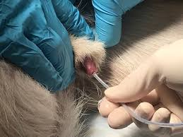
INTRODUCTION-
Urinary catheterization in dogs is a procedure done by veterinarian places a plastic tube [catheter]into the dogs penile urethra or vulva urethra.

Slide 3
INDICATION-
To collect urine for urinalysis.
To empty the urinary bladder.
To administer radiographic contrast media into the lower urinary tract.
Indwelling catheter to controlled bladder drainage, maintain patent urethra, monitor urinary output, nursing care of recumbent patient (unable to urinate voluntarily)

Slide 4
Contraindication
Pre-existing urethral trauma
Large space-occupying urethral mass or urethral stricture
Avoid for microbiology use (cystocentesis is preferred).

Slide 5
Equipment -
Catheters
Sterile soft gauze swabs
Gloves
Lignocaine jelly
10 ml syringe, plane sample pot, kidney dish
Antiseptic solution: 4% chlorhexidine gluconate or 10% povidone iodine.

Slide 6
Catheter
Catheter type | material | Indwelling? | Sizes (Fr) | Length (Cm)
Dog Catheter | Flexible nylon | No | 6-10 | 50-60 cm
Silicone Foley | Flexible medical grade Silicone | Yes | 5-10 | 30, 55

Slide 8
Point for indwelling catheter
For silicone foley catheters, water sufficient to fill balloon.
For standard flexible nylon (polyamide) catheters: suture materials, zinc oxide tape
Sterile intravenous fluid administration set and empty fluid bag or commercial closed urine collection system, with appropriate adapters for attachment to selected urinary catheter.
Elizabeth collar

Slide 9
Closed urinary collection bag

Slide 10
Patient preparation and positioning-
Gentle physical restraint
Sedation
Lateral recumbency with upper leg held away from prepuce
The prepuce should be cleaned with the antiseptic solution
The area around the prepuce can be maintained aseptically .

Slide 11
ANATOMICAL VIEW-

Slide 12
Procedure -
Position –lateral recumbency or standing position .
Preparation –sedation is generally not required .
exrude the penis from prepuce and wipe the
urethral orifice.
-measure the approximate length of catheter.

Slide 13
Slide the catheter through the penile ureathra and stop insertion when urine fill the catheter and leaks from the end of catheter

Slide 14
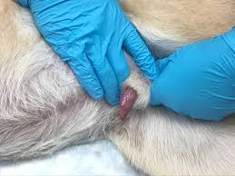
Once catheter is entered the bladder ,release the penis into the prepuce

Slide 15
Uretheral cathetrization in bitch-
Bitches may require sedation or general anaesthesia.
Bitches positioned in dorsal recumbency
Clean the vulva with the antiseptic to remove any discharge and surface dirt.

Slide 16
Instrument ant technique -

Slide 17
Urine collection for sample handling -
For urinalysis-
approximately 5 ml is required.
sample should be collected into plain tube.
urine collected by cystocentesis because by catheterization
sample may by contaminated.

Slide 18
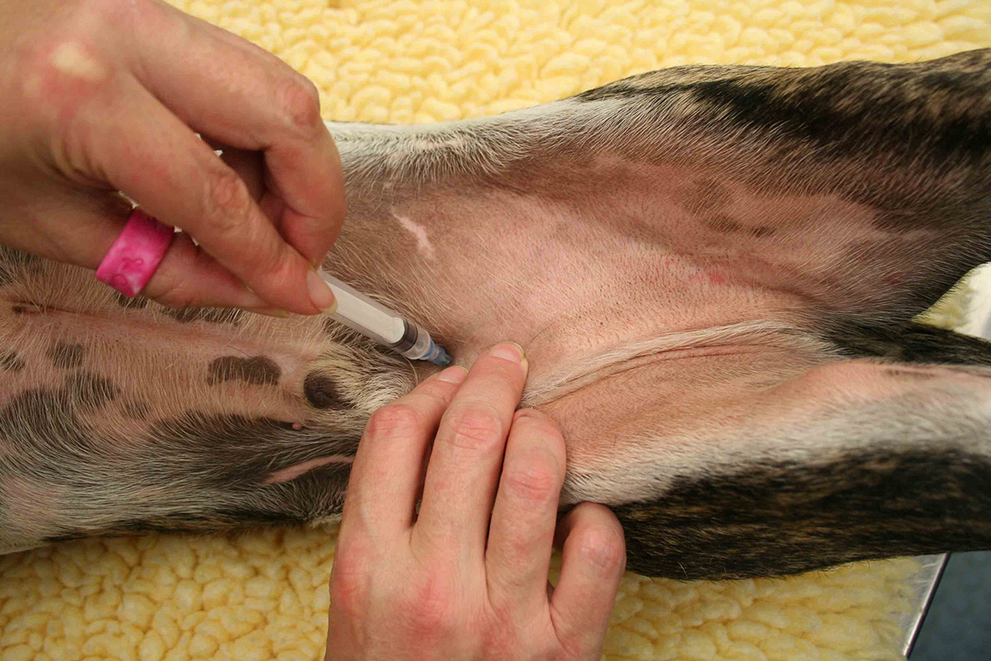
Process -

Slide 19
THANK YOU

