Slide 1
ANTHELMINTICS Anticestodal Drugs …………………………………………………………………………………………………………………………………………………………………………………………………………………………………………… Chemotherapy (VPT-411) (Lecture-22)
Dr. Kumari Anjana
Asstt. Professor
Deptt. of Veterinary Pharmacology & Toxicology
Bihar Veterinary College, Bihar Animal Sciences University, Patna

Slide 2
Content of the chapter
Anticestodal Drugs
Natural compounds
Inorganic compounds and
Synthetic organic compounds.

Slide 3
Anticestodal Drugs
These are the drug effective against cestodes or tapeworms and are of two types:
Taeniafuges:
These drugs simply cause expulsion of tapeworms.
They generally paralyze the tapeworm and are combined with purgative to facilitate expulsion.
e.g. older natural organic anticestodal drugs like arecoline.
Taenicides:
They cause actual death of the tapeworms in situ. e.g. synthetic organic compounds like bunamidine.

Slide 4
Classification
Pumpkin seeds,
Male fern
Kamala,
Nicotine
Arecholine
Natural compounds
Bunamidine hydrochloride
Niclosamide
Dichlorophen,
Hexachlorophene,
Resorantel,
Bithionol,
Bithionol sulphoxide,
Uredophos,
Nitroscanate,
Praziquantel,
Benzimidazoles- Mebendazole,
Fenbendazole
Anticestodal Drugs
Synthetic organic compounds
Inorganic compounds
Tin compounds
Lead arsenate

Slide 5
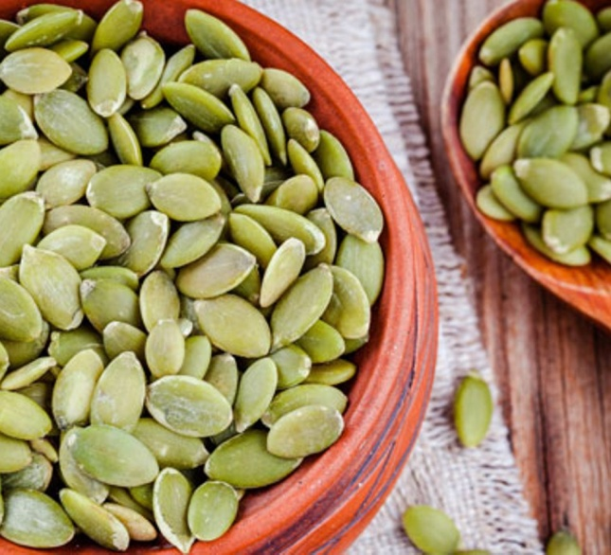
Natural compounds
Pumpkin seeds:
The minced pumpkin seed has anticestodal activity and still used in some countries.
The active principle is cucurbitine.
It has low efficacy but high safety even in debilitated and young patients.
Fig: pumpkin seed
Source : Google image

Slide 6
Male fern (Dryopteris Felix Mas):
The powdered rhizome of this fern was best known and had been most commonly used by the Greek physicians against human cestodes.
The active principle was found to be filicic acid that caused paralysis of the tapeworm.
Fig: Male fern
Source : Google image

Slide 7
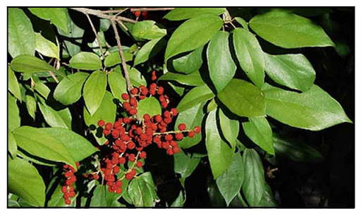
Kamala:
Source: Glands and hairs covering of fruits of a plant Mellotus philippinensis.
Found in Philippines, India, and China.
Previously it was the drug of choice for
cat tapeworms like Dipylidium caninum and Taenia taeniformis.
Kamala causes paralysis of both cestodes and host intestinal muscle and never used in veterinary medicine.
Kamala: Mellotus philippinensis
Philippine Medicinal herb
Source : Google image

Slide 8
Nicotine:
Source : Nicotiana tabacum.
It was commonly used with copper sulphate for removal of ruminant tapeworms and roundworms.
The drug causes persistent depolarization of the neuromuscular junction followed by paralysis of the worm.
The efficacy and safety of the drug are low.

Slide 9
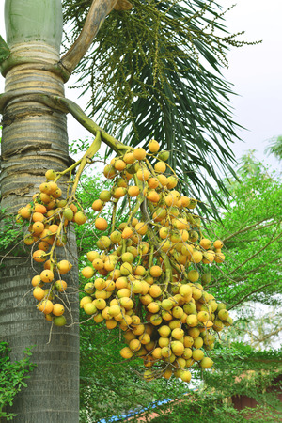
Arecholine:
It is an alkaloid obtained from Seeds of betel nut palm, Areca catechu.
Used in dogs.
Arecholine itself is unstable so its stable salts are used.
Fig: Seeds of betel nut palm,
Areca catechu
Source : Google image

Slide 10
Arecoline hydrobromide:
Against all tapeworms of dogs (Taenia, Dipylidium) including Echinococcus.
It has two fold action. Act as cholinergic agonist, paralysis detachment of the worm and also increase the peristaltic movement of the intestine so that the detached worm is expelled by purgation.
The drug causes only temporary paralysis of the worm. So if purgation does not occur within 2 hours of medication, a saline purgative is given to dogs to induce evacuation.
Contraindicated in cats- increase tracheobronchial secretions.
Excessively increase the tracheo-boronchial secretion and thereby causes suffocation.

Slide 11
Arecoline acetersol:
Active moiety- arecoline. The drug is used in dogs and cats as anticestodal against Taenia and Dipylidium and as a laxative.
Arecoline carboxyphenylstibonate:
It is used in dogs as an anticestodal drug against Taenia and Dipylidium.

Slide 12
Synthetic organic compounds
Bunamidine hydrochloride:
Good activity against all tapeworms of dog and cat including Echinococcus granulosus.
MOA: Bunamidine salts disrupt the tegument of the parasite resulting into reduced rate of glucose uptake and ultimate death of the parasite.
The dead worms are digested in the host gut.

Slide 13
Toxicity:
Vomiting and diarrhea.
The drug may cause sensitization of heart muscle to catecholamine and sudden death of animals.
Bunamidine hydroxynaphthoate:
The drug is safely used against Moniazia sp. in sheep and goats even in pregnancy.

Slide 14
Niclosamide:
Tapeworm infections (mainly for Taenia) of dog, cat and man but it has poor efficacy against Echinococcus and variable for Dipylidium.
It is also used against
Moniezia and Thysaosoma infection in ruminants and
Tapeworm infections in lab, animals, monkeys and reptiles.
Intestinal flukes such as Paramphistomum in ruminants.
Metabolized to inert amine rapidly excreted in urine.
Safe for all stages of pregnancy and in debilitated animals.
Niclosamide is extensively used as a taenicide both in human and vety. Medicine.

Slide 15
Dichlorophen:
It is mainly used as a narrow spectrum taenicide in veterinary medicine.
It is effective against Taenia and Dipylidium in dogs and cats.
But it is ineffective against Echinococcus, thus it is not the drug of choice for this tapeworm.
The drug has bactericidal and fungicidal properties.
Orally available as tablets or suspension - after overnight fasting.
Pugative is not required. Dog, Cat and Sheep: 200 mg/kg

Slide 16
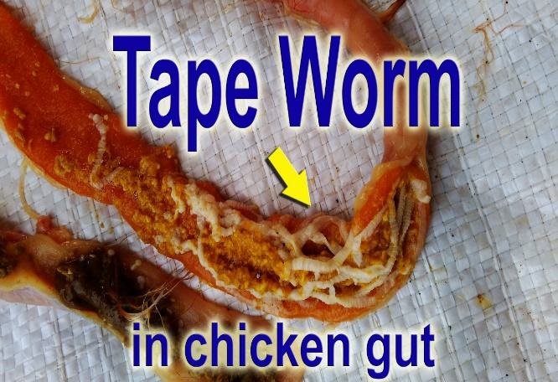
Hexachlorophene:
It is mainly used as an antitrematodal drug for the treatment of liver fluke infection in sheep and cattle.
The main anticestodal use of this drug is for the control of chicken tapeworms, especially of Raillietina cesticillus.
The drug is toxic to dogs.
Fig: Tapeworm in chicken gut Source : Google image

Slide 17
Resorantel:
It is an anticestodal for ruminants.
It is highly effective against Moniezia in both sheep and cattle and against Thysaniezia gardi in sheep.
It has 90% efficacy in sheep and cattle against adult and immature rumen flukes (Paramphistomum spp.).

Slide 18
Bithionol:
It has anthelmintic as well as bacteriostatic and antifungal activities.
Used tor the treatment of Tapeworm infections (Taenia) dogs, cats and poultry.
The drug is also used for
Tapeworm (Moniezia and Thysanosoma)
Rumen fluke (adult and immature Paramphistomum) infections of sheep, cattle and goats.
Lung flukes (Paragonimus spp) in dogs and cats.

Slide 19
Bithionol sulphoxide:
The special advantage of this drug is that it has equal anticestodal efficacy to bithionol in dogs, sheep at lower therapeutic dose level of 60 mg/kg.
Excellent efficacy against liver flukes of both sheep and cattle.
Notes:
.

Slide 20
Uredophos:
A OP compound, introduced as broad spectrum anthelmintic for use against both nematode (Ascaris and hookworms) and cestodes of dogs and cats at the dose rate of 50 mg/kg.
The most important feature of the drug is that it is 100% efficacy against Dipylidium caninum that is resistant to most other anticestodal drugs excepts praziquntel.

Slide 21
Nitroscanate:
It is active against tapeworms and roundworm of dogs but not suitable for cat.
It is very safe and can be given to pups and pregnant and lactating bitches.

Slide 22
Praziquantel:
Chemically it is an isoquinoline and colorless, crystalline and bitter compound.
It is a new broad spectrum anthelmintic effective against all species of Schistosomes pathogenic to humans and has unique, extremely high activity wide range of adult and larval cestodes of both animals and man (including Cysticercosis).
It is also effective against ruminant and snake tapeworms and certain flukes.
But it has no activity against nematodes.

Slide 23
Benzimidazoles:
The cestocidal benzimidazoles are:
Mebendazole:
Taeniasis in Dog and Cat: @ 22 mg/kg/day for 5 days;
For adult Echinococcus @ 160 mg/kg.
For Moniezia in ruminants: @ 20 mg/kg.
Fenbendazole:
Taeniasis in Dog and Cat: @ 50mg/kg/day for 3 days.
Both drugs are ineffective against D. caninum.
Oxfendazole, Cambendazole and Albendazole:
For Moniezia in ruminants: @ 7.5-15 mg/kg.

Slide 24
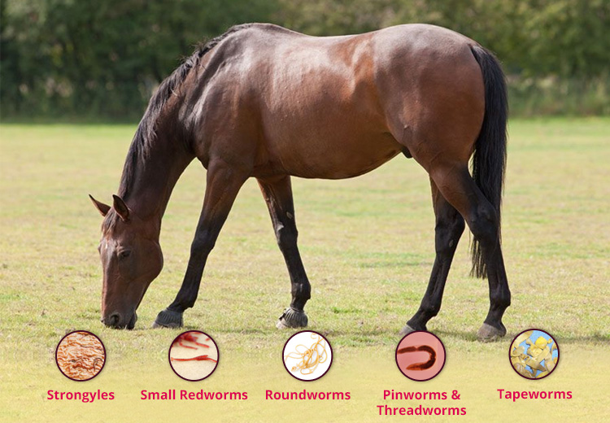
Anticestodal drugs for Horses:
Drugs for Equine Tapeworms (Anoplocephala spp).
Mebendazole: @ 20 mg/kg;
Niclosamide: @ 88 mg/kg ;
Dichlorophen: 20 mg/kg
Bithinol: 7 mg/kg;
Pyrantel palmate: @ 13.2 mg/kg.
Fig: Horse tapeworm
Source : Google image

Slide 25
Inorganic compounds
TIN COMPOUNDS:
Metallic tin with its oxide (stannous oxide) or chloride of di-n-butyl tin dilaurate:
Highly effective against tapeworm, such as
T. solium, T. saginata and
Dipylidium in dogs;
Davinea in poultry.
Extensively used as anticestodal in man and domestic animals.

Slide 26
LEAD ARSENATE:
Highly effective against Moniezia and used worldwide for the treatment of Moniezia infection in lambs, calves and kids.
Low margin of safety and it should never be used in poultry.

Slide 27
Summary
Anticestodal Drugs: Natural compounds, Inorganic compounds and Synthetic organic compounds.
Bunamidine hydrochloride: Good activity against all tapeworms of dog and cat including Echinococcus granulosus.
Resorantel: It is an anticestodal for ruminants.
Nitroscanate: It is very safe and can be given to pups and pregnant and lactating bitches.

Slide 28
References
B.K.Roy., “Veterinary Pharmacology and Toxicology” – 2011, Kalyani Publication, pp -459-465.
H.S. Sandhu and S. Rampal., “Essential of Veterinary Pharmacology and Therapeutics”, pp- 1268-75.
Prasad V. Vani. and Koley K.M., “Synopsis of Veterinary Pharmacology and Toxicology” – 2006, Vahini Publications, pp-249-253.

Slide 29
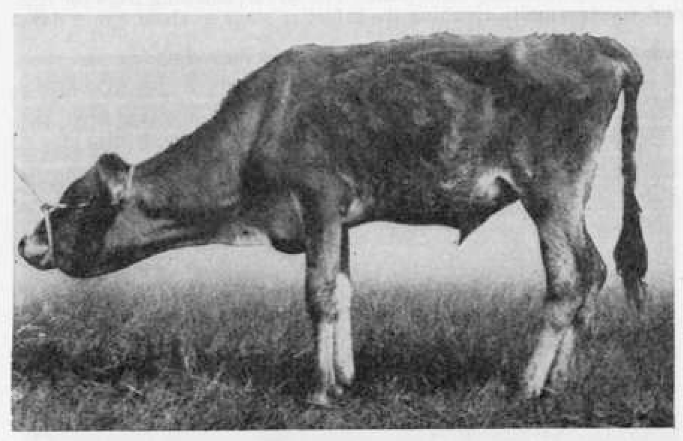
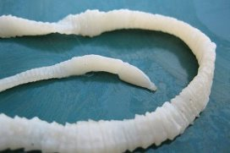
Thank You

