Slide 1
Antitubercular Drugs …………………………………………………………………………………………………………………………………………………………………………………………………………………………………………… Chemotherapy (VPT-411) (Lecture-24)
Dr. Kumari Anjana
Asstt. Professor
Deptt. of Veterinary Pharmacology & Toxicology
Bihar Veterinary College, Bihar Animal Sciences University, Patna

Slide 2
Content of the chapter
Antitubercular Drugs
Introduction,
classification
spectrum of activity
MOA
Applications
Side effects

Slide 3
Introduction
Tuberculosis :chronic granulomatous disease.
Mycobacterium bovis -- Ruminants.
M. bovis and M. avium -- Dog.
M. avium -- Pig.
Sheep and horse are rarely affected.

Slide 4
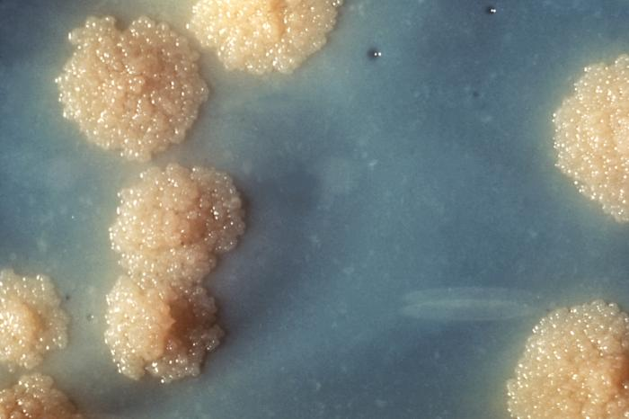
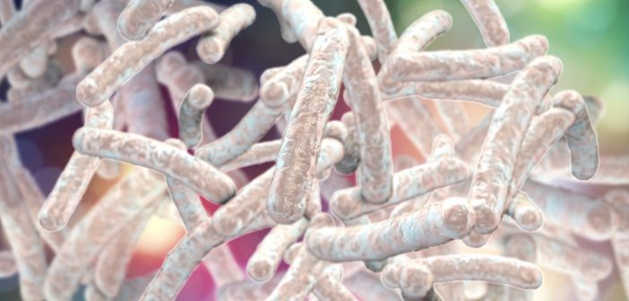
Introduction contd…
Mycobacterium from the Greek word "mycos," refers to Mycobacteria's waxy appearance, which is due to the composition of their cell walls.
More than 60% of the cell wall is lipid, mainly mycolic acids.
This extraordinary shield prevents many pharmacological compounds from getting to the bacterial cell membrane or inside the cytosol.
Another barrier is the property of some of the bacilli to hide inside the patient's cells, thereby surrounding themselves with an extra physicochemical barrier that antimicrobial agents must cross to be effective.
waxy appearance of
Mycobacteria
Source : Google image

Slide 5
Classification
First Generation
Streptomycin,
Isoniazid/isonicotinic acid hydrazide (INH or H),
Rifampicin,
Ethambutol (E),
Paraaminosaliclic acid (PASA)
Pyrazinamide (PZ) and
Thiacetazone (T).
Second Generation
Capreomycin (A),
Cycloserine (C),
Kanamycin (K),
Ethionamde (Et).
These drugs low anti TB efficacy, but relatively high toxicity.
These drugs have high antitubercular efficacy and low toxicity.
Fluoroquinolones are also used under reserve category anti-TB drugs.

Slide 6
Some clinicians categorize the first and second line drugs as:
contd…
Standard Drugs:
Isoniazid/isonicotinic acid hydrazide (INH or H),
Rifampicin (R),
Streptomycin(S),
Ethambutol (E),
Pyrazinamide (PZ) and
Thiacetazone (T).
Reserve Drugs:
Capreomycin (A),
Cycloserine (C),
Kanamycin (K),
Ethionamde (Et).

Slide 7
Basing on the Antibacterial Action:
contd…
Bactericidal:
Isoniazid/isonicotinic acid hydrazide (INH or H),
Rifampicin (R),
Streptomycin(S),
Pyrazinamide (PZ) and
Capreomycin (A),
Kanamycin (K),
Cycloserine (C) and,
Fluoroquinolones.
Bacteriostatic:
Ethionamde (Et).
Ethambutol (E),
Thiacetazone (T).
Paraaminosalicylic acid (PASA)

Slide 8
General consideration for Treatment of TB
Treatment of TB includes use of combination therapy; to avoid emergence of resistance in tubercular bacilli.
In general the first-line (standard) drugs are to be used.
The second-line (reserve) drugs are to be considered:
when the bacilli become resistant to first-line drugs
or when the first-line drugs are to be discontinued due to appearance of adverse reactions.

Slide 9
The effective antitubercular combinations include:
Starting Phase: Daily dosing for2-3 months.
INH(H),
R,
PZ and
E or S:
Continuation Phase: Daily dosing for about 6 months.
H,
R or H,E.
Thus anti-TB therapy extends up to a total duration of 8 or 9 months.

Slide 10
Isoniazid
Isoniazid is chemically related to MAO inhibitor iproniazid.
It posses bacteriostatic and bactericidal property.
Well absorbed from GIT.
Easily penetrates into caseous tubercular lesions and also readily taken up by TB bacilli.
MOA:Exerts bactericidal effect
by inhibiting the synthesis of mycolic acids (essential cell wall constituents in Mycobacterium) and
also causing damage to cell membrane by inhibiting phospholipids synthesis.

Slide 11
Resistance:
If INH is given alone, after 2-3 months an apparent resistance emerges.
Mechanism of resistance is attributed to failure of the drug being taken by organism.
Adverse effect:
Its prolonged use may cause neurotoxicity (Peripheral neuritis -neurological manifestations such as paresthesis, numbness, mental disturbances).
These are due to interference with utilization of pyridoxine (due to formation of pyridoxal-hydrazone complex) and its increased excretion in urine.
Pyridoxine given prophylactically (10 mg/day) prevents neurotoxicity even with higher doses.

Slide 12
Rifampicin
It is a semisynthetic derivative of rifamycin B (Streptomyces mediterranei).
It has bactericidal action on M. tuberculosis, M. para-tuberculosis and other subpopulations of TB bacilli.
It acts best on slowly or intermittently dividing bacilli as well as on many atypical mycobacteria.
Both extra and intracellular organisms are affected.

Slide 13
MOA: acts by inhibiting protein synthesis in mycobacteria by inactivating DNA-dependent RNA synthesis.
One of the most effective anti-TB antibiotics; also effective against many other Gram negative or Gram positive bacteria, including Mycobacterium laprae.
It imparts orange color to saliva, sputum, tears and sweat.
Adverse effect: Hepatitis.

Slide 14
Ethionamde
It is chemically related to INH (H).
It is tuberculostatic drug acts on both extra and intracellular organisms.
It is rapidly and widely distributed.
It also diffuses in CSF at effective concentrations.
It is excreted rapidly through urine, less than 1% is excreted unchanged.

Slide 15
Ethambutol
Ethambutol (d-Ethambutol) is a commonly used anti-tubercular drug, possess selective tuberculostatic activity.
When it is used in combination with Isoniazid and Pyrazinamide it has been found to hasten the rate of sputum conversion and prevent development of resistance in humans.
MOA: Not fully understood but it has been found to inhibit arabinogalactan synthesis and to interfere with mycolic acid synthesis and cell wall formation; ineffective against other bacteria.
It readily enters into RBC, where it serves as store depot.
Adverse Reactions: Loss of visual acquity or colour vision due to optic neutritis.

Slide 16
Pyrazinamide
It is chemically related to nicotinamde and thiosemicarbazones.
It is ineffective against bovine TB bacilli.
It is chemically similar to isoniazid.
It is active against intracellularly located bacilli and in acidic medium, at pH 5 — 5.5.
It is highly effective during the first 2 months of therapy when inflammatory changes are present.

Slide 17
Thiacetazone
Thiacetazone is derivative of thiosemicarbazone.
It is used orally along with Isoniazid as a substitute for Paraaminosalicylic acid.
It is a tuberculostatic drug possess low efficacy.
It is orally active, primarily excreted unchanged in urine with a half life of 12 hours.
It is frequently used as combined tablet with isoniazid.
Adverse effects-hepatitis, exfoliative dermatitis and rarely bone marrow depression.

Slide 18
Capreomycin
Capreomycin is a peptide antibiotic (Streptomyces capreolus).
Like streptomycin it causes renal damage and injury to VIII cranial nerve (deafness and ataxia).
Not to be combined with S or K (synergistic toxicity).

Slide 19
Cycloserine
A broad spectrum antibiotic, obtained from Streptomyces orchidaceus and also effective against many other bacteria.
It is analogue of D-alanine, inhibits bacterial cell wall formation by preventing d-ala-d-ala dipeptide synthesis required for formation of NAMA pentapeptide (peptidoglycon).
It is soluble in water and is stable in alkaline solution but destroyed when exposed to neutral or acidic pH.
Highly diffusible in body fluids and tissues, concentrations in CSF correspond to plasma.

Slide 20
Streptomycin
It was the first clinically useful anti- tubercular drug.
It is an aminoglycoside antibiotic obtained from Streptomyces griseus.
It is tuberculocidal but less effective than Isoniazide & Rifampin.
It acts only on extracellular bacilli (poor penetration into cells).

Slide 21
Kanamycin
Mechanism of Action : Inhibition of bacterial protein synthesis by binding with 30s subunit of bacterial ribosomes. After exposure to it sensitive bacteria becomes more permeable to ions, AA and proteins leak out followed by death.
Kanamycin (Streptomyces kanamyceticus); should not be combined with S or A (synergistic toxicity).

Slide 22
Paraaminosalicylic acid (PAS)
Paraaminosalicylic acid (PASA) exerts anti PABA activity like sulfonamides; has no antipyretic or analgesic or anti-inflammatory action of salicylic acid.
It was introduced in 1946 on the basis of observed effects of salicylic acid on the metabolism of mycobacterium tuberculosis.
Least active drugs, only delay the development of resistance.
It is tuberculostatic drug active only on TB bacilli and not on other bacteria.

Slide 23
Mechanism of Action : Competitively inhibits an enzyme dihydropteroate synthetase as they are structural analogues or antagonists of Para-aminobenzoic acid (PABA), leading to inhibition of synthesis of folic acid and subsequent metabolites resulting in tuberculostatic effect.
PASA is not effective against sulphonamide sensitive organism and vice versa.
Selectivity for T.B. may be due to difference in the affinity of Folate synthatase of T.B.

Slide 24
Fluoroquinolones such as
Ciprofloxacin,
Ofloxacin and
Sparfloxacin and
Newer macrolides like
Azithromycin and
Clarithromycin
These drugs can be considered as second-line or reserve category.

Slide 25
Dosage of anti-TB drugs
The dosage of anti-TB drugs in man:
Isoniazid: 5 (mg/kg/day).
Rifampicin: 10 (mg/kg/day).
Pyrazinamide: 25 (mg/kg/day).
Ethambutol and Streptomycin: 15 (mg/kg/day).

Slide 26
Summary
More than 60% of the cell wall is lipid, mainly mycolic acids.
Treatment of TB includes use of combination therapy.
Thus anti-TB therapy extends up to a total duration of 8 or 9 months.
Rifampin imparts orange color to saliva, sputum, tears and sweat.

Slide 27
References
B.K.Roy., “Veterinary Pharmacology and Toxicology” – 2011, Kalyani Publication, pp -431-434.
Tripathi K.D. ,”Essentials of medical pharmacology”,6th edition-2008,Jaypee Brothers Medical Publishers, PP - 739-750.
Prasad V. Vani. and Koley K.M., “Synopsis of Veterinary Pharmacology and Toxicology” – 2006, Vahini Publications, pp-206-207.

Slide 28
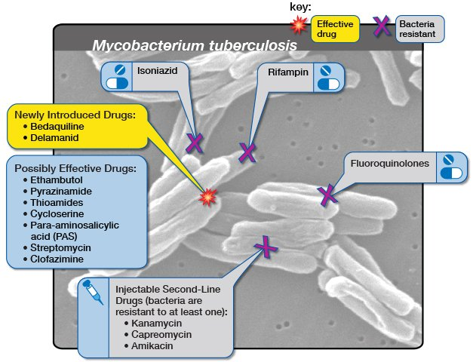
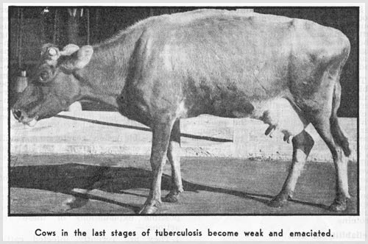
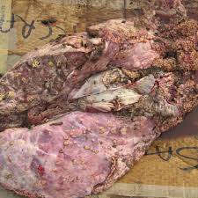
Thank You

