Slide 1
Unit 7: Jurisprudence, Ethics and Animal Welfare
TOPIC:
1. Legal duties of the veterinarians
2. Common offences against animals
3. Offences Affecting the Public Health
4. Judicial procedures
By
Dr. Anil Kumar
Associate Professor
Dept. of Veterinary Medicine
BVC, Patna

Slide 2
LEGAL DUTIES OF THE VETERINARIANS

Slide 3
To make a veterinarian know and recognize his exact duties, privileges and responsibilities in vetro-legal cases both as witness and as an expert advisor it is very essential that he should have a fair knowledge of all the subjects of veterinary sciences.
He must be well acquainted with the animal related Acts and the legal procedures in the criminal courts.
He must be well acquainted with Government orders, statutes and Acts regarding his privileges and obligations in veterinary practice.
The veterinarian's responsibilities are as follows:
Conducting postmortem examination of the vetro-legal cases.
Investigations of common offences against animals.
Investigations in case of malicious and accidental poisoning
Investigations in case of frauds in the sale of livestock and livestock products.

Slide 4
Issuing health certificates.
To get the real culprits punished and help in providing justice and fair treatment to man and animal and also to save innocent people/persons from the false accusations of crime.
To prevent cruelty to animals.
Application and enforcement of state of law meant for animals. (Prevention of cruelty to Animals, Cattle Trespass Act)
To protect the interests of society at large and prevent the unethical practices in relation to animals in the society.
Anything pertaining to the veterinary profession for which legal action is required is necessary

Slide 5
Using latest medical tools to diagnose and treat the animals
Emergency surgeries and carry out animal welfare activities as far as possible

Slide 6
COMMON OFFENCES AGAINST ANIMALS AND LAWS RELATED TO THESE OFFENSES
It is more or less mandatory for a veterinarian to be familiar with the laws for protection of animals, more so because of his training and profession which shows a spirit of sympathy and understanding towards our dumb companions, the domestic animals, who deserve all sympathy and kindness.
The common offences against animals are:
Mischief
Bestiality
Cruelty

Slide 7
Mischief:
This includes killing, poisoning or maiming an animal. Poisoning is the commonest method of mischievous killing.
Abrus precatrius seed, arsenic, aconite root, snake venom, datura leaves, and seeds of yellow oleander arecomrnon poisons used in the mischievous killing of the animals.
Accidental poisoning may occur in animals by linseed or jowar consumption.
Mischief is punishable under sections 428 and 429:I.P.C

Slide 8
Maiming:
It means making an animal permanently useless by the use of violence, and for doing such offence it is punishable under section 429 in The Indian Penal Code
This type of offence is also common and its aim is to harm the owner when his animal damages the crop or other property.
The common forms of hurting animals and rendering them useless are:
Fracture of bone
Cutting tendons of legs and neck
Injury to udder in milch animals
Tearing of the vagina or rectum by introducing sharp or blunt object
Punctured wounds, etc.

Slide 9
Bestiality:
Bestiality means carnal intercourse with man, woman or animal, against the order of nature. This type of crime is quite frequently found in India due to the following reasons:
The common belief among illiterate people that intercourse with she-donkey is a remedy for gonorrhoea.
Excessive sexual desire with little opportunity for natural intercourse.
Young villagers who go out to graze cattle in fields far away from human eyes, are incited, owing to loneliness and the proximity of the animals, to commit this crime, People having some mental abnormalities.
The human male is generally the active agent and the passive agent a goat, donkey, mare, cow, or even hen. Examination of animal for bestiality
Bestiality is punishable under Section 377, I.P.C.
The offenders are usually caught red-handed.

Slide 10
The vagina of the animal should be examined for evidence of injury and the suspect examined for marks of injuries caused by the kicks teeth or claws of the animal.
The surrounding hair of the animal should be examined for presence of human spermatozoa (it is very important to note whether the spermatozoa found are of the same animal or not and for this purpose the presence or absence of heat in the female animal is also a guide).
The presence of organisms of gonorrhoea in the vagina of the animal is a definite sign of bestiality.
The clothes of the suspect will smell of urine or faeces of the animal as after a sexual act animals have a habit of urinating
Cruelty
This offence includes basting, overloading, using a diseased animal for work, starvation, "Phuka", etc. These acts are punishable under the Prevention of Cruelty to Animals Act, 1960

Slide 11
Offences Affecting the Public Health
Section 269:- Negligent act likely to spread infection of disease dangerous to life
Section 270:- Malignant act likely to spread infection of disease dangerous to life
Section 271:- Disobedience to quarantine rule
Section 272:- Adulteration of food or drink intended for sale
Section 273:- Sale of noxious food or drink
Section 274:- Adulteration of drugs
Section 275:- Sale of adulterated drugs
Section 276:- Sale of drug as a different drug or preparation
Section 278:- Making atmosphere noxious to health
Section 289:- Negligent conduct with respect to animal

Slide 12
JUDICIAL PROCEDURES
It is very important for a practicing veterinarian to be well acquainted with the duties entrusted to him by the law and his legal obligations under the statutes.
He must be familiar with the legal procedure in courts.

Slide 13
The Subordinate Courts managing the Civil cases are considered as-
Junior Civil Judge Court
Principal Junior and Senior Civil Judge Court
Sub Courts
The Subordinate Courts managing the Criminal cases are known as-
Second Class Judicial Magistrate Court
First Class Judicial Magistrate Court
Chief Judicial Magistrate Court
Metropolitan Courts are to be established at such places in every metropolitan area having population of ten lakh or more. It has jurisdiction throughout such metropolitan area. The presiding officers of such courts shall be appointed by the High Court.

Slide 14
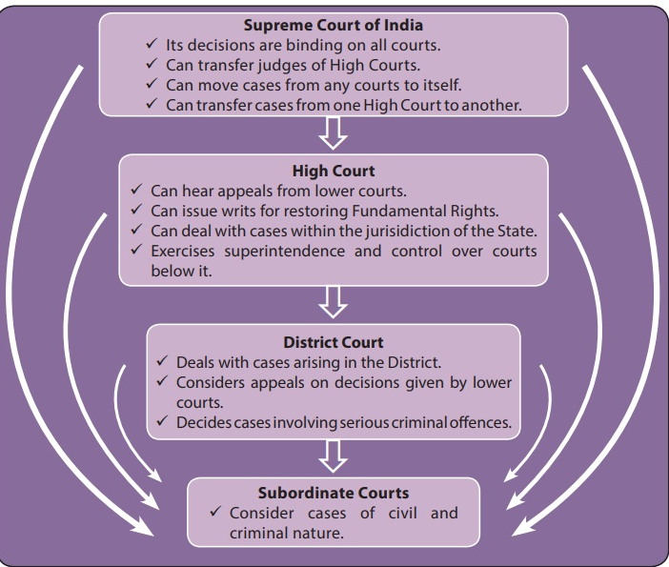

Slide 15
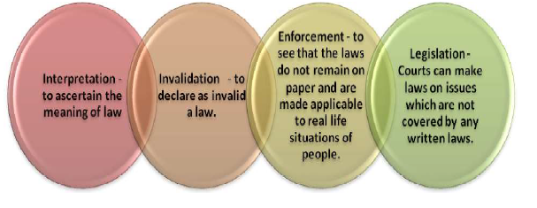
Functions of the Court

Slide 16
The Courts of Sessions are invested with jurisdiction over all kinds of offences, but they can only try cases which are committed to them by a Magistrate.
They may pass any sentence authorized by law, but a sentence of death passed must be confirmed by the High Court before it can be carried out.
An Assistant Sessions Judge may pass any sentence authorized by law, except a sentence of death or of imprisonment for life, or imprisonment for a tenn exceeding seven years.
Of these, a Magistrate of the First Class may pass a sentence of imprisonment not exceeding two years.
He is also empowered to direct that a certain portion of the sentence shall be served out in solitary confinement, within the limits laid down by the Indian Penal Code.
The tenn of imprisonment which a Second Class Magistrate may award is six months, and a Magistrate of the Third Class cannot pass a sentence of imprisonment exceeding one month.

Slide 17
The first classes Magistrates are authorized to pass a sentence of fine not exceeding one thousand rupees,
A Magistrate of the Second Class not exceeding two hundred rupees
A Magistrate of the Third Class not exceeding rupees fifty.
As regards solitary confinement a Magistrate of the Third Class is not, but a Magistrate of the Second Class is, authorized to order that a portion of the sentence of imprisonment should be of the description known as solitary confinement.
Twice the period of imprisonment which a Magistrate is authorized to award may be inflicted by him when passing a sentence for two or more offences at one trial.
Of course, the court of any Magistrate may pass any lawful sentence combining any of the sentences which it is authorized by law to pass.
It may be noted that it is only a Magistrate who can take cognizance of an offence.

Slide 18
Commonly Used Terms in Court
a) Subpoena (Summons): A document compelling the attendance of a witness
in a court of law under a penalty.
b) Warrant: An order issued by a competent magistrate authorizing an officer to make arrest, a seizure or a search or do any other act incidental to the administration of justice.
c) Cognizable Offence: An offense for which a police officer may arrest without warrant.
d) Arrest: Ordinarily means the apprehension or restrain to the deprivation of one’s personal liberty.
e) Inquest: An inquiry in respect of anybody lying dead.
f) Oath: Solemn affirmation substituted by law for an oath and any declaration required or authorized by law to be made before a public servant or to be used for the purpose of proof, whether in a Court of Justice or not.
g) Evidence: All statements which court permits or require to be made before it by a witness in relation to matters under investigation.
It includes:
Oral evidence
Documentary evidence (e.g. Vetero-legal report)
Examination of exhibits, electronic records

