Slide 1
Unit 7: Jurisprudence, Ethics and Animal Welfare
TOPIC:
1.Process of prosecution
2. Legal importance of examination of the carcass
3. Recording of Evidence
4. Kinds of Witness
By
Dr. Anil Kumar
Associate Professor
Dept. of Veterinary Medicine
BVC, Patna

Slide 2
Process of prosecution
If the owner of an animal wishes seek redress for his grievances in a court of law for his animal having been criminally injured, he has to lodge:
A report at the nearest police station mentioning the names of the culprit as well as of the witnesses.
In the case of a Government animal, the veterinary surgeon in charge of the area, wherein the animal has been injured, is supposed to lodge a report with the police.
The injured or dead animal should be examined by the veterinary surgeon either in the hospital, or on the spot, to give his report to the police.
His report would normally provide material evidence in the court for prosecution and should, therefore, be carefully drafted.

Slide 3
Legal importance of examination of the carcass
The object of the examination is to ascertain the cause and the manner of death (criminal violence/ in sudden deaths from unknown causes).
Every possible cause should be investigated before venturing (proceed) an opinion as to the cause of death.
Not only should the postmortem lesions, both external and internal, be carefully examined
All circumstantial evidence given and the surroundings, such as the field, or the land, etc., where the animal was found dead should be described.
The history, as given by the owner, should be noted briefly and signed by the owner, or left thumb impression (right thumb impression, if a woman) taken if he or she is illiterate.

Slide 4
In our climatic conditions, it is necessary to perform the post-mortem as early as possible to avoid decomposition and mutilation of carcass by carrion animals
The pro-forma for recording a post-mortem report must be filled in triplicate at the time of the postmortem examination, signed, timed and dated.
Maintain a vetero- legal register
Where only bones are available, record the detailed description of the important bones, to identify the species, the sex and age if possible of the animal.
The odour and feel of bones should be noted carefully for assessing the time of death, as recent bones have a peculiar odour and a greasy fee.

Slide 5
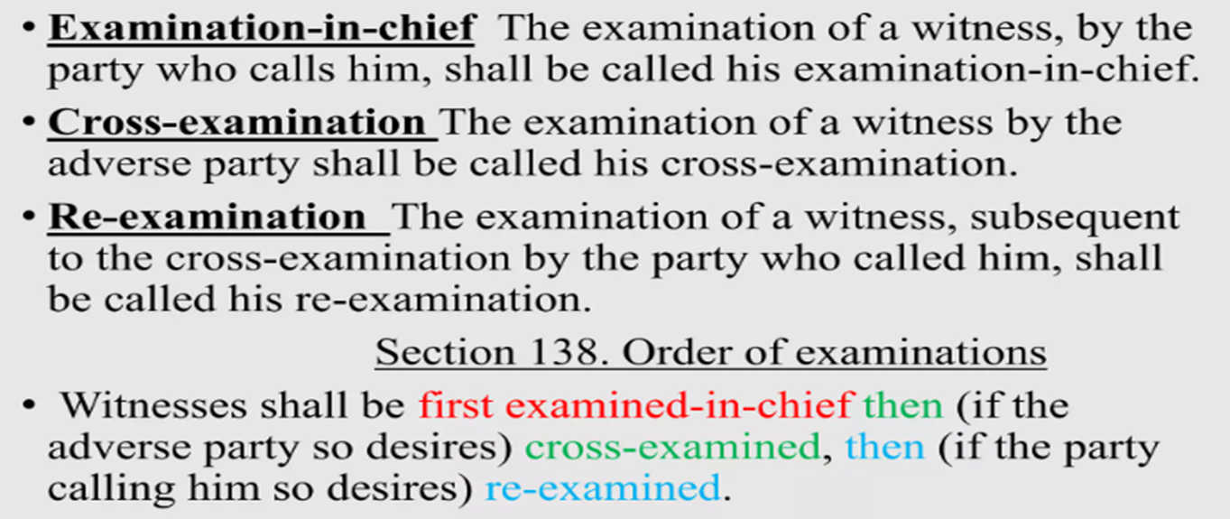
Recording of Evidence
The evidence is then recorded in the following manner:
Examination-in-Chief
Cross-examination
Re-examination
Questions put by the Judge, Juror or Assessor.

Slide 6
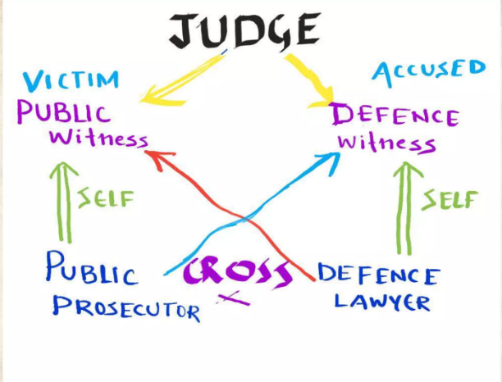

Slide 7
Examination-in-Chief:
This is the first examination of a witness by the party which calls him.
In Government prosecution cases the prosecuting inspector, as a rule, first examines the witness to elicit the principal facts concerning the case.
यह गवाह की उस पक्ष द्वारा पहली परीक्षा होती है जो उसे बुलाता है।
सरकारी अभियोजन मामलों में अभियोजन निरीक्षक, एक नियम के रूप में, मामले से संबंधित मुख्य तथ्यों को जानने के लिए पहले गवाह की जांच करता है।

Slide 8
If the witness is summoned by a private party, he is first examined by the pleader of that party.
यदि गवाह को किसी निजी पक्ष द्वारा बुलाया जाता है, तो सबसे पहले उस पक्ष के वकील द्वारा उसकी जांच की जाती है।
जांच के इस भाग में प्रमुख प्रश्न, यानी ऐसे प्रश्न जो अपने उत्तर सुझाते हैं, की अनुमति नहीं है, सिवाय उन मामलों को छोड़कर जिनमें न्यायाधीश को यह विश्वास हो कि गवाह शत्रुतापूर्ण है, और वह सही तथ्यों को छिपाने की कोशिश कर रहा है।
''क्या आपने एक निश्चित दोपहर को एक्स को वाई पर डंडे से हमला करते देखा था'' एक प्रमुख प्रश्न है, क्योंकि इससे उत्तर "हां" का संकेत मिलता है। इसलिए, इसे गवाह से नहीं पूछा जा सकता।
हमले के मामले में प्रश्न के उचित प्रारूप हैं: ''यह घटना कब हुई? आप उस समय कहां थे? आपने क्या देखा?'' इत्यादि। उस मामले में गवाह एक्स द्वारा वाई पर हमला करने की पूरी घटना को उसी तरह बताएगा जैसा उसने देखा था।

Slide 9
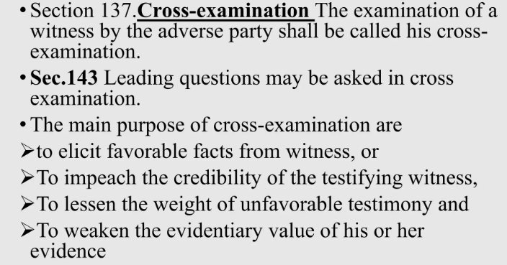
The witness may also be asked such questions which tend to test his veracity (reality) , to discover his knowledge, experience and qualifications and even to injure his character.

Slide 10
In some instances, cross-examination acts as a double-edged sword, which cuts both ways, i.e. it may damage the defence as much as, and sometimes more than, the prosecution, specially if counsel is not familiar with Veterinary Science, and the witness happens to be well up in his subject, and at the same time honest and straightforward.
“कुछ मामलों में, जिरह एक दोधारी तलवार की तरह काम करती है, जो दोनों तरफ से काटती है, अर्थात यह बचाव पक्ष को उतना ही नुकसान पहुंचा सकती है, जितना कि, और कभी-कभी अभियोजन पक्ष से भी अधिक, विशेषकर यदि वकील पशुचिकित्सा विज्ञान से परिचित नहीं है, और गवाह अपने विषय में अच्छी तरह से पारंगत है, और साथ ही ईमानदार और सीधा है”।
There is no time-limit for cross-examination. It may last for hours or even days, although the presiding officer can always disallow irrelevant questions and cut short the cross-examination.

Slide 11
The prosecuting inspector or counsel, who conducts the examination-in chief, has the right to re-examine the witness to explain any discrepancies that may have occurred during cross-examination; \
but the witness should not introduce any new subject without the consent of the judge or opposing counsel (lawyer), lest he should become liable to cross-examination on the new point thus introduced.

Slide 12
अभियोजन निरीक्षक या वकील, जो मुख्य परीक्षा का संचालन करता है, को यह अधिकार है कि वह गवाह से पुनः परीक्षा करके जिरह के दौरान हुई किसी विसंगति को स्पष्ट कर सकता है; किन्तु गवाह को न्यायाधीश या विरोधी वकील की सहमति के बिना कोई नया विषय प्रस्तुत नहीं करना चाहिए, अन्यथा वह इस प्रकार प्रस्तुत किए गए नए बिन्दु पर जिरह के लिए उत्तरदायी हो जाएगा
Question put by the Judge, Juror or Assessor
The Judge, Juror or Assessor may question the witness at any stage to clear up doubtful points

Slide 13
Veterinary Evidence
Veterinary evidence given before a court oflaw is of two types:
(1). Documentary, and (2) Oral or parol.
Documentary Evidence: This includes:
(a) Veterinary certificates.
(b) Vetero-Iegal reports.
Oral evidence is more important than documentary evidence, since a person has to prove on oath or affirmation documentary evidence supplied by him to the court, that it is true and correct and is in his own handwriting.

Slide 14
Kinds of Witnesses
Witnesses are of four kinds:
Common
Expert
skilled and
Hostile
A common witness is one who testifies to the facts observed by himself
An expert witness is someone who, because of his professional training, can draw opinions and inferences from facts that he has observed or that others have noticed
Thus, it is clear that a veterinary witness is both common and expert

