Slide 1
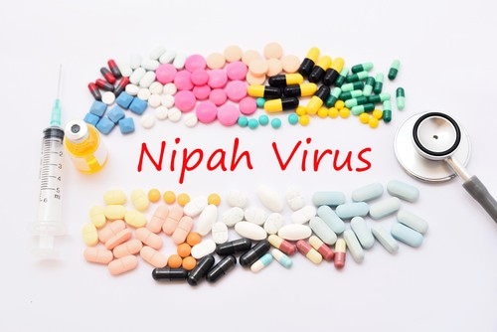
Nipah Virus disease
Nipah virus disease, caused by the Nipah virus, disease is characterized by fever, constitutional symptoms and encephalitis, some time accompanied by respiratory illness
The case fatality rate is estimated at 40% to 75%
Its name originated from Sungai Nipah, a village in the Malaysian Peninsula where pig farmers became ill with encephalitis

Slide 2
Introduction
Nipah virus was first recognized in 1999 during an outbreak among pig farmers in, Malaysia
In the 1999 outbreak:
  Nipah virus caused a relatively mild disease in pigs,
  300 human cases with over 100 deaths
  More than a million pigs were euthanized,
  In 2001-Outbreak occur in Bangladesh in humans
Genetic sequencing confirmed this virus as Nipah virus, but a strain different from the one identified in 1999
In the same year, another outbreak was identified retrospectively in Siliguri, India with reports of person-to-person transmission in hospital settings (Nosocomial transmission)
Unlike the Malaysian NiV outbreak, outbreaks occur almost annually in Bangladesh and have been reported several times in India

Slide 3
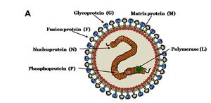
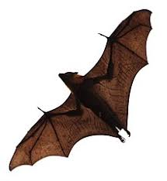
Etiology and Host range
Caused by the Nipah virus (NiV)
  Family-Paramyxoviridae
  Genus- Henipavirus
Natural reservoir -Pteropus bat species and several other bat species in a number of countries
In case of animals Pig is mainly affected

Slide 4
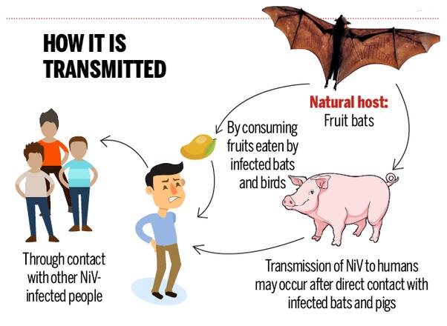
Transmission
Transmission of Nipah virus to humans
  After direct contact with infected bats
  Consumption of raw date palm sap contaminated with infectious bat excretions
  Direct contact with infected pigs
  From other NiV infected people
Person-to-person transmission of Nipah virus in Bangladesh and India is regularly reported
In Malaysian outbreak –No person to person transmission were reported

Slide 5
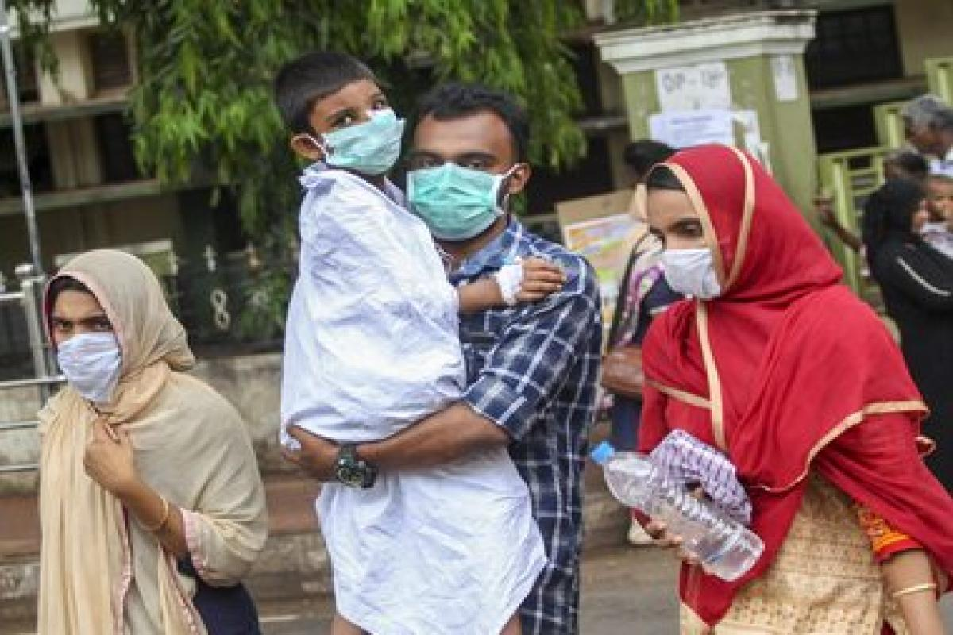
Sign and Symptoms
In Human's
  Incubation period-5 to 14 days
  Illness presents with 3-14 days of fever & headache, followed by drowsiness, disorientation & mental confusion
  Encephalitis
  These signs and symptoms can progress to coma within 24-48 hours.
  Some patients have a respiratory illness during the early part of their infections, and half of the patients showing severe neurological signs showed also pulmonary signs.
  Long-term sequelae following Nipah virus infection have been noted, including persistent convulsions and personality changes
  Latent infections with subsequent reactivation of Nipah virus and death have also been reported months and even years after exposure

Slide 6
Diagnosis
Initial symptoms are non specific, and the diagnosis is often not suspected at the time of presentation
  Make difficult the diagnosis
  Creates challenges in outbreak detection
  Effective and timely infection control measures
  Outbreak response activity
Factors effect the accuracy of the result
  Quantity
  Quality
  Type
  Timing of the clinical samples
  Time needed to transfer of the samples to the laboratory
Diagnostic technique
Sample-Body fluid
Virus isolation by cell culture
PCR
RT-PCR
ELISA to diagnosis of the antibody

Slide 7
Treatment
Supportive care
The drug ribavirin has been shown to be effective against the viruses in vitro
Passive immunization -Human monoclonal antibody targeting the Nipah G glycoprotein
Evaluated in the post-exposure therapy in the ferret model and found to be of benefit

Slide 8
Prevention
Avoiding exposure to sick pigs & bats in endemic areas & not drinking raw date palm sap
Surveillance and awareness will help prevent future outbreaks
Research is needed to better understand the ecology of bats and Nipah virus
Surveillance tools should include reliable laboratory assays for early detection of disease in communities and livestock
To avoid human-to-human infections in hospital settings (nosocomial)
Vaccine
  A subunit vaccine, using the Hendra G protein
  Produces cross-protective antibodies against HENV and NIPV has been recently used in Australia to protect horses against Hendra virus
  This vaccine offers great potential for henipavirus protection in humans as well

